Slide 1

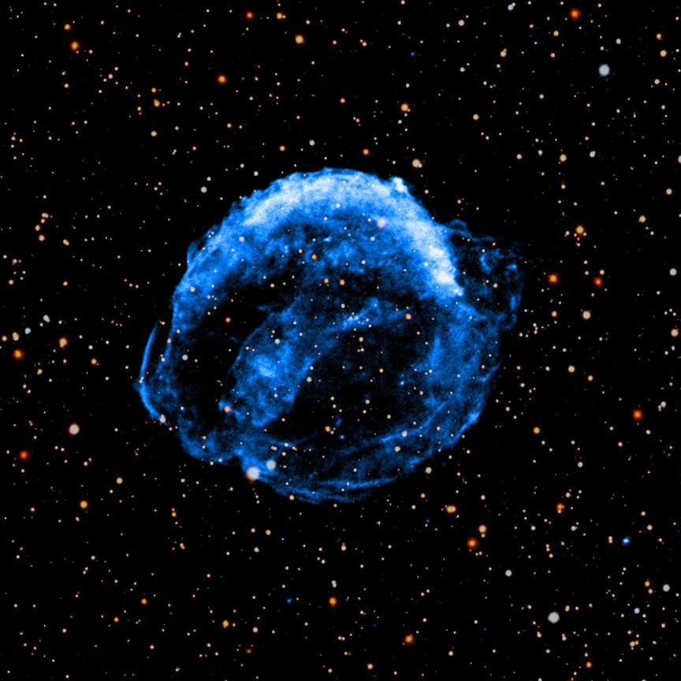

Chandra Science Highlight
Supernova Remnant Video From NASA's Chandra Is Decades in Making
A new X-ray video of Kepler’s Supernova Remnant by Chandra spanning two and a half decades has been released.
German astronomer Johannes Kepler was among those who saw the star’s explosion in 1604 A.D.
Today, astronomers know that this was a Type Ia supernova remnant from the thermonuclear explosion of a white dwarf.
This is the longest-spanning video of data ever released by Chandra, making it a remarkable tool in understanding these important objects.
Distance estimate: 17,000 light-years from Earth
Credit: X-ray: NASA/CXC/SAO; Optical: Pan-STARRS; Image and video processing: NASA/CXC/SAO/N. Wolk and A. Jubett
Instrument: ACIS
Reference: J. Gassel et al., 2026, 247th AAS meeting
More information: The detailed caption and other material are here: https://chandra.si.edu/photo/2026/kepler/
A new video shows changes in Kepler’s Supernova Remnant using data from NASA’s Chandra X-ray Observatory captured over more than two and a half decades, with observations taken in 2000, 2004, 2006, 2014, and 2025. In this video, which is the longest-spanning one ever released by Chandra, X-rays (blue) from the telescope have been combined with an optical image (red, green, and blue) from Pan-STARRS. The image above shows a still from the video, and the video is available here: https://chandra.si.edu/photo/2026/kepler/animations.html
The Chandra X-ray Center is operated for NASA by the Smithsonian Astrophysical Observatory
January 2026

