Slide 1

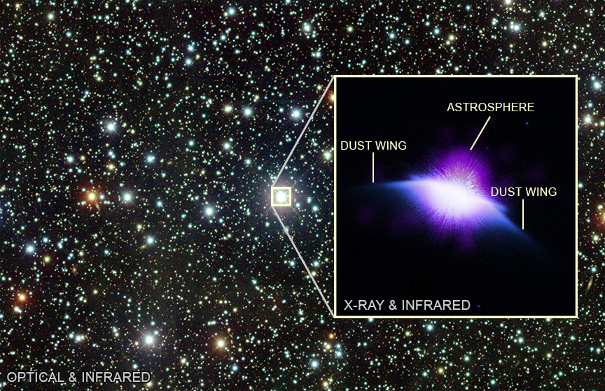

CHANDRA SCIENCE HIGHLIGHT: February 2026
National Aeronautics and Space Administration
Young "Sun" Caught Blowing Bubbles by NASA’s Chandra
Astronomers have discovered an astrosphere, a bubble blown by winds from its surface, around the star HD 61005.
This is the first astrosphere discovered around a Sun-like star. The Sun has a similar structure around it, which astronomers call the “heliosphere.”
HD 61005 is similar in size and mass to our Sun, but it is several billion years younger.
By studying stars like HD 61005, astronomers can learn more about what the Sun’s wind may have been like early in its evolution.
Distance estimate: 117 light-years from Earth
Credit: X-ray: NASA/CXC/Johns Hopkins Univ./C.M. Lisse et al.; Infrared: NASA/ESA/STIS; Optical: NSF/NoirLab/CTIO/DECaPS2; Image Processing: NASA/CXC/SAO/N. Wolk
Instrument: ACIS
Reference: Lisse, C., ApJ, 2026, ApJ, 999, 125
More information: The detailed caption and other material are here: https://chandra.harvard.edu/photo/2026/astrosphere/
In this labeled, composite image of HD 61005 in the inset, X-rays from Chandra (purple and white) have been combined with infrared data from Hubble (blue and white). Chandra reveals a bright source of X-rays in the center of the image, which is the star itself surrounded by the star’s astrosphere. The wing-like structures sweeping away from the star in the infrared image are dusty material that remained behind after the formation of the star. These wings have been swept backwards as the object flies through space. The larger view is an optical image from the Cerro Tololo Inter-American Observatory in Chile (red, green, and blue) showing the field HD 61005 is located in..
The Chandra X-ray Center is operated for NASA by the Smithsonian Astrophysical Observatory

