Slide 1

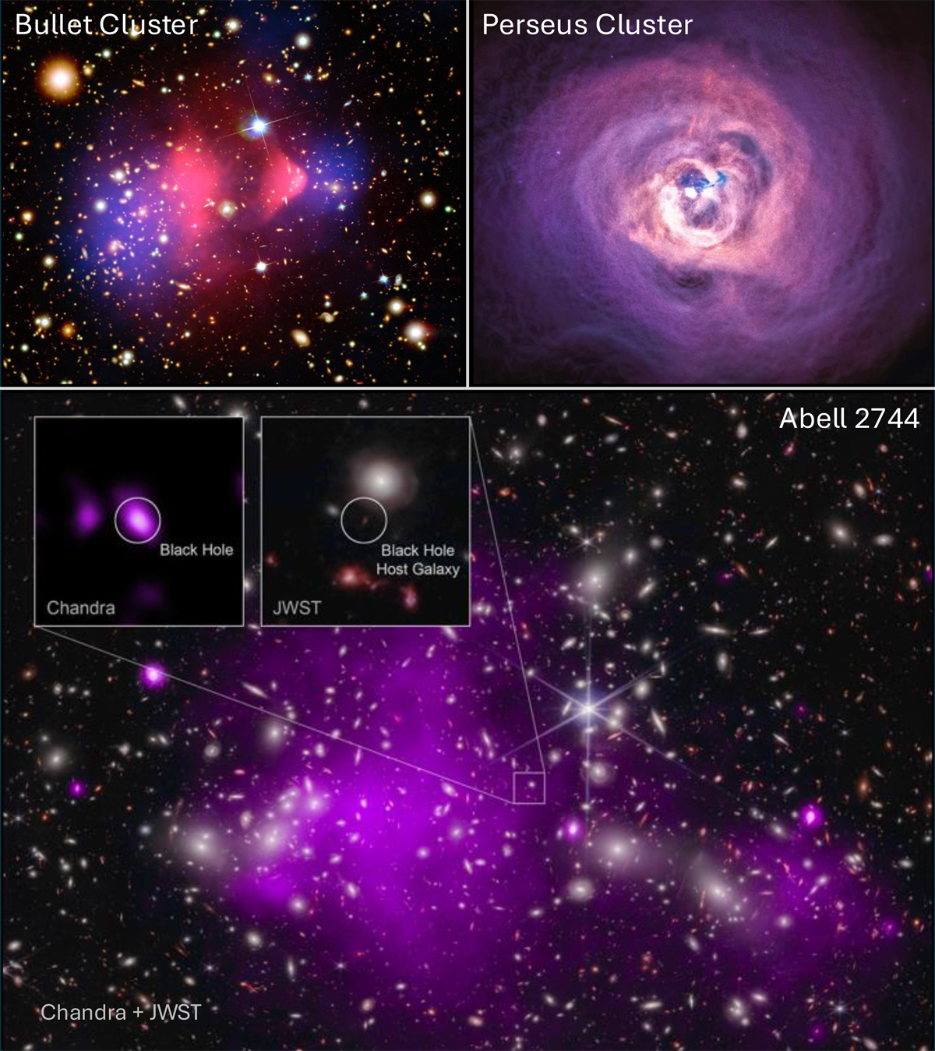
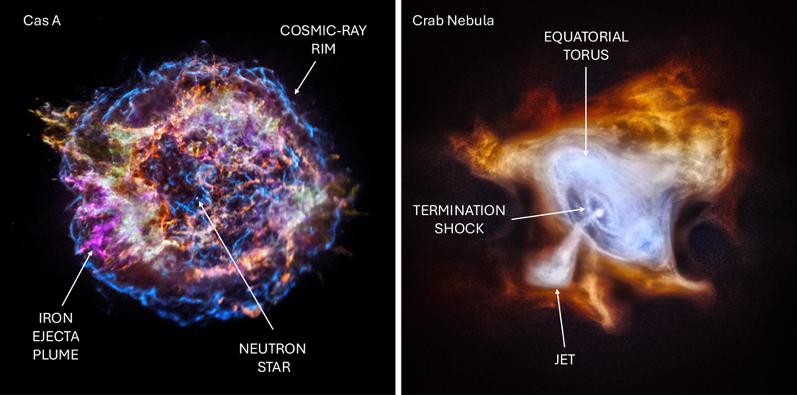

Chandra Science Highlight
25 Years of Groundbreaking Discoveries with Chandra
From an invited paper recently published in Nature Astronomy:
Chandra has the best angular resolution of any X-ray mission and imaging and spectral capabilities in the 0.5-10 keV band. These capabilities have led to breakthroughs in nearly all areas of astrophysics.
After more than 25 years Chandra continues to provide unique information in a diverse range of areas, including the contributions of compact objects to the evolution of galaxies, the nature of supernova explosions, the impact of energetic jets from supermassive black holes on their host environments, and the fate of exoplanet atmospheres in systems rich with stellar flares.
This review gives a representative but incomplete summary of Chandra’s exquisite past and promising future.
Reference: Slane, P. et al., 2025, Nature Astronomy, 9, 1431l https://ui.adsabs.harvard.edu/abs/2025NatAs.tmp..210S/abstract
Galaxy clusters: Top left: A composite image of the Bullet Cluster (Chandra in pink). Top right: A Chandra image of the Perseus Cluster. Bottom: A Chandra/JWST composite image of Abell 2744 (Chandra in purple). The caption of Fig 4 in Slane et al. (2025) gives details.
The aftermath of stellar explosions. Left: Chandra image of Cas A. Right: Chandra image of the Crab Nebula. The caption of Fig 2 in Slane et al. (2025) gives details, including explaining the labeled features.
The Chandra X-ray Center is operated for NASA by the Smithsonian Astrophysical Observatory
October 2025

