Slide 1

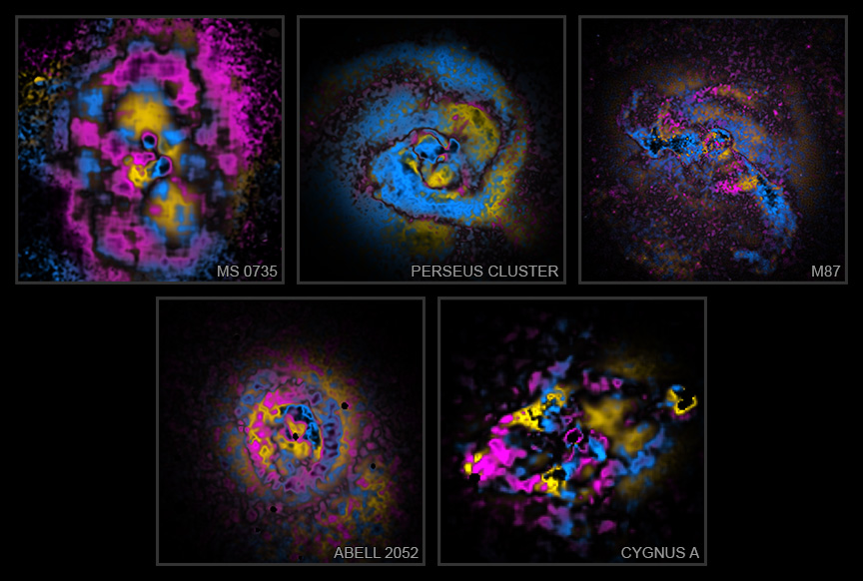

Chandra Science Highlight
Painting Galaxy Clusters by Numbers (and Physics)
A new technique gives astronomers — and the public — a different look at some of the largest objects in the universe.
Developed using NASA’s Chandra X-ray Observatory data, “X-arithmetic” classifies galaxy clusters and groups by their physical nature rather than appearance.
The technique sorts features in galaxy clusters and groups into three types of physical structures and then applies a color to each.
This new collection shows the central regions of five galaxy clusters in the sample: MS 0735+7421, the Perseus Cluster, M87, Abell 2052, and Cygnus A.
Distance estimates: 2.6 billion, 240 million, 54 million, 480 million, 760 million light-years
Credit: NASA/CXC/Univ. of Chicago/H. McCall
Instrument: ACIS
Reference: McCall, H. et al, 2025, ApJ, 989, 159;
https://iopscience.iop.org/article/10.3847/1538-4357/adea67
More information: The detailed caption and other graphics materials are here: https://chandra.harvard.edu/photo/2025/xa/
By splitting Chandra data into lower-energy and higher-energy X-rays and comparing the strengths of each structure in both, researchers classified them into three distinct types, which they have colored differently. A pink color is given to sound waves and weak shock fronts, which arise from pressure disturbances traveling at close to the speed of sound, compressing the hot gas into thin layers. The bubbles inflated by jets are colored yellow, and cooling or slower-moving gas is blue. The resulting images, “painted” to reflect the nature of each structure, offer a new way to interpret the complex aftermath of black hole activity using only X-ray imaging data.
The Chandra X-ray Center is operated for NASA by the Smithsonian Astrophysical Observatory
November 2025

