Slide 1

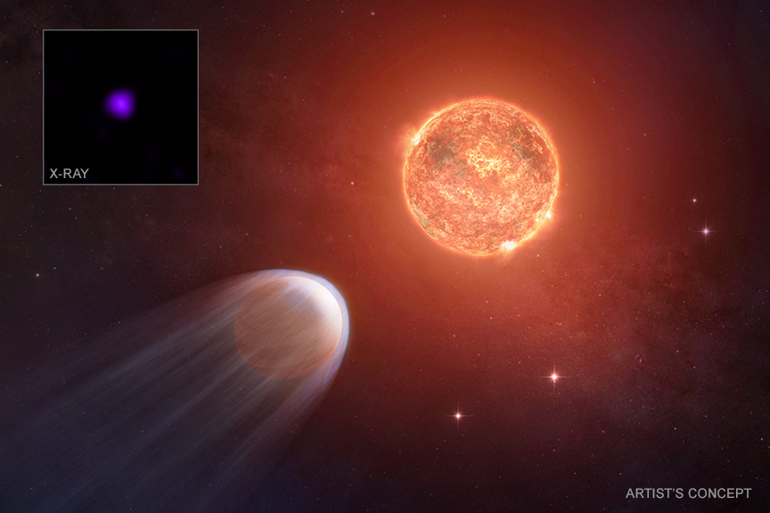

Chandra Science Highlight
NASA's Chandra Finds Baby Exoplanet is Shrinking
A very young planet is shrinking due to a barrage of X-rays from its host star, according to a new study from NASA’s Chandra X-ray Observatory.
TOI 1227b is a planet that orbits its faint red star at just a fraction of the distance that Mercury is from the Sun.
Chandra data shows its star is unleashing a torrent of high-energy radiation onto TOI 1227b, stripping away the planet’s atmosphere.
Astronomers estimate TOI 1227 b will lose enough mass that it will go from the size of Jupiter down to a small barren world because of this onslaught.
Distance estimate: 330 light-years
Credits: X-ray: NASA/CXC/RIT/A. Varga et al.; Illustration: NASA/CXC/SAO/M. Weiss; Image Processing: NASA/CXC/SAO/N. Wolk
Instrument: ACIS
Reference: Varga, A. et al. 2025, ApJ, 988, 128; 10.3847/1538-4357/ade151
More information: The detailed caption and other graphics materials are here: https://chandra.harvard.edu/photo/2025/baby/
This graphic is an artist’s concept showing what astronomers think is happening around the star TOI 1227 and a planet that is orbiting it at a fraction of the distance between Mercury and the Sun. This “baby” planet, called TOI 1227b, is only about 8 million years old, about a thousand times younger than our Sun. The main panel is an artist’s concept that shows the Jupiter-sized planet (lower left) around TOI 1227, which is a faint red star. Powerful X-rays from the star’s surface are tearing away the atmosphere of the planet, represented by the blue tail. The star’s X-rays may eventually completely remove the atmosphere. A Chandra image of TOI 1227 is shown in the inset.
The Chandra X-ray Center is operated for NASA by the Smithsonian Astrophysical Observatory
July 2025

