Slide 1

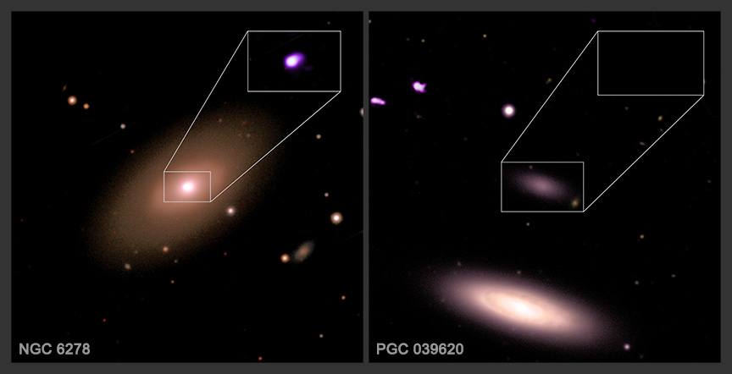

Chandra Science Highlight
NASA's Chandra Finds Small Galaxies May Buck the Black Hole Trend
Smaller galaxies may not contain supermassive black holes nearly as often as larger ones, according to a new finding.
This study looked at X-ray signatures from over 1,600 galaxies that have been observed over two decades by NASA’s Chandra.
The researchers found that galaxies with less than 3 billion solar masses did not have giant black holes nearly as often as bigger galaxies.
Astronomers are interested in this because it has important implications for understanding how supermassive black holes formed.
Distance estimates: 127 million and 61 million light-years from Earth
Credit: X-ray: NASA/CXC/SAO/F. Zou et al.; Optical: SDSS; Image Processing: NASA/CXC/SAO/N. Wolk
Instrument: ACIS
Reference: Zou, F. et al. 2025, ApJ, 992, 176
More information: The detailed caption and other graphics materials are here: https://chandra.harvard.edu/photo/2025/smbhs/
The two galaxies shown here, NGC 6278 and PGC 039620, are representative of the galaxies in the new study. In optical and X-ray images (X-rays are purple), both galaxies are seen in optical light data from the Sloan Digital Sky Survey. The insets contain just the X-ray data from Chandra. NGC 6278 is roughly the same size as our home galaxy and has X-rays detected from its core. The presence of bright X-rays in the middle of galaxies like NGC 6278 is a clear signature that there is a supermassive black hole in the center. PGC 03620 on the other hand is a much smaller galaxy and does not show any evidence of an X-ray source. Other low mass galaxies in the study also lack detectable X-ray sources in their centers. A careful analysis of the data showed that the lack of X-ray sources implies that most of these galaxies are lacking supermassive black holes in their centers, rather than that X-rays from material falling into a black hole being too faint to be detected.
The Chandra X-ray Center is operated for NASA by the Smithsonian Astrophysical Observatory
December 2025

