Slide 1
National Science Olympiad
Astronomy 2020 (Division C)
Star and Galaxy Formation and Evolution
Supported by NASA Universe of Learning STEM Literacy Network

Slide 2
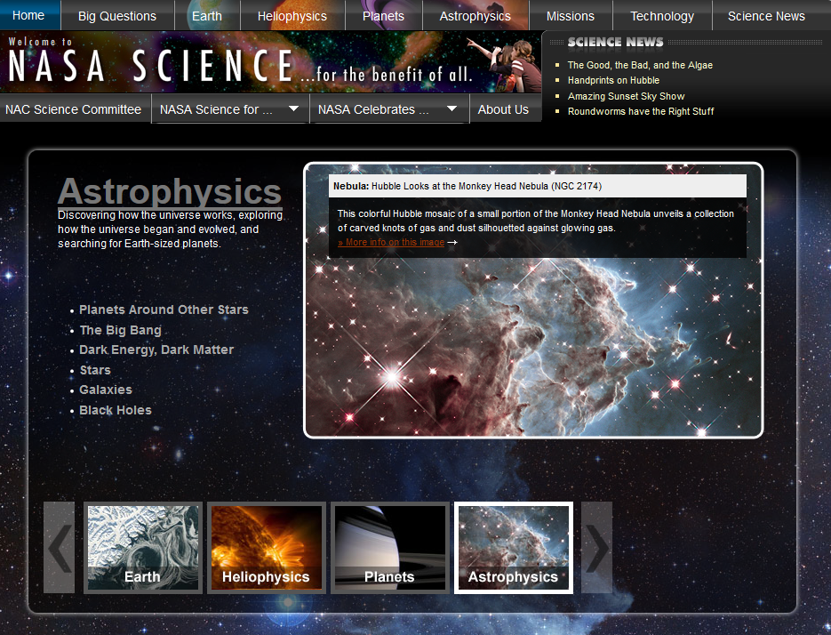
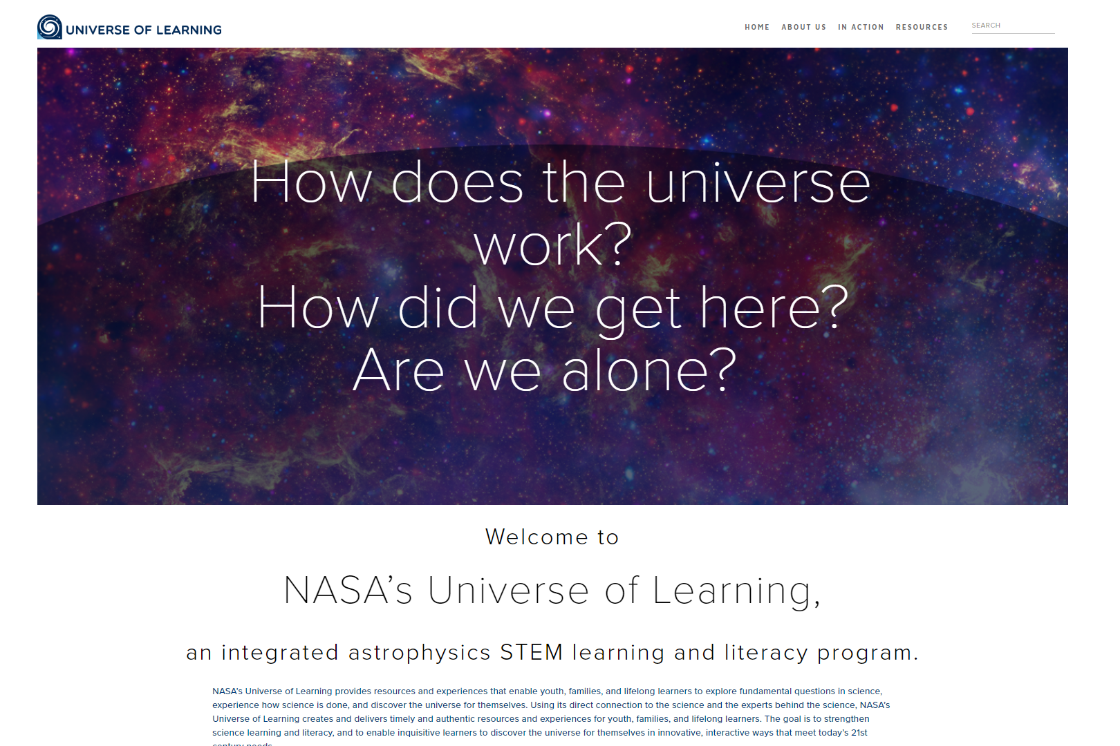
NASA Astrophysics Division/CXC/NSO
https://www.universe-of-learning.org/
Notes:
https://www.universe-of-learning.org/
http://chandra.harvard.edu/index.html

Slide 3
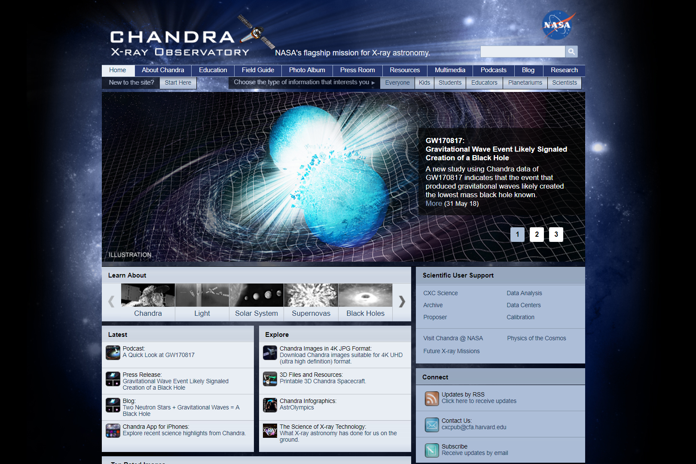
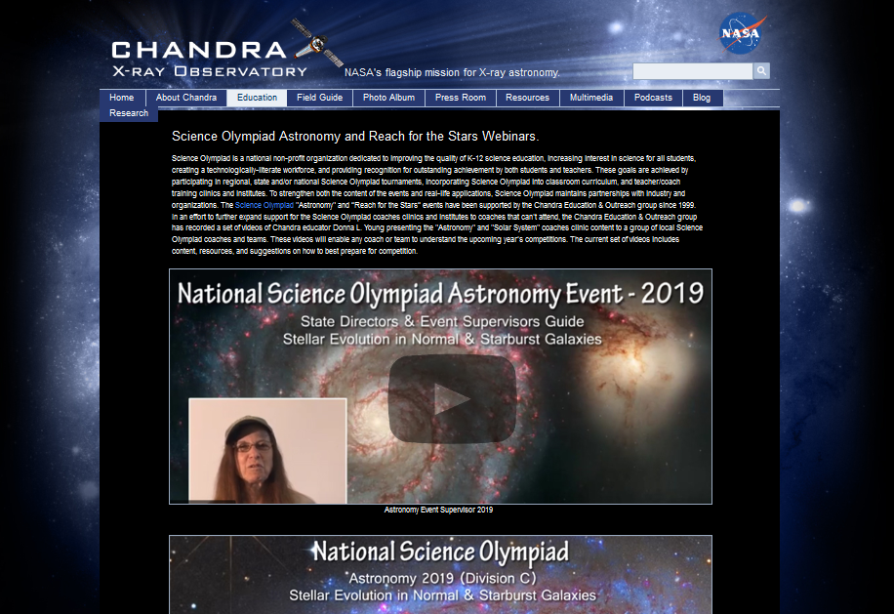
Chandra X-Ray Observatory
http://chandra.harvard.edu/index.html
http://chandra.si.edu/edu/olympiad.html

Slide 4
2020 Rules [DRAFT]
1. DESCRIPTION: Teams will demonstrate an understanding of Star and Galaxy Formation and Evolution
A TEAM OF UP TO: 2 APPROXIMATE TIME: 50 minutes
2. EVENT PARAMETERS: Each team may bring one of the following options containing information in any form and from any source:
  i. a computer/tablet and a three-ring binder; or,
  ii. two computers/tablets, of any kind.

Slide 5
2020 Rules [DRAFT]
  b. If three ring binders are used they may be of any size and the information contained should be attached using the available rings. The information or pages may be removed during the event. Sheet protectors and laminated sheets are allowed.
  c. Each team may bring two calculators of any type (stand alone or computer app)
  d. Participants using computers/tablets as a resource should have all information stored so that it is available to them offline. However; teams may be accessing a dedicated NASA image analysis website to answer JS9 questions. For JS9 questions, supervisors must provide an alternative (e.g. proctor-supplied computer or screen shots) for teams that did not bring a laptop/tablet.

Slide 6
2020 Rules [DRAFT]
3. THE COMPETITION: Using information which may include Hertzsprung-Russell diagrams, spectra, light curves, motions, cosmological distance equations and relationships, stellar magnitudes and classification, multi-wavelength images (gamma-ray, X-ray, UV, optical, IR, radio), charts, graphs and JS9 imaging analysis software, teams will complete activities and answer questions related to:
  a. Stellar and galactic evolution including stellar classification, spectral features and chemical composition, luminosity, blackbody radiation, color index and H-R diagram transitions, neutron stars, stellar mass and supermassive black holes, Type Ia supernovas, galactic structure and interactions, quasars, active galactic nuclei (AGNs), galaxy clusters and groups of galaxies, gravitational waves, gravitational lensing, dark matter and energy, warm hot intergalactic medium (WHIM), and the Cosmic Microwave Background (CMB).

Slide 7
2020 Rules [DRAFT]
  b. Use Kepler’s laws, rotation and circular motion to answer questions relating to the orbital motions of galaxies; use the distance modulus, Type Ia supernovas, Hubble’s law and redshift to answer questions about Hubble’s constant and the recessional velocities and distances to galaxies.
  c. Identify and answer questions relating to the content areas outlined above for the following objects: SN UDS10Wil, NGC 2623, GRB 150101B, JKCS 041, MACS J0717.5+3745, MACS J1149.5+2223, Bullet Cluster (1E 0657-56), H1821+643, The 3 Quasars (152156.48+520238.5, 153714.26+271611.6, 222256.11-094636.2), GOODS-S 29323, H2356-309, PSS 0133+0400 & PSS 0955+5940, GW151226, M87, 3C 273

Slide 8
Deep Sky Objects
Galaxy Clusters
Bullet Cluster (1E 0657-56)
MACS J0717.5+3745
MACS J1149.5+2223
JKCS 041
Early Universe
SN UDS10Wil
GOODS-S 29323
PSS 0133+0400 & PSS 0955+5940
Gravitational Waves
GW 151226
GRB 150101B
AGN/Quasars
3C 273
NGC 2623
M87
The 3 Quasars (152156.48+520238.5, 153714.26+271611.6, 222256.11-094636.2)
WHIM
H1821+643
H2356-309

Slide 9
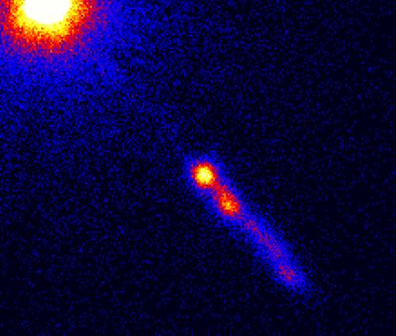
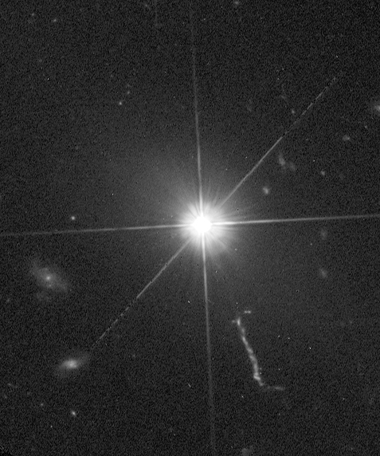
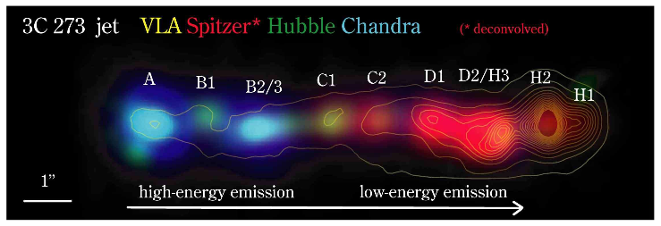
3C 273
First quasar discovered, in 1959 (quasi-stellar radio source)
  Observable at many wavelengths
  Brightness varies over months – must be smaller than light-months in size
Central supermassive black hole
  Accretion disk
  Jet of material ejected perpendicular to disk
Notes:
https://www.spacetelescope.org/images/potw1346a/
https://earthsky.org/space/1st-close-up-look-supermassive-black-hole-3c273
https://www.aavso.org/vsots_3c273
Advanced:
http://www.astro.caltech.edu/~george/ay21/eaa/eaa-3c273.pdf
http://adsabs.harvard.edu/full/1964ApJ...140....1G
https://arxiv.org/pdf/astro-ph/0605530.pdf

Slide 10
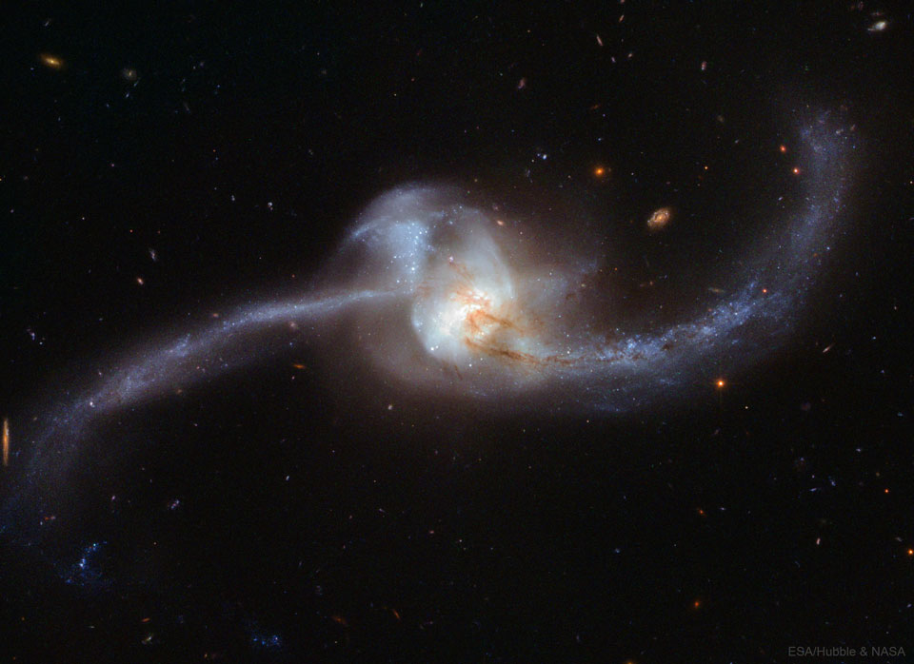
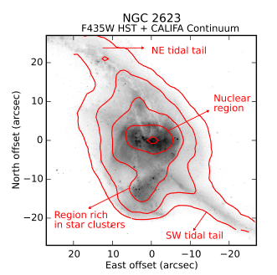
NGC 2623
Merging galaxies
  Star formation (seen in blue) triggered by compression of gas
  Material flung out in tidal tails
LIRG (Luminous InfraRed Galaxy)
  Lots of star formation – bright in IR since dust absorbs visible light
  AGN (Active Galactic Nucleus) hidden behind dust
Notes:
https://www.nasa.gov/image-feature/goddard/2017/hubble-unravels-a-twisted-cosmic-knot
https://apod.nasa.gov/apod/ap180110.html
https://www.spacetelescope.org/news/heic0912/
Advanced:
https://arxiv.org/abs/1706.01896
https://iopscience.iop.org/article/10.1086/533499/pdf

Slide 11
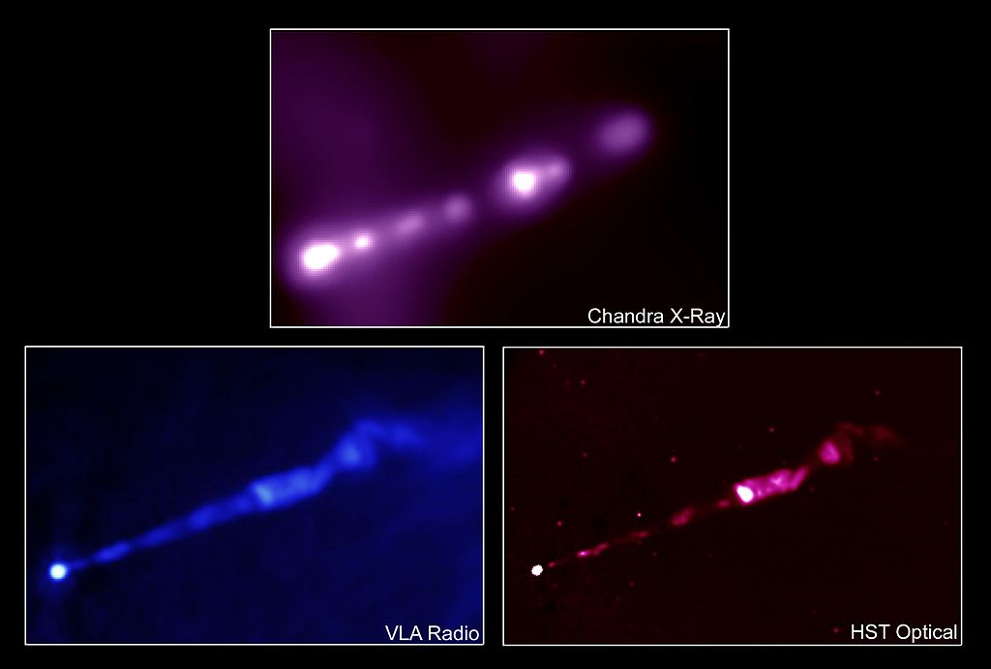
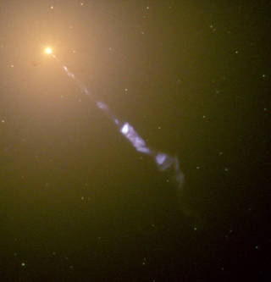
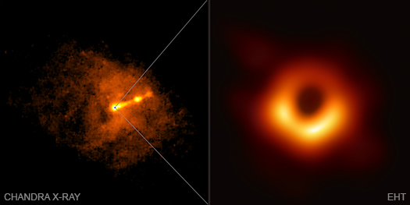
M87 (aka Virgo A)
Giant elliptical galaxy in the nearby Virgo Cluster
Supermassive black hole surrounded by hot gas
  Imaged by the Event Horizon Telescope!
Jet appears to move faster than speed of light (relativistic effect)
  Suggests all active galaxies are the same, just viewed differently
Notes:
http://chandra.harvard.edu/photo/2019/black_hole/
https://www.nasa.gov/feature/goddard/2017/messier-87
http://coolcosmos.ipac.caltech.edu/cosmic_classroom/multiwavelength_astronomy/multiwavelength_museum/m87.html
https://www.jpl.nasa.gov/spaceimages/details.php?id=PIA23122
Advanced:
https://www.messier-objects.com/messier-87-virgo-a/
https://en.wikipedia.org/wiki/Messier_87

Slide 12
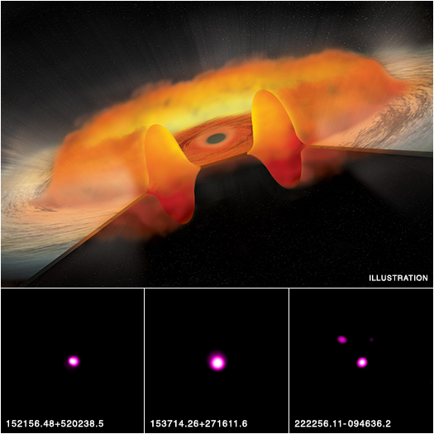
The 3 Quasars
(152156.48+520238.5, 153714.26+271611.6, 222256.11-094636.2)
“Thick disk” quasars
  Disk puffs up due to lots of material flowing towards black hole
  Weak in UV and X-ray due to absorption from disk
Black holes growing very rapidly
  Fast enough to explain high masses of early black holes?
Notes:
http://chandra.harvard.edu/press/15_releases/press_043015.html
https://www.youtube.com/watch?v=NWqafCnDvdg
Advanced:
https://arxiv.org/abs/1503.02085

Slide 13
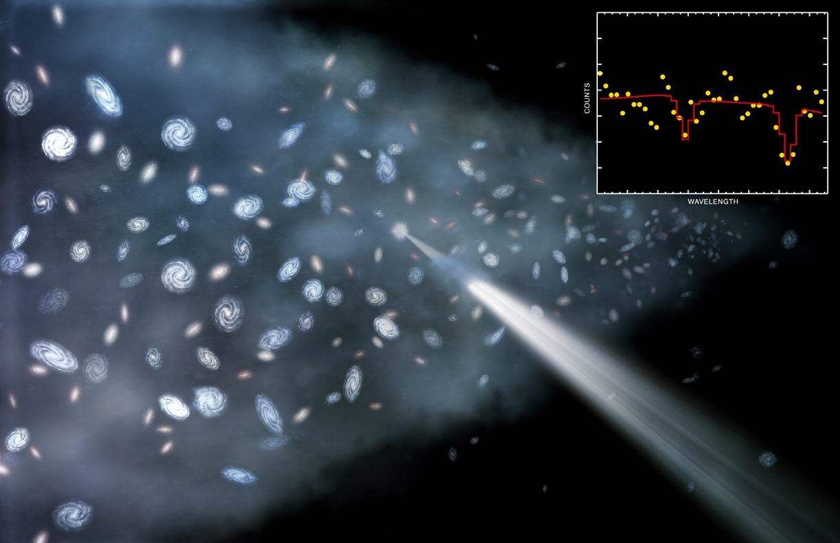
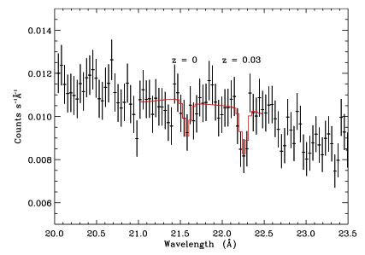
H2356-309
Quasar beyond the Sculptor Wall of galaxies
  Blazar – jet pointed directly at us!
Evidence for WHIM (Warm Hot Intergalactic Medium)
  Possible this is the “missing matter” in the nearby universe
  Hard to detect because it is hot and diffuse, but large quantities will absorb noticeably
Notes:
http://chandra.harvard.edu/photo/2010/h2356/
https://www.space.com/8386-huge-chunk-universe-missing-matter.html
Advanced:
https://www.mpi-hd.mpg.de/hfm/HESS/pages/home/som/2006/01/
https://dspace.mit.edu/bitstream/handle/1721.1/63603/Canizares2.pdf?sequence=1&isAllowed=y

Slide 14
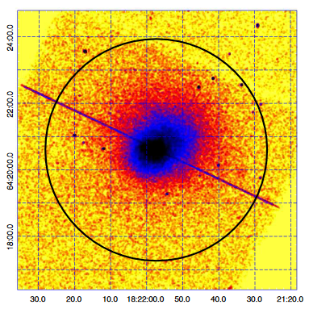
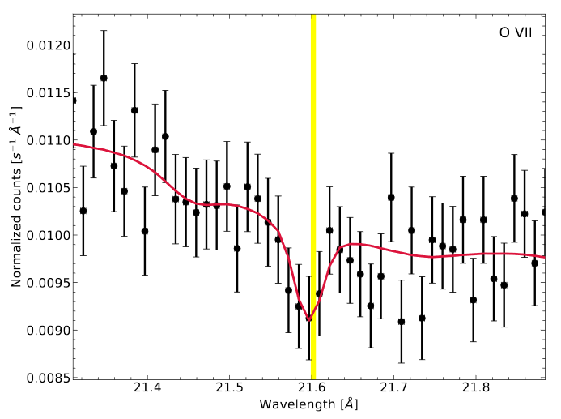
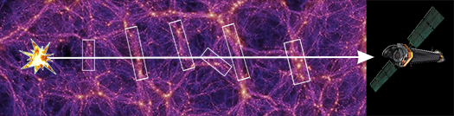
H1821+643
Quasar at the center of a cooling-core galaxy cluster
  Center is cooler than edges because it is denser and emits more energy
Used to detect WHIM
  Filaments of WHIM between the quasar and us absorb x-rays
  Very weak absorption, so have to stack many observations
Notes:
https://apod.nasa.gov/apod/ap000516.html
http://chandra.harvard.edu/photo/2019/whim/
Advanced:
https://iopscience.iop.org/article/10.1088/2041-8205/792/2/L41/pdf
https://arxiv.org/abs/1405.7522
https://arxiv.org/abs/1812.04625

Slide 15
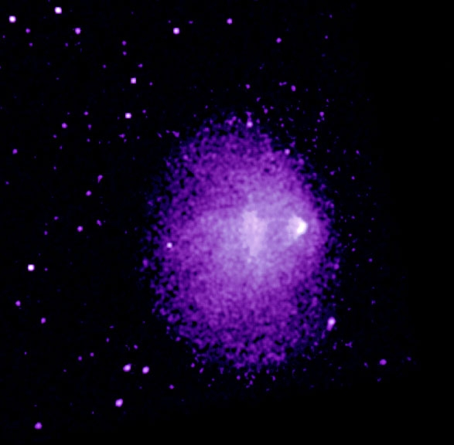
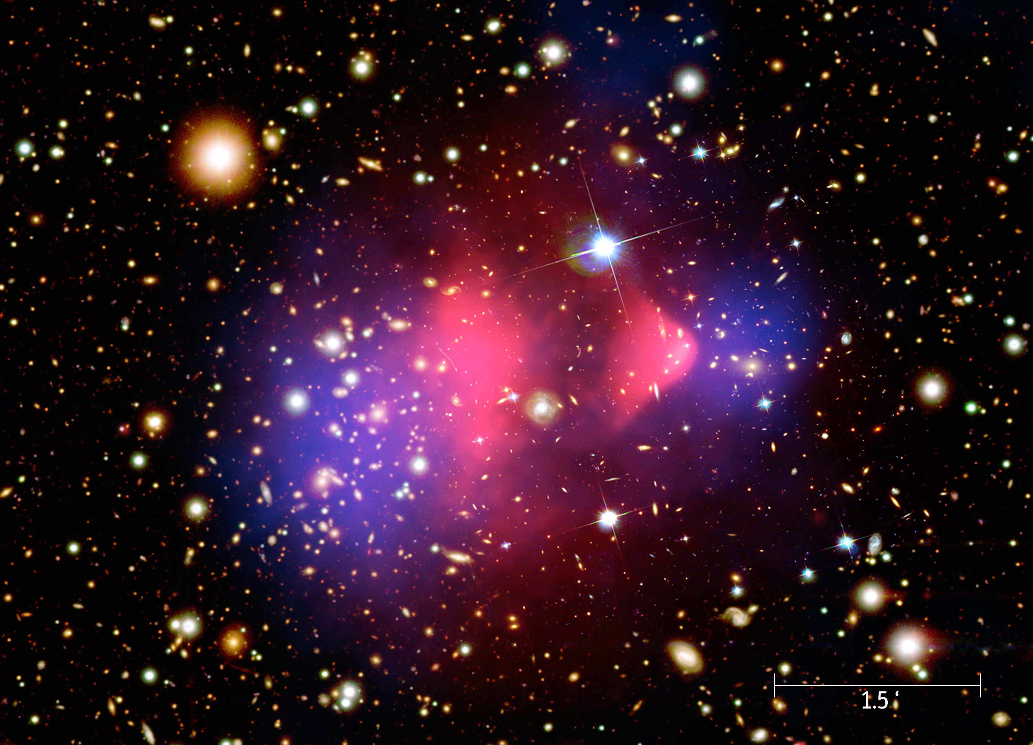
Bullet Cluster (1E 0657-56)
Galaxy cluster merger
  X-ray emission from colliding gas (hot!)
  Dark matter doesn’t collide though...
Evidence of dark matter
  Mass distribution is different from VISIBLE mass distribution
  Gravitational lensing of background galaxies
Notes:
https://apod.nasa.gov/apod/ap170115.html
https://heasarc.gsfc.nasa.gov/docs/objects/heapow/archive/large_scale_structure/1E0657-56.html
http://chandra.harvard.edu/press/06_releases/press_082106.html
Advanced:
https://arstechnica.com/science/2017/09/science-in-progress-did-the-bullet-cluster-withstand-scrutiny/
https://astrobites.org/2016/11/04/the-bullet-cluster-a-smoking-gun-for-dark-matter/

Slide 16
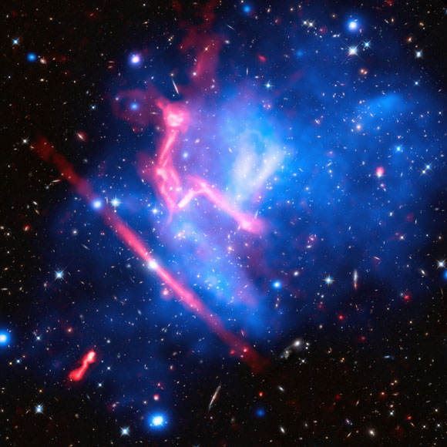
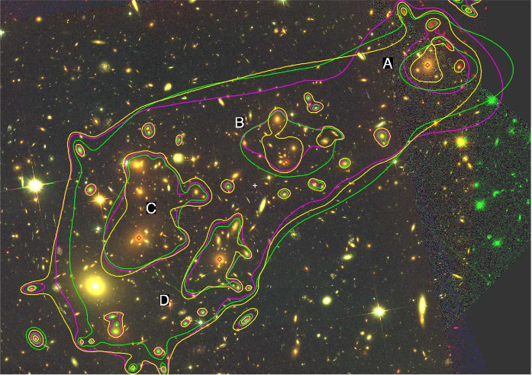
MACS J0717.5+3745
Complex colliding galaxy cluster
  4 subclusters – determined by positions of visible galaxies vs their gas
  Lots of x-rays from superheated gas
Mass distribution determined based on gravitational lensing
  Lensing also brightens background galaxies, allowing them to be studied
Notes:
https://www.spacetelescope.org/images/opo0917a/
https://scitechdaily.com/three-datasets-produce-a-unique-new-view-of-macs-j0717/
http://chandra.harvard.edu/photo/2016/frontier/index.html
Advanced:
https://arxiv.org/abs/1512.04527
https://arxiv.org/abs/1510.08077

Slide 17
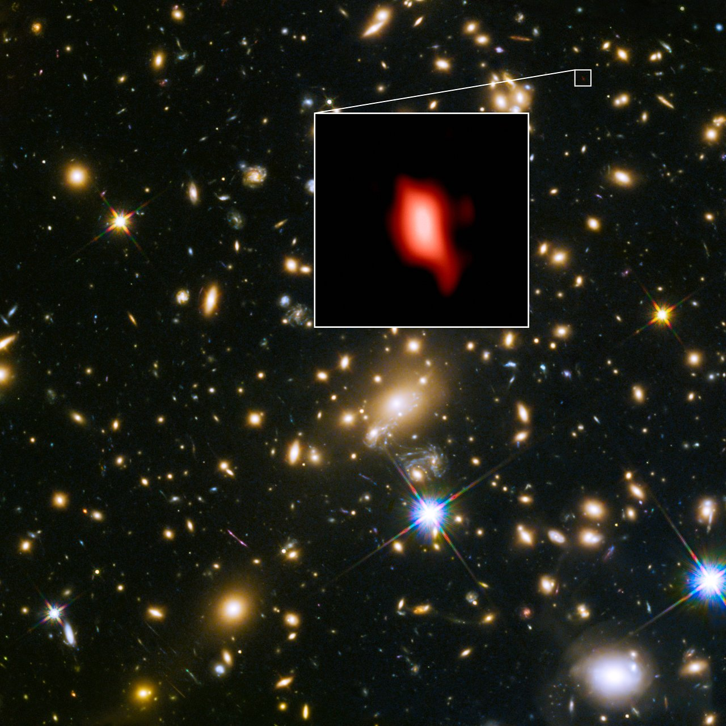
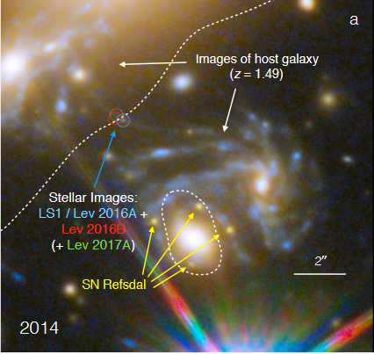
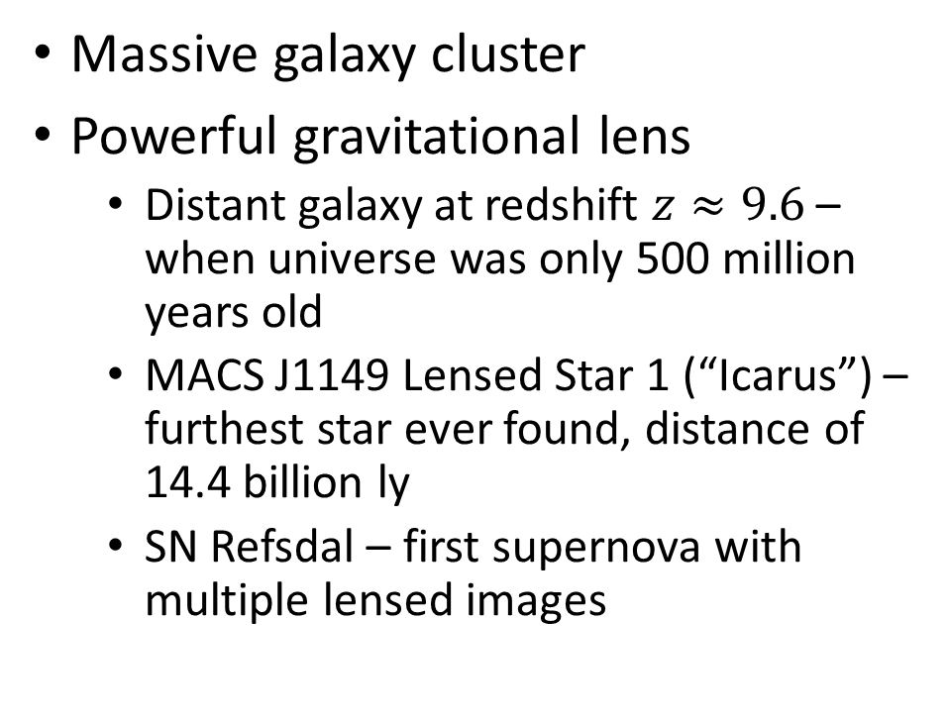
MACS J1149.5+2223
Massive galaxy cluster
Powerful gravitational lens
  Distant galaxy at redshift $z≈9.6$ – when universe was only 500 million years old
  MACS J1149 Lensed Star 1 (“Icarus”) – furthest star ever found, distance of 14.4 billion ly
  SN Refsdal – first supernova with multiple lensed images
Notes:
https://frontierfields.org/meet-the-frontier-fields/macsj1149/
http://hubblesite.org/news_release/news/2012-31
https://en.wikipedia.org/wiki/MACS_J1149_Lensed_Star_1
https://en.wikipedia.org/wiki/SN_Refsdal
Advanced:
http://www.mergingclustercollaboration.org/macs-j114952223.html
https://arxiv.org/pdf/1204.2305.pdf
https://arxiv.org/pdf/1706.10279.pdf

Slide 18
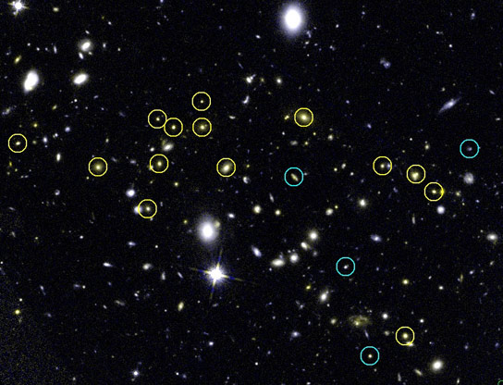
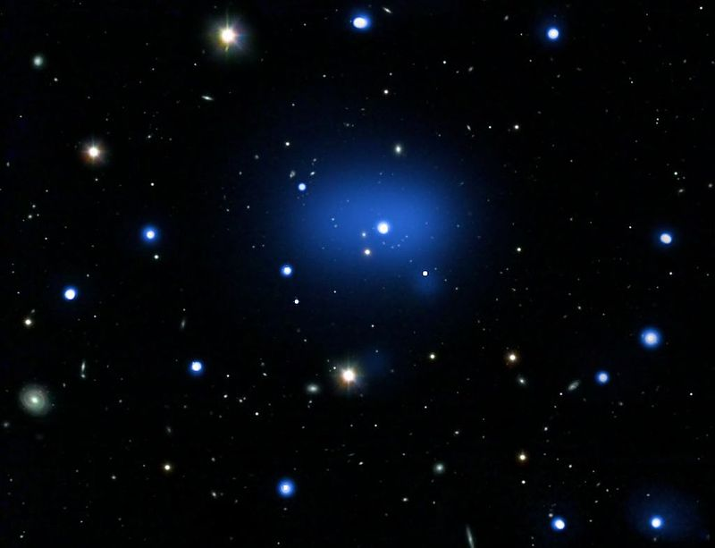
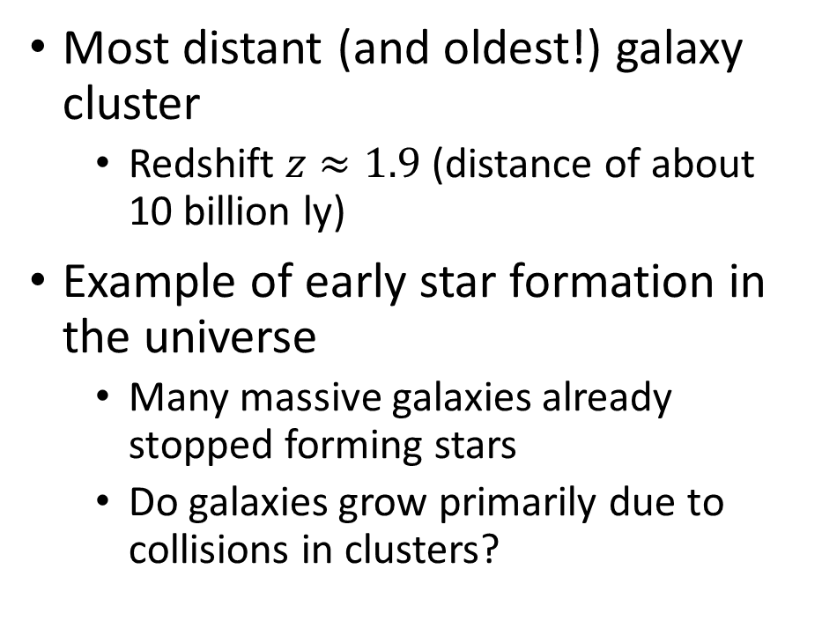
JKCS 041
Most distant (and oldest!) galaxy cluster
  Redshift $z≈1.9$ (distance of about 10 billion ly)
Example of early star formation in the universe
  Many massive galaxies already stopped forming stars
  Do galaxies grow primarily due to collisions in clusters?
Notes:
https://apod.nasa.gov/apod/ap091028.html
https://scitechdaily.com/hubble-confirms-distance-galaxy-cluster-jkcs-041/
Advanced:
https://arxiv.org/abs/1310.6754
https://www.aanda.org/articles/aa/pdf/2014/05/aa23077-13.pdf

Slide 19
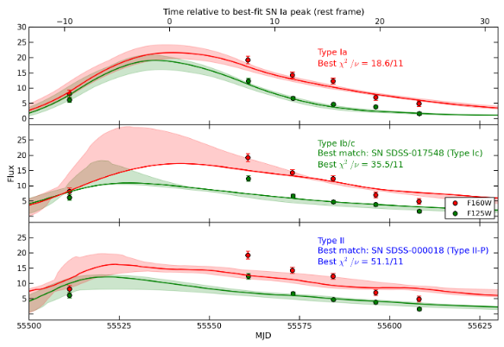
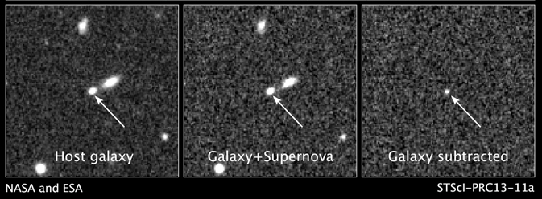
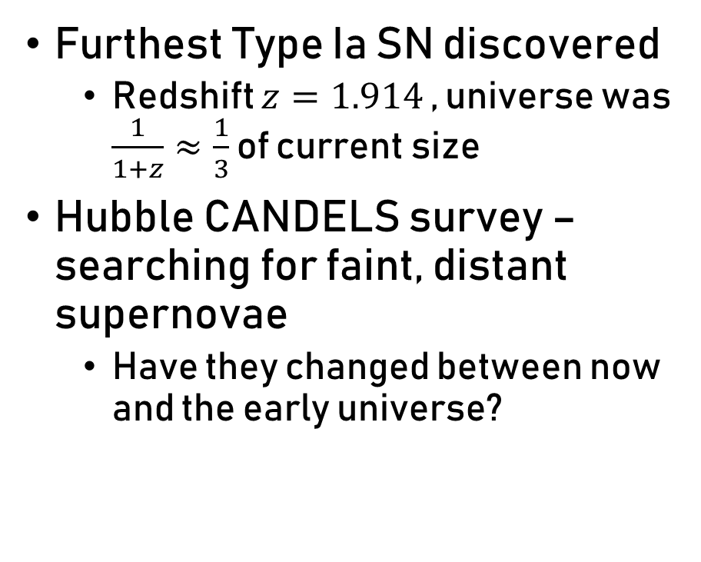
SN UDS10Wil
Furthest Type Ia SN discovered
  Redshift $z=1.914$ , universe was $\frac{1}{1+z}≈\frac{1}{3}$ of current size
Hubble CANDELS survey – searching for faint, distant supernovae
  Have they changed between now and the early universe?
Notes:
https://www.nasa.gov/mission_pages/hubble/science/sn-wilson.html
https://www.skyandtelescope.com/astronomy-news/the-oldest-loneliest-supernova/
Advanced:
https://ned.ipac.caltech.edu/level5/March18/Czerny/Czerny2.html
https://arxiv.org/abs/1304.0768

Slide 20
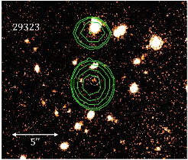
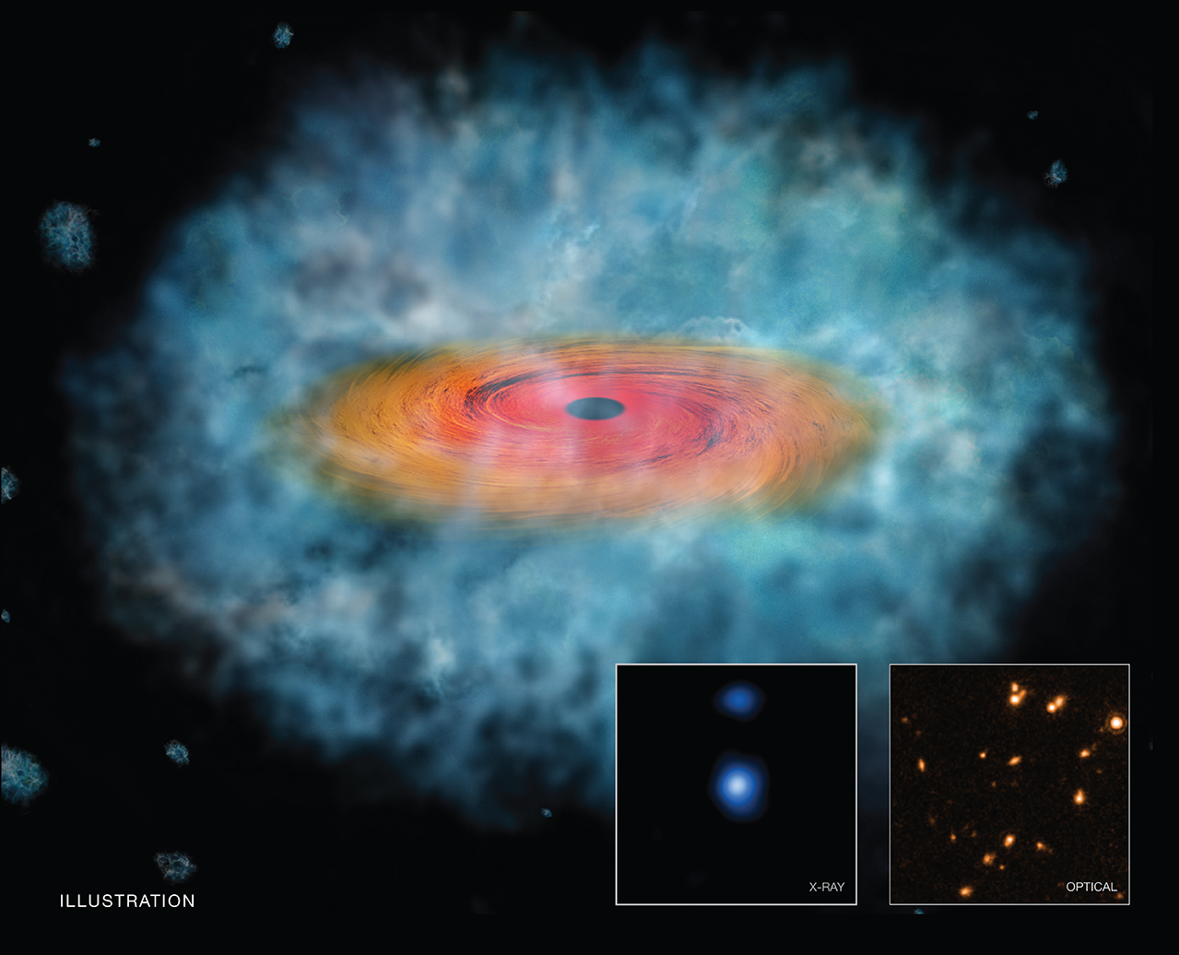
GOODS-S 29323
Early supermassive black holes may have collapsed directly from large gas clouds
  Matter can fall straight in instead of spiraling around in a disk
Searched Hubble surveys for objects matching predictions
  Very “red” (infrared-bright) because disk absorbs and re-emits light
Notes:
https://www.nasa.gov/mission_pages/chandra/goods-s-29323.html
https://arstechnica.com/science/2016/05/building-a-supermassive-black-hole-skip-the-star/
Advanced:
https://astrobites.org/2016/05/30/monsters-in-the-dark-first-detection-of-a-direct-collapse-black-hole-candidate/
https://arxiv.org/abs/1603.08522

Slide 21
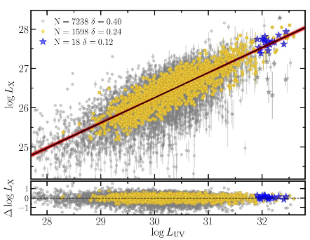
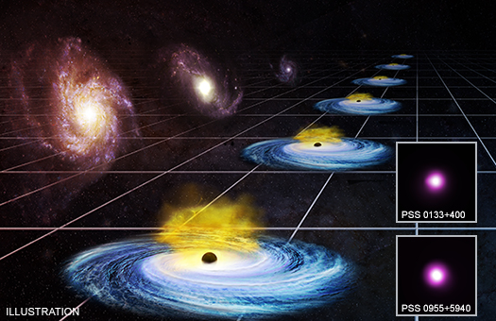
PSS 0133+0400 and PSS 0955+5940
Quasars 10 billion ly away – very luminous
  Used as “standard candles” based on relationship between UV and X-ray flux
Track expansion of the universe over time
  Dark energy (driving expansion) may be increasing...
Notes:
http://chandra.harvard.edu/press/19_releases/press_012919.html
https://www.skyandtelescope.com/astronomy-news/what-quasar-cosmology-can-teach-us-about-dark-energy/
Advanced:
https://arxiv.org/abs/1811.02590

Slide 22
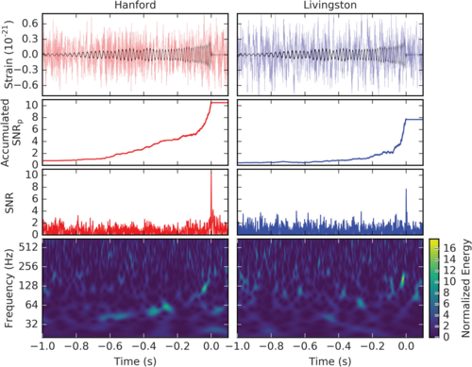
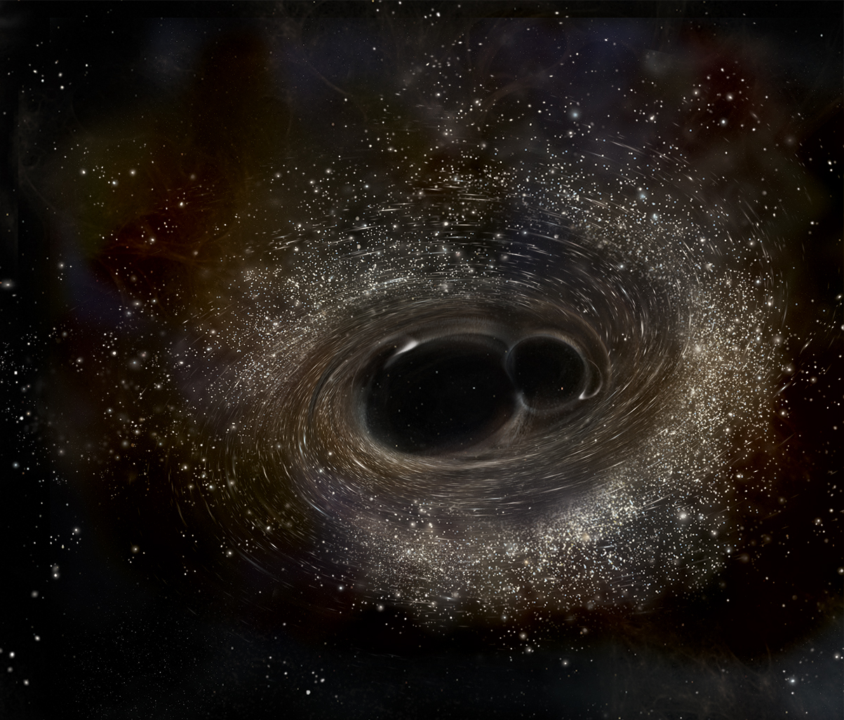
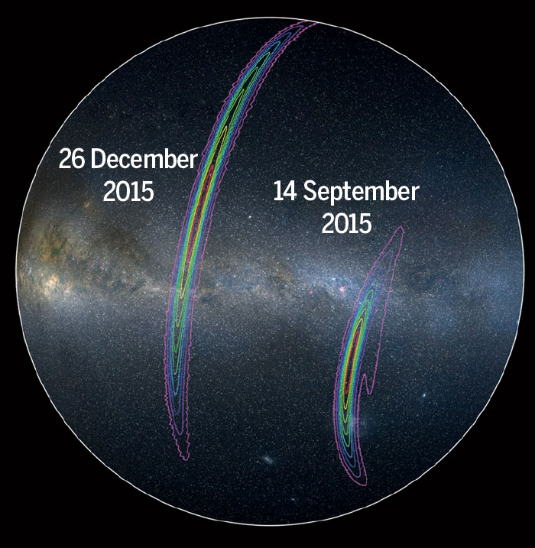
GW 151226
2nd confirmed gravitational wave event (December 26, 2015)
  Found by LIGO (+ VIRGO)
  General Relativity still works!
  Location hard to constrain
Merger of two black holes
  M_final = 20.8 Msun, less than combined mass before merger (turned into energy)
Notes:
https://www.ligo.org/detections/GW151226.php
https://en.wikipedia.org/wiki/GW151226
https://www.sciencemag.org/news/2016/06/ligo-detects-another-black-hole-crash
Advanced:
https://www.ligo.org/science/Publication-GW151226/index.php
https://arxiv.org/abs/1606.04855

Slide 23
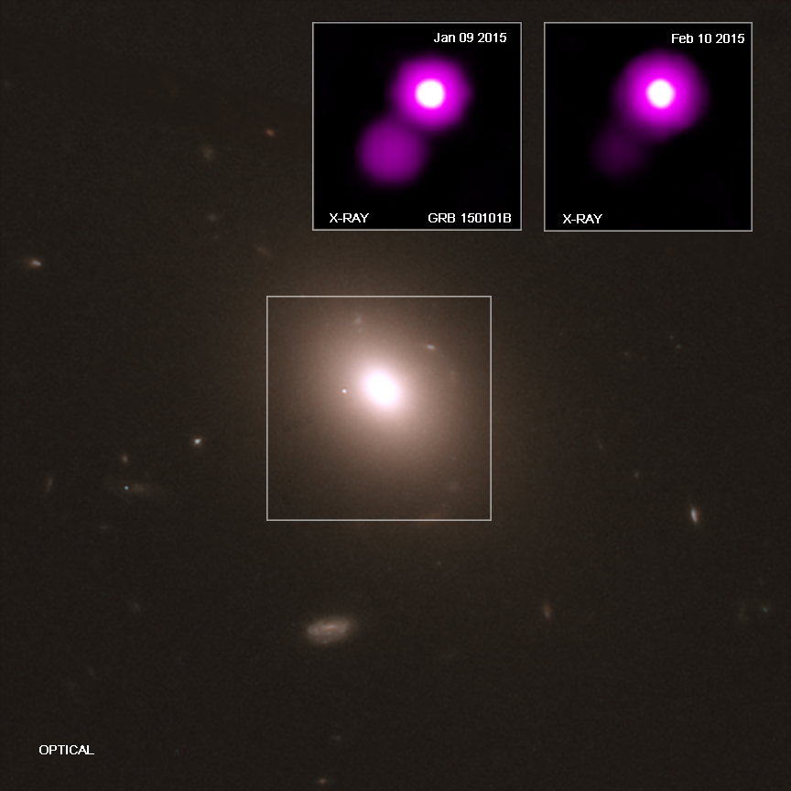
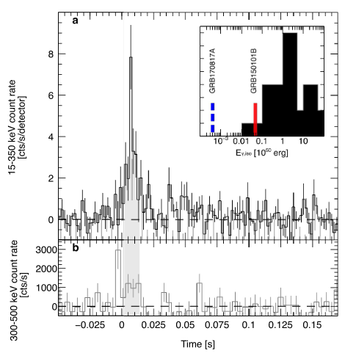
GRB 150101B
Short gamma-ray burst (< 0.1 sec!)
  Detected by Fermi (gamma-ray)
  Fast follow-up by Swift, Chandra, Hubble, and more!
Similar to GW 170817
  Known neutron star + neutron star merger (kilonova)
  Observed in gravitational waves (LIGO) and multiple wavelengths
Notes:
http://chandra.harvard.edu/photo/2018/kilonova/
https://www.youtube.com/watch?v=NCVsx6drHrM
https://www.space.com/42158-another-neutron-star-crash-detected.html
Advanced:
https://arxiv.org/abs/1807.02866
https://arxiv.org/ftp/arxiv/papers/1806/1806.10624.pdf

Slide 24
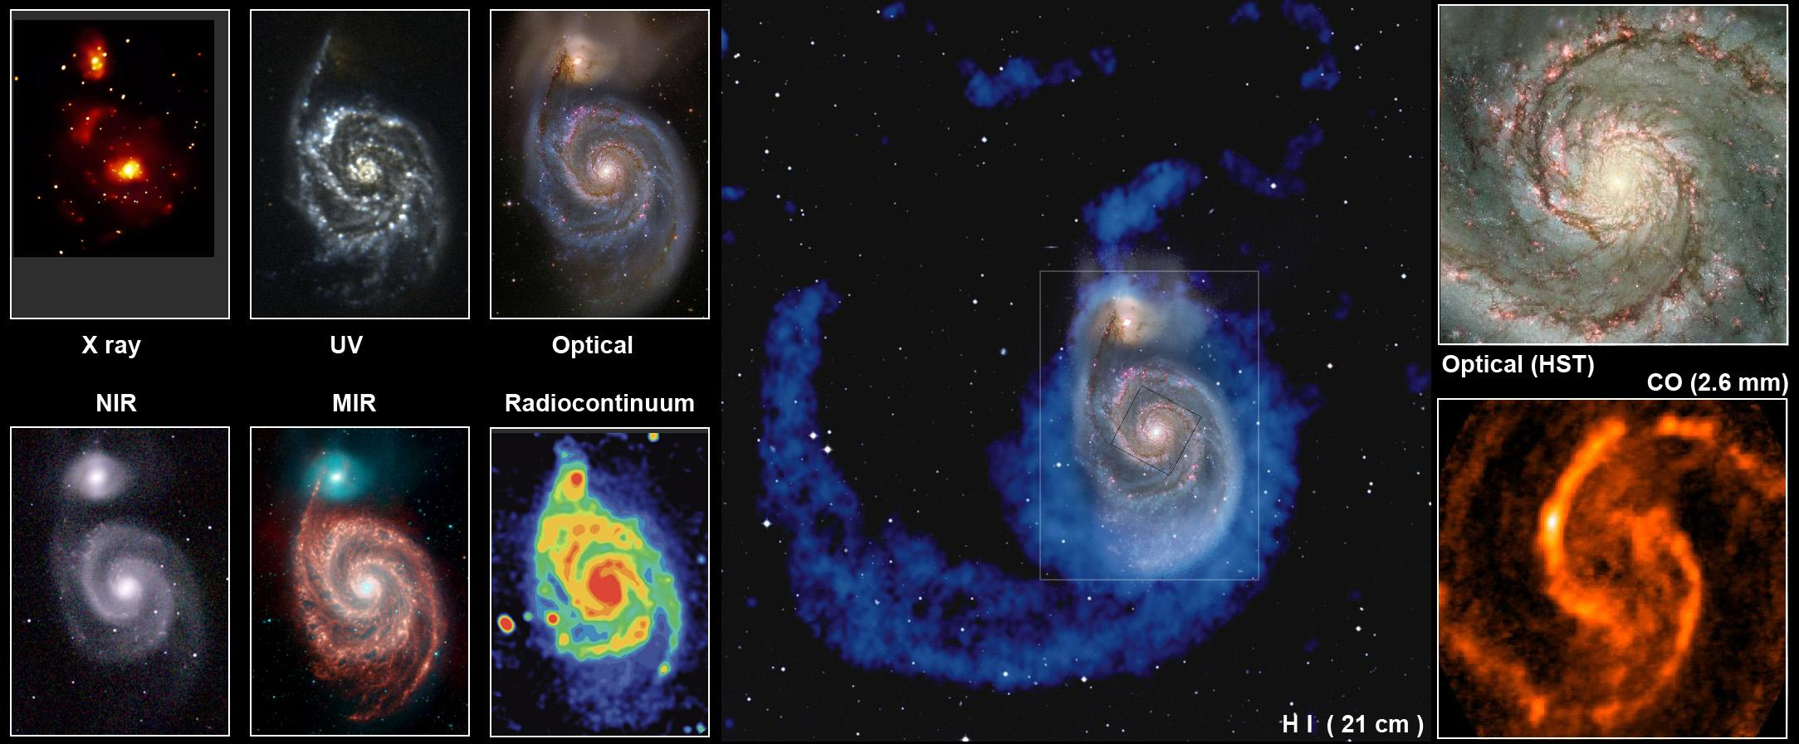
Multi-Wavelength Observations
Notes:
http://www.atnf.csiro.au/people/lop009/multiwave.html

Slide 25
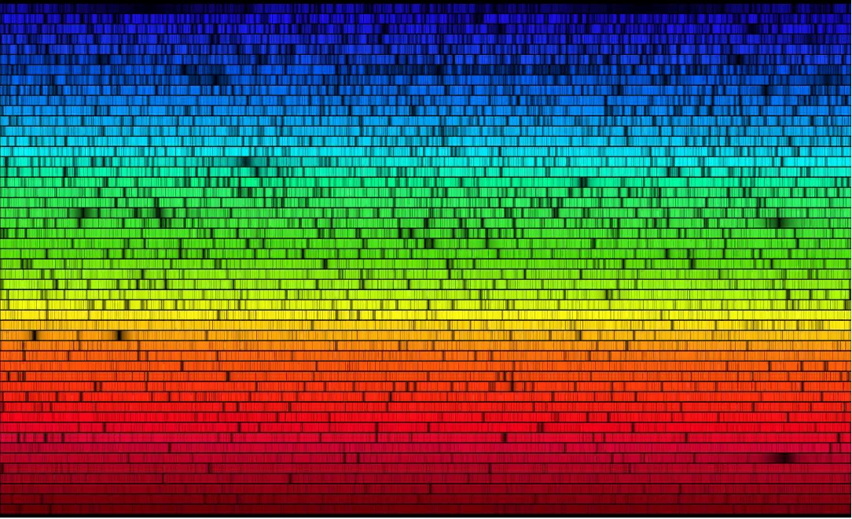
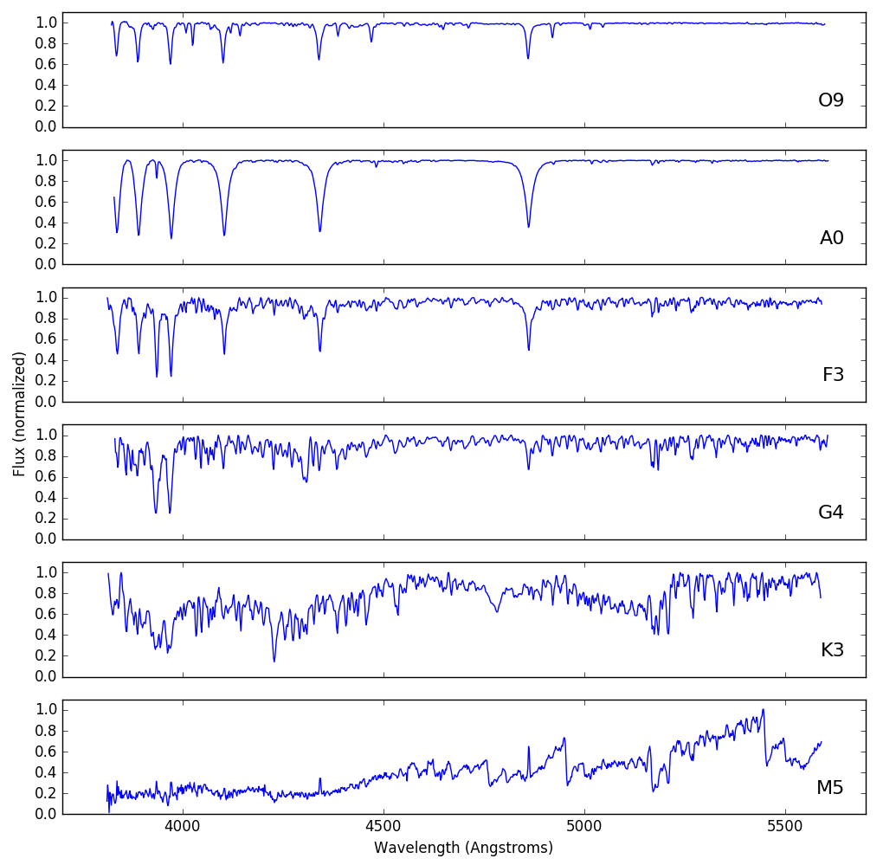
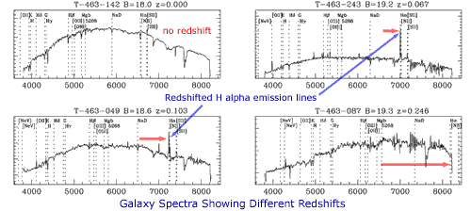
Spectra
Notes:
http://spiff.rit.edu/classes/phys230/lectures/spec_interp/spec_interp.html
http://star-www.st-and.ac.uk/~spd3/Teaching/PHYS1002/phys1002_lecture6.pdf
http://www.atnf.csiro.au/outreach/education/senior/astrophysics/spectra_astro_types.html
http://spiff.rit.edu/classes/phys301/lectures/doppler/doppler.html

Slide 26
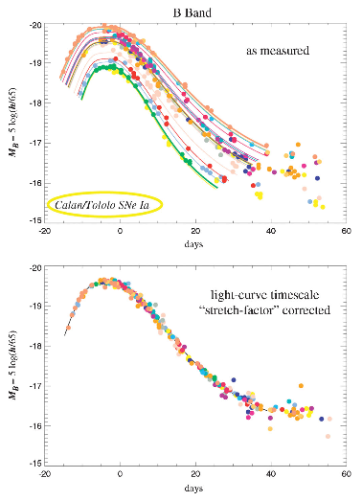
Type Ia Supernovae
From white dwarf with mass > 1.4 solar masses (Chandrasekhar Limit)
“Standard candle” for measuring distance because they are all the same brightness (well... maybe)
  Slow mass transfer from binary companion, mass = 1.4 solar masses
  Collision with another white dwarf, mass = ???
Notes:
https://en.wikipedia.org/wiki/Type_Ia_supernova
https://hubblesite.org/contents/articles/dark-energy
http://astronomy.swin.edu.au/cosmos/T/Type+Ia+Supernova+Progenitors

Slide 27
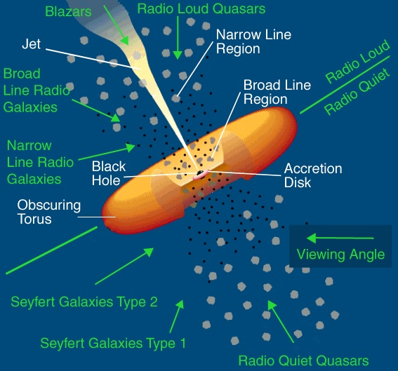
AGNs & Quasars
Bright across many wavelengths, often variable
Unified Model – all AGNs/quasars are similar, just viewed from different angles
  Disk of matter accreting onto a supermassive black hole
  Sometimes (but not always) produces a narrow jet
Notes:
http://astronomy.swin.edu.au/cosmos/A/Active+Galactic+Nuclei
https://imagine.gsfc.nasa.gov/science/objects/active_galaxies1.html
https://www.space.com/17262-quasar-definition.html

Slide 28
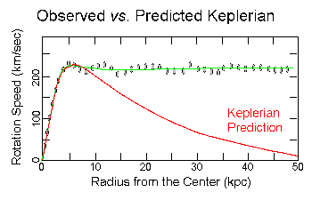
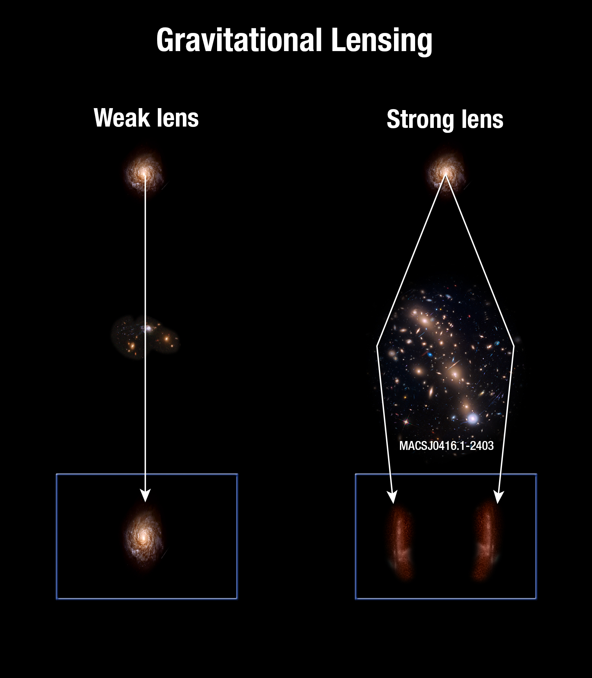
Dark Matter
Several times more mass than “normal” matter
Galactic orbital velocities should follow Kepler’s Law
  Instead, rotation curves are flat
Gravitational lensing
  Mass bends light paths
  Strong lensing (multiple images or arcs) vs. weak lensing (shape distortion)
Notes:
https://science.nasa.gov/astrophysics/focus-areas/what-is-dark-energy
https://www.space.com/20930-dark-matter.html
https://frontierfields.org/2014/12/09/mapping-mass-in-a-frontier-fields-cluster/

Slide 29
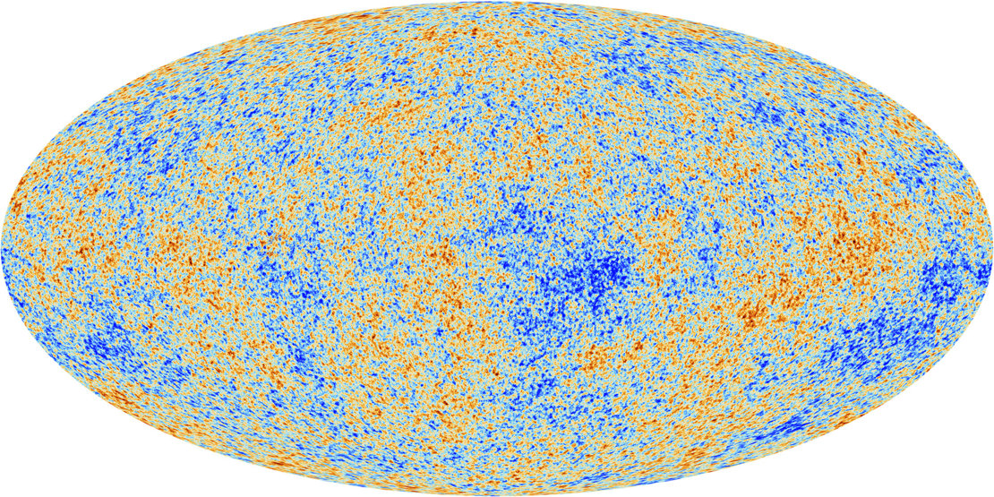
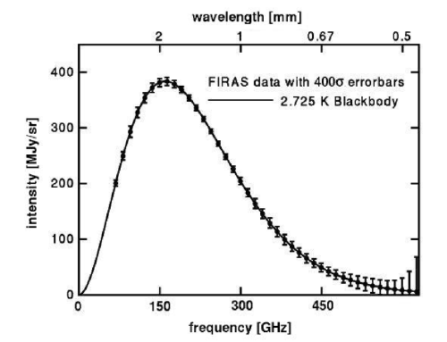
Cosmic Microwave Background
Era of Recombination
  When universe was ionized, photons couldn’t travel far without interacting with matter
  Recombination of electrons + nuclei – no longer ionized, photons go free
Almost perfect blackbody
  Temperature at recombination, redshifted by expansion of the universe
  Primordial fluctuations
Notes:
https://wmap.gsfc.nasa.gov/universe/bb_tests_cmb.html
http://astronomy.swin.edu.au/cosmos/C/Cosmic+Microwave+Background
https://m.esa.int/Our_Activities/Space_Science/Planck/Planck_and_the_cosmic_microwave_background

Slide 30


Basic Equations & Relationships
Distance Modulus:
$m−M=5\log_{10}\left(\frac{d}{10}\right)$
Type Ia supernova: $M≈−19.6$
Astronomical Units:
1 pc = 3.26 ly = $3.08∗{10}^{16} m$
1 degree = 60 arcmin = 3600 arcsec
Small Angle Formula: $d=\frac{αD}{206,265}$
Inverse Square Law: $\frac{L_{1}}{L_{2}}=\frac{r_{2}^{2}}{r_{1}^{2}}$
Circumference, Area, Surface Area, and Volume of a Sphere

Slide 31



Radiation Laws
Blackbody – described by Planck’s Law
Wien’s Law: $λ_{max}=\frac{2.9∗{10}^{6} nm∗K}{T}$
Stefan-Boltzmann Law: $L=AσT^{4}$
LRT: $\frac{L_{1}}{L_{2}}={\left(\frac{R_{1}}{R_{2}}\right)}^{2}{\left(\frac{T_{1}}{T_{2}}\right)}^{4}$
Notes:
http://hyperphysics.phy-astr.gsu.edu/hbase/wien.html
http://jila.colorado.edu/~ajsh/courses/astr1120_03/text/chapter1/SBLaw.htm

Slide 32


Orbital Motion
Kepler’s Third Law:
$\left(M_{1}+M_{2}\right)=\frac{a^{3}}{P^{2}}$
(in solar masses, AU, years)
$\left(M_{1}+M_{2}\right)=\left(\frac{G}{4π^{2}}\right)\frac{a^{3}}{P^{2}}$
(in meters, kilograms, seconds)
Circular Motion:
$v=\frac{d}{t}$
$a=\frac{v}{t}$
$P=\frac{2πr}{v}$
$F_{c}=ma_{c}=\frac{mv^{2}}{r}$

Slide 33



Hubble’s Law & Hubble’s Constant
All galaxies recede from us due to expansion of the universe
For nearby galaxies, peculiar motion (due to gravity, etc.) is more important
$v_{rec}=H_{0}d$ ($H_{0}≈70 \frac{{km}/s}{Mpc}$)
Age of universe $≈\frac{1}{H_{0}}$
Notes:
https://www.e-education.psu.edu/astro801/content/l10_p3.html
http://hosting.astro.cornell.edu/academics/courses/astro201/hubbles_law.htm

Slide 34

JS9
https://js9.si.edu/
Notes:
https://js9.si.edu/

Slide 35
Resources
National Science Olympiad
Chandra (x-ray)
Hubble (visible)
Spitzer (infrared)
Fermi (gamma-ray)
Swift (x-ray/UV)
Nat’l Radio Astronomy Observatory
Astronomy Picture of the Day
http://www.soinc.org
http://chandra.harvard.edu/
http://stsci.edu/hst/
http://www.spitzer.caltech.edu/
https://fermi.gsfc.nasa.gov/
https://swift.gsfc.nasa.gov/
https://public.nrao.edu/
http://apod.nasa.gov/astropix.html

Slide 36
Event Information
National Event Supervisors:
Donna L. Young (dlyoung.nso@gmail.com)
Tad Komacek (tkomacek@gmail.com)
Rules Clarifications available at soinc.org under Event Information
Read the Event Description for content and allowable resources.
Use the webinar (Chandra) and/or powerpoint (NSO) for an overview of the content topics and deep sky objects.
Use the Astronomy Coaches Manual (NSO) as a guide for background information.

Slide 37
Event Information
Use the resources listed in the event description for images and content.
Youtube has many related videos.
Invitationals.
Tests from invitationals and sample state tests will be posted on the NSO website for teams to use for practice.
The scioly.org test exchange (https://scioly.org/wiki/index.php/2019_Test_Exchange).
ASTRO 101 introductory college courses.
Scientific papers. Most useful parts: abstract, introduction, figures. Don’t worry if you don’t understand everything!

