Slide 1
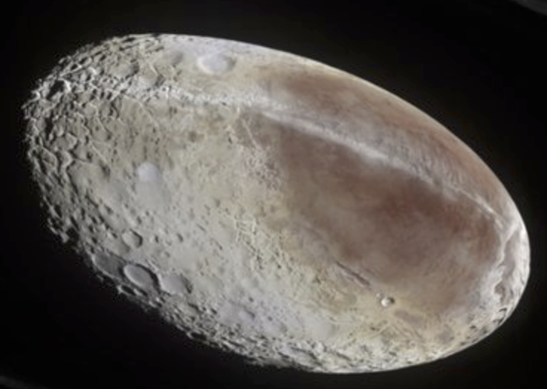
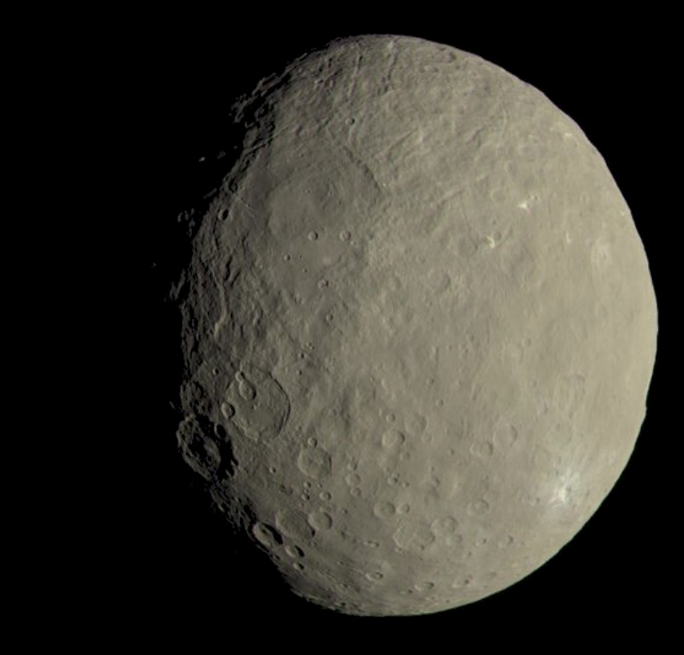
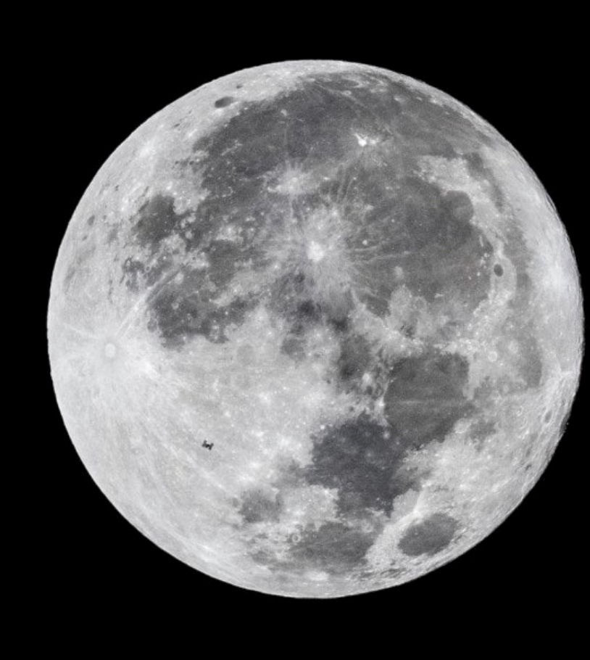
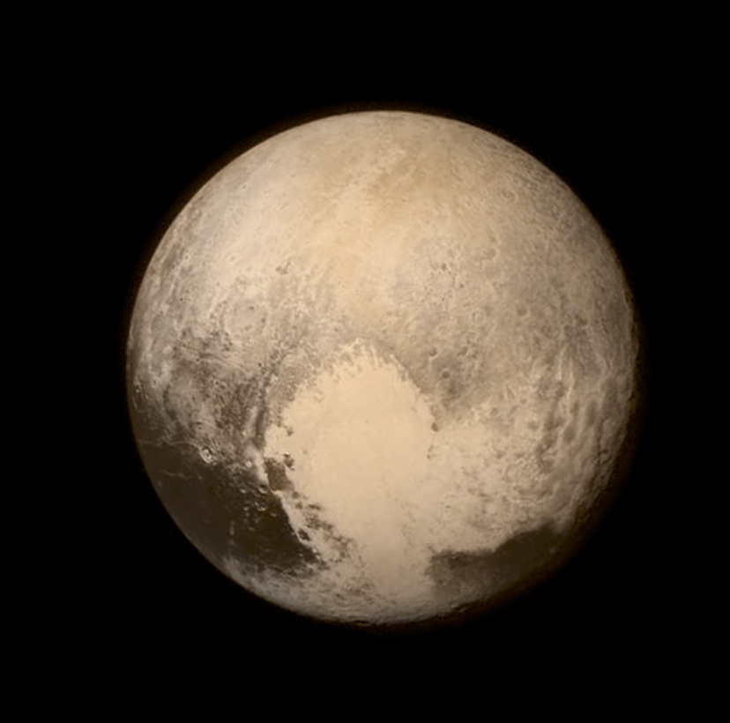
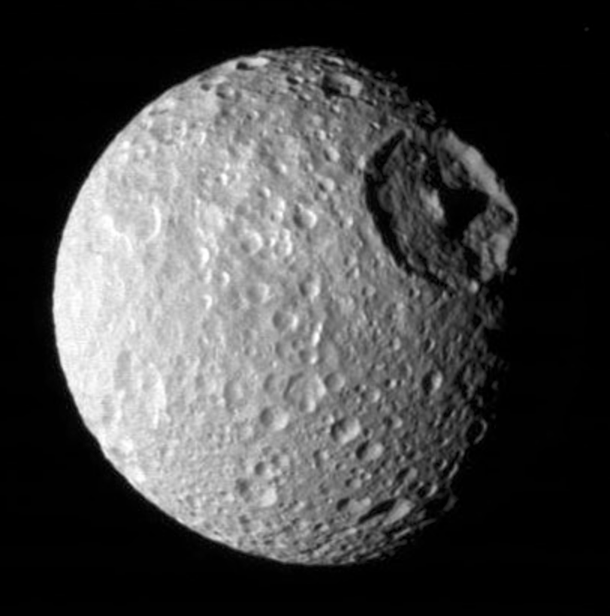
National Science Olympiad
2019 B Division Solar System Event
Earth’s Moon and Geologic Solar System Bodies

Slide 2
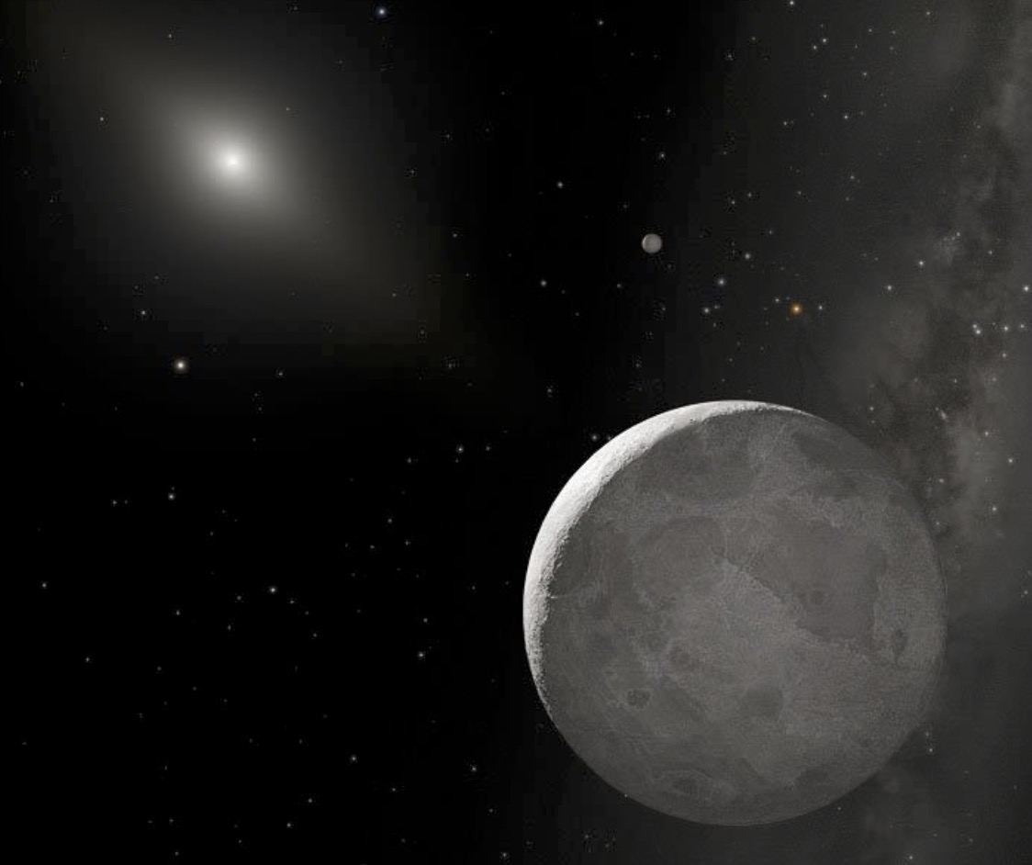
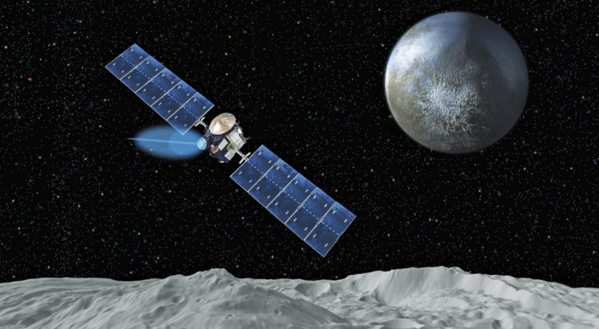
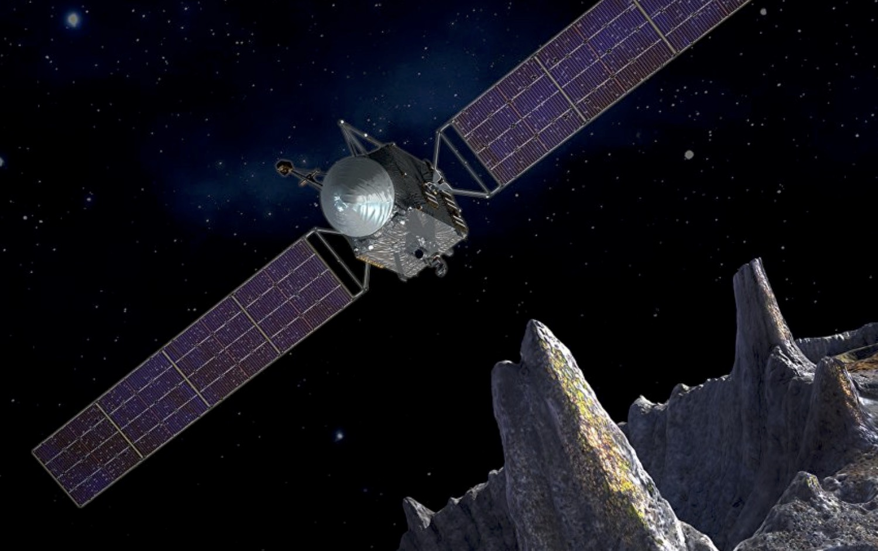
National Solar System Event
DESCRIPTION: Students will demonstrate an understanding and knowledge of the geologic characteristics and evolution of the Earth’s moon and other rocky bodies of the solar system.

Slide 3
Participants may be asked to identify geologic surface features and internal structure of the objects listed below as they appear on diagrams, maps, or images and must be knowledgeable about the history and geologic processes involved in their formation and evolution.
i. Dwarf Planets: Pluto, Ceres, Haumea, Makemake, Eris
ii. Satellites: Earth’s Moon, Mimas, Phoebe, Charon
iii. Asteroid Belt, Centaurs, Trans-Neptunians Objects, Trojans, ‘Oumuamua, (225088) 2007 OR₁₀

Slide 4
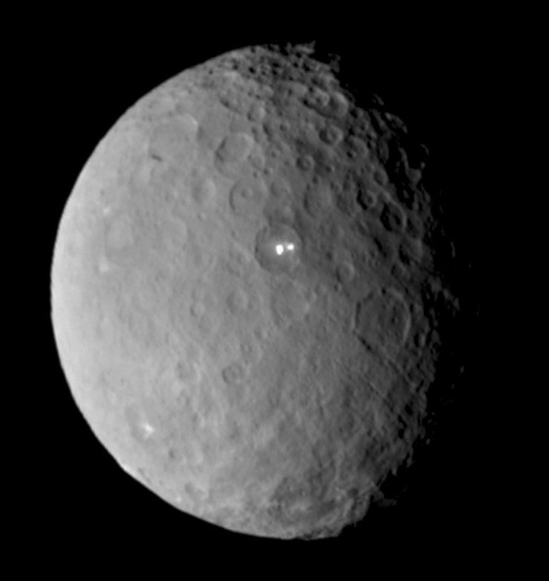
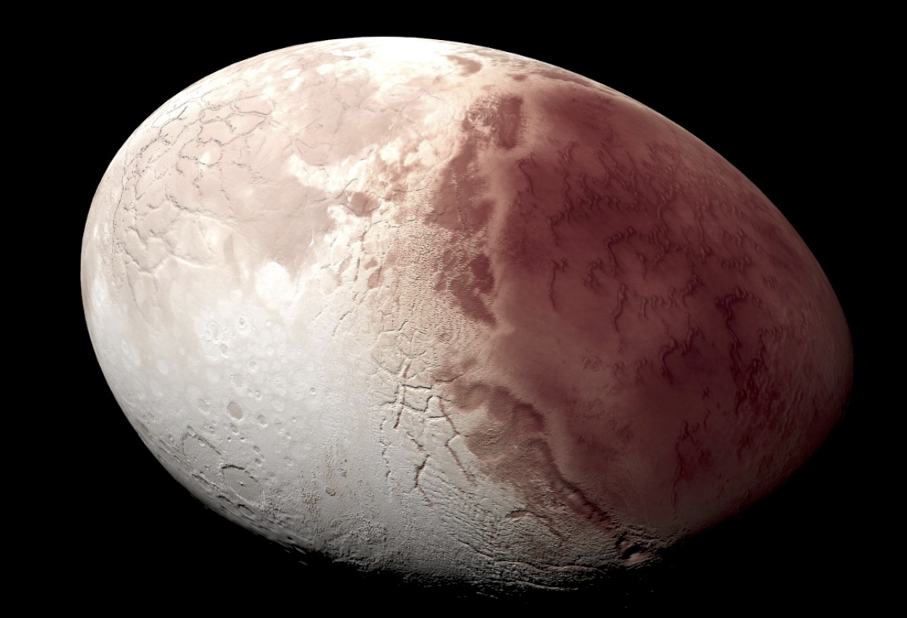
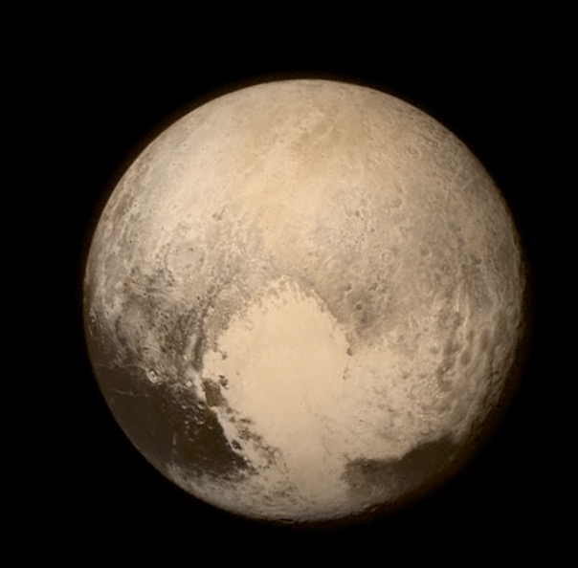
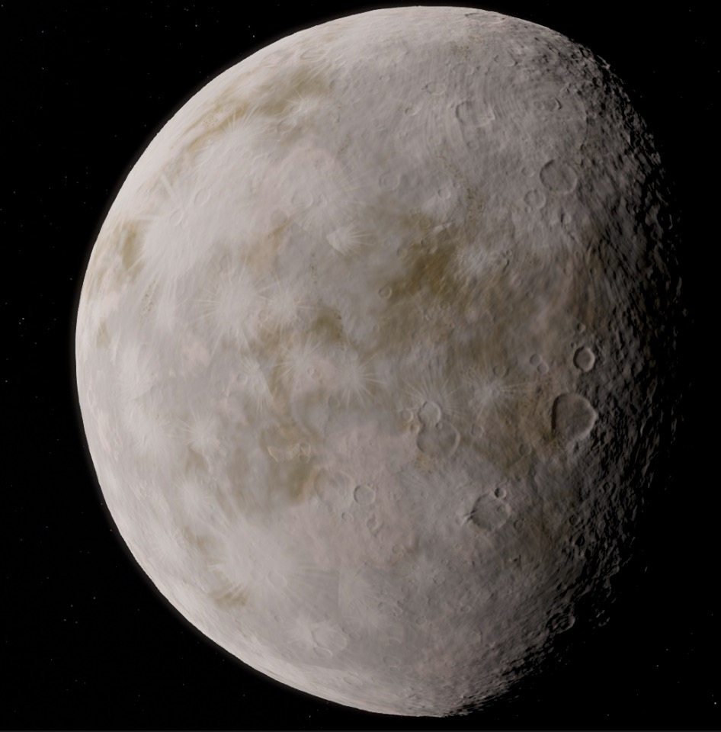
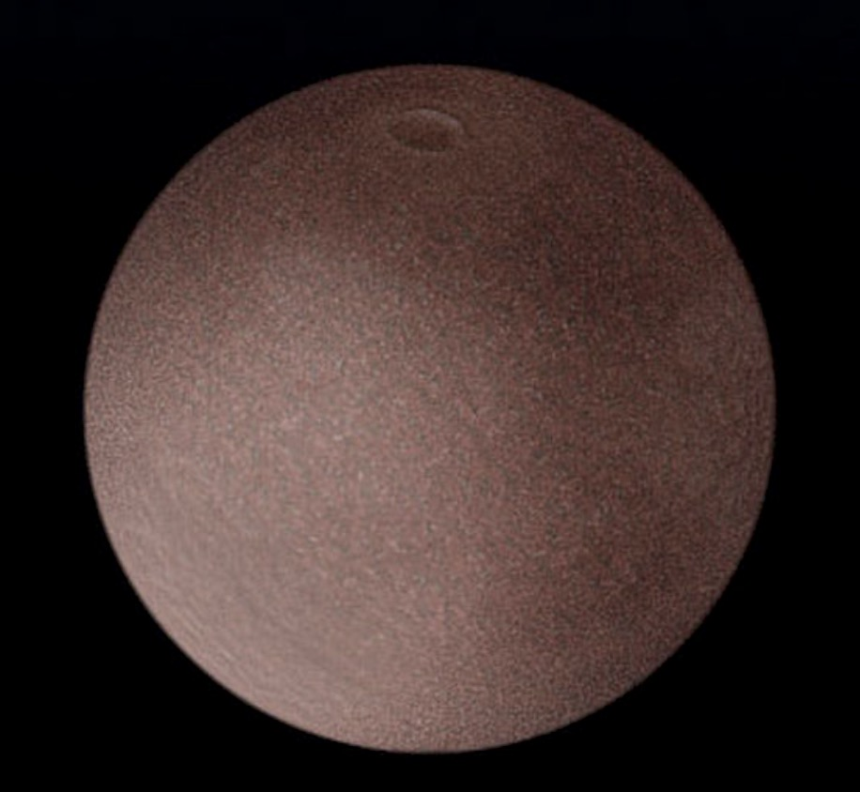
Dwarf Planets: Pluto, Ceres, Haumea, Makemake, Eris

Slide 5
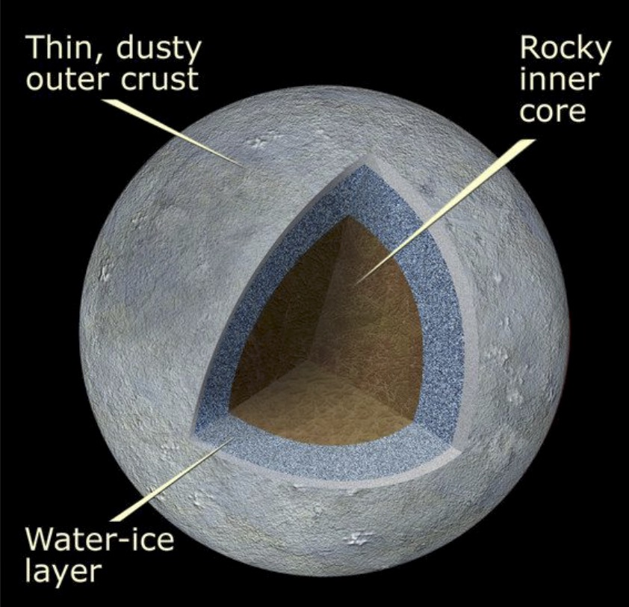
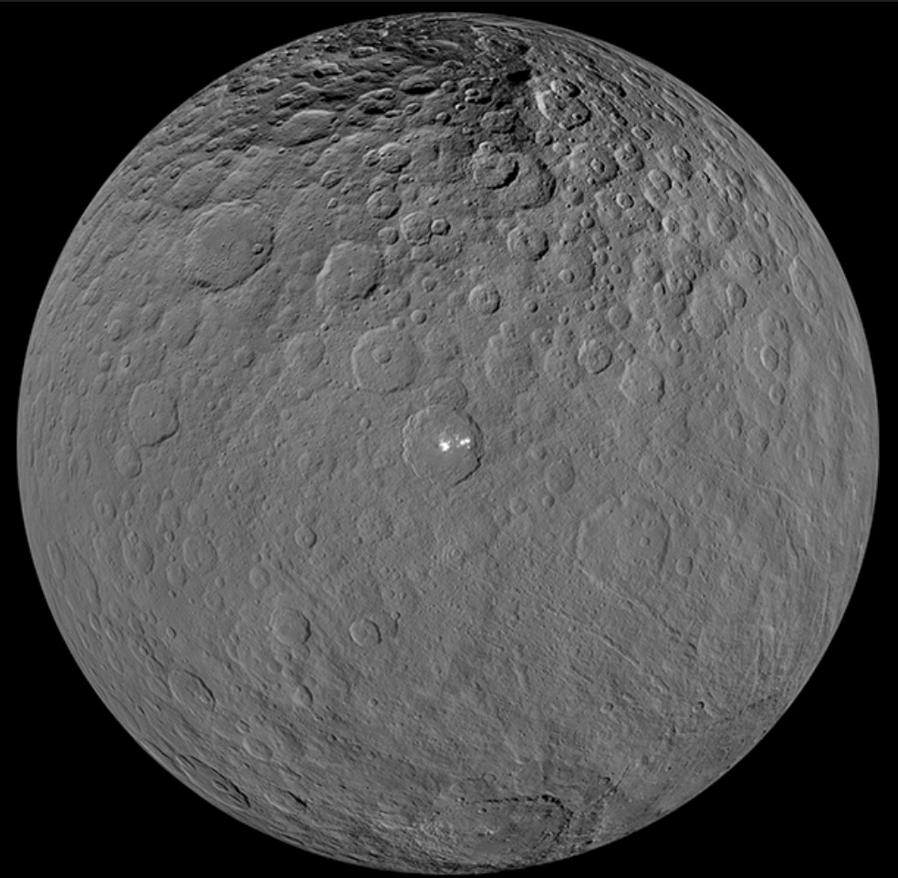
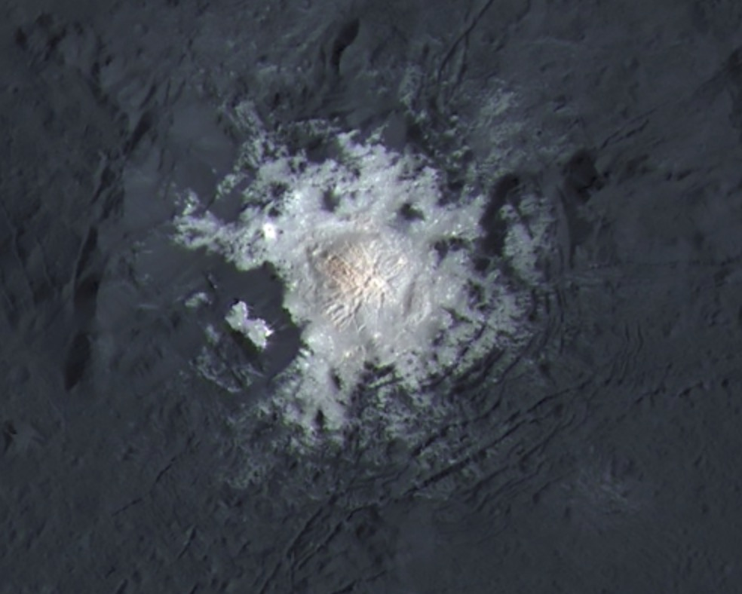
Ceres

Slide 6
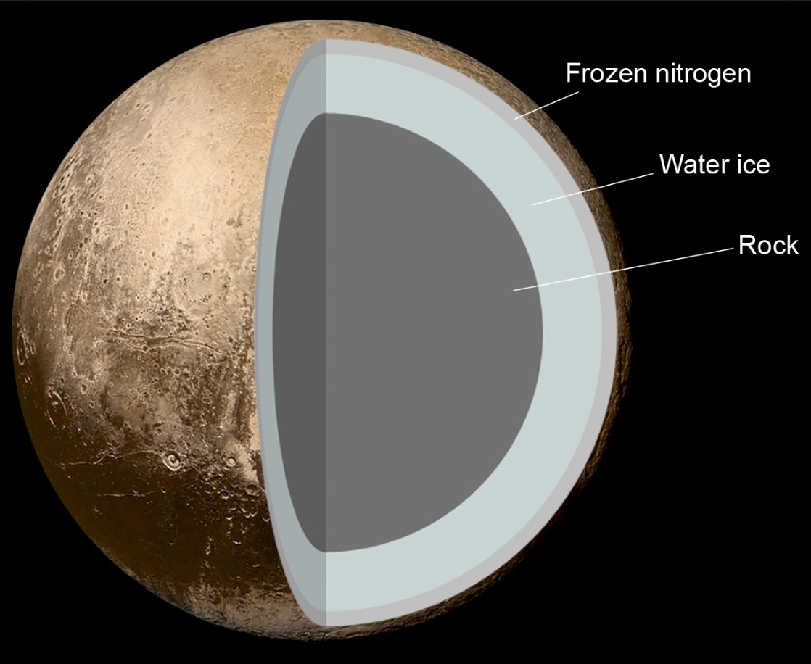
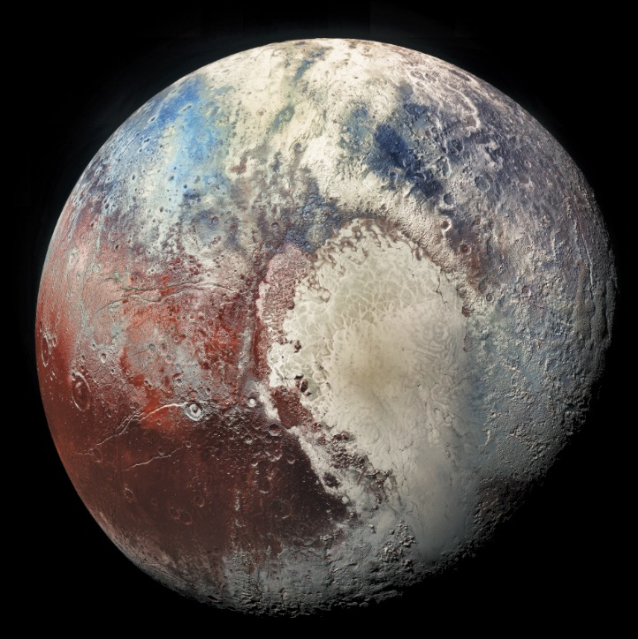
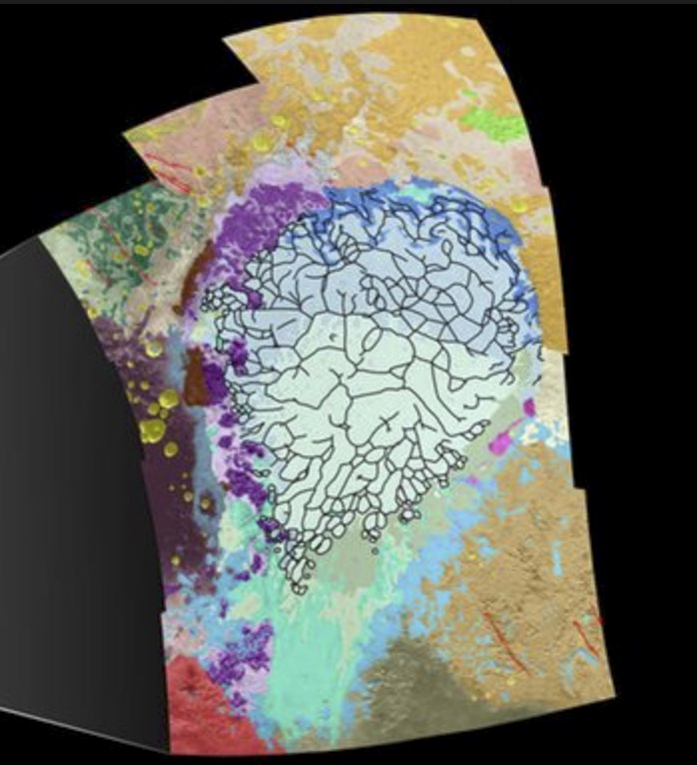
Pluto
Geologic Coloring of
Sputnik Planitia

Slide 7
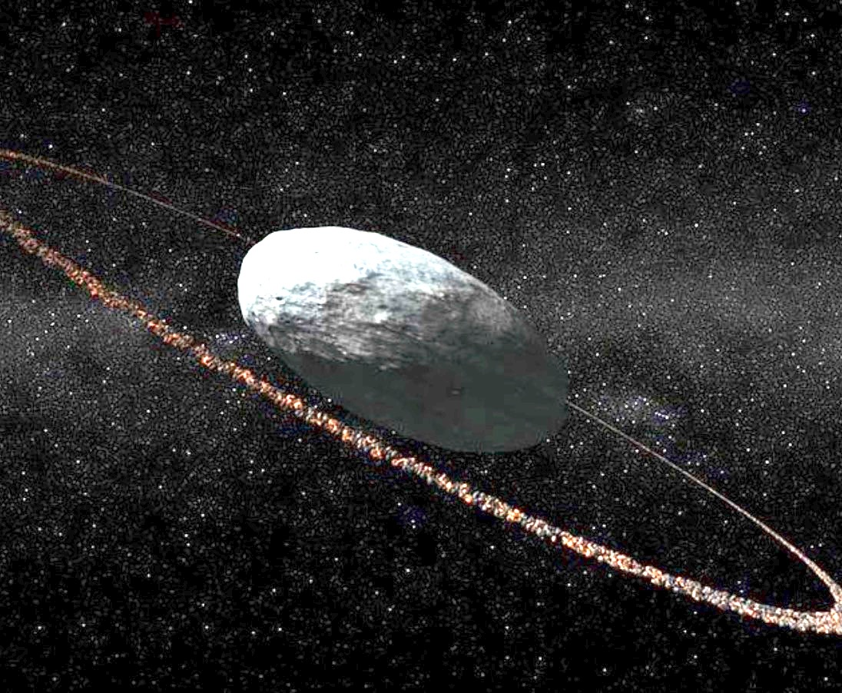
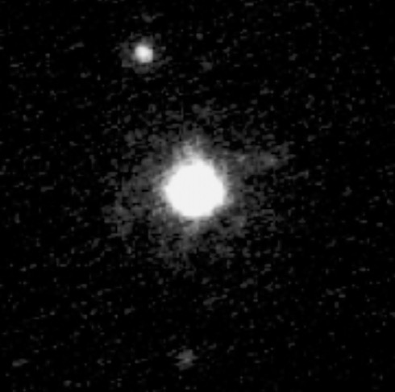
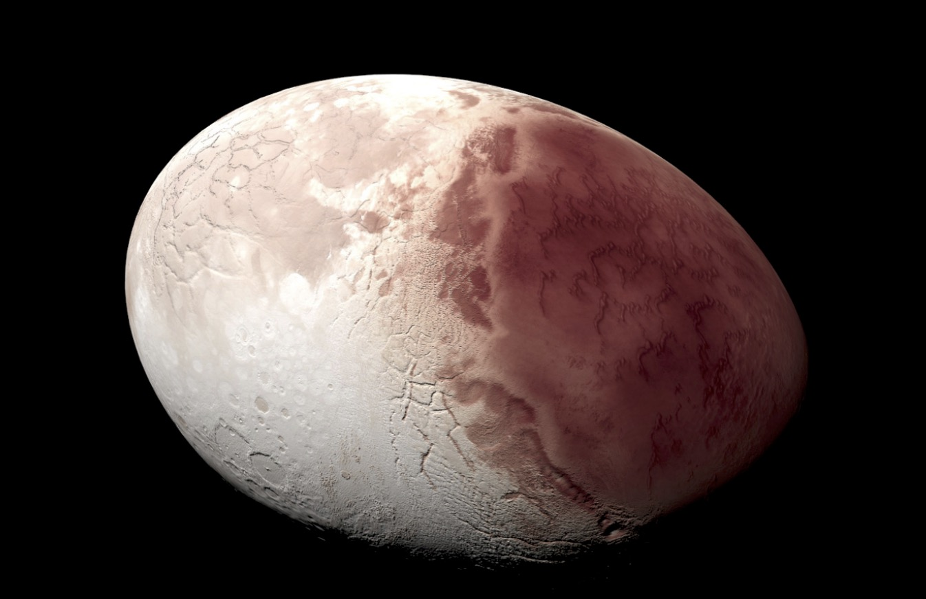
Haumea

Slide 8
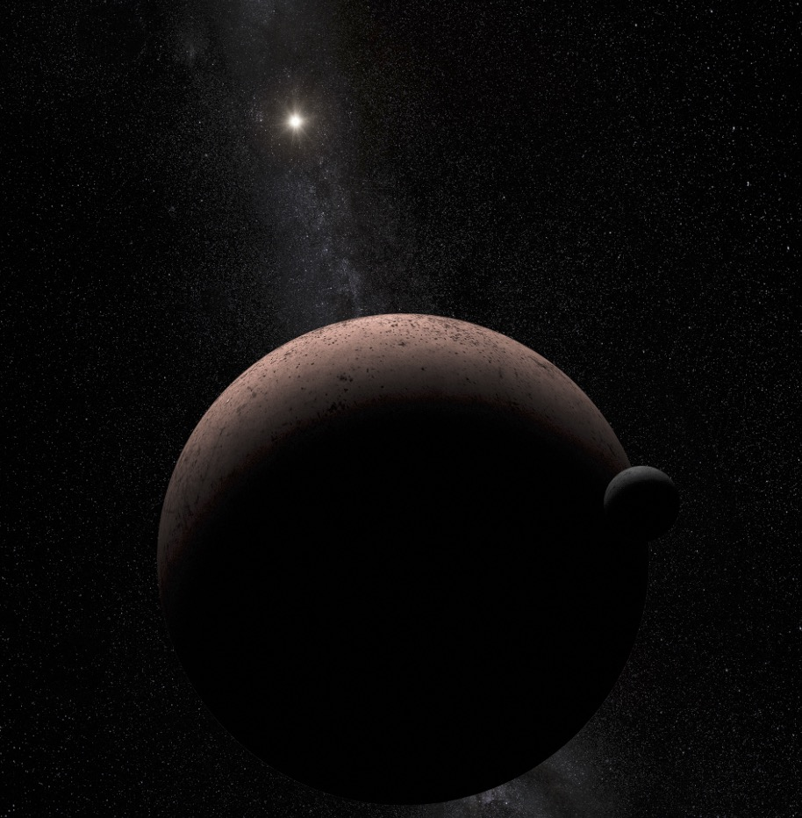
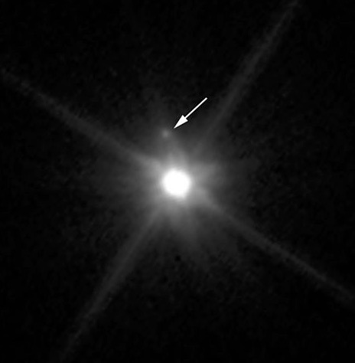
Makemake
Makemake and its moon

Slide 9
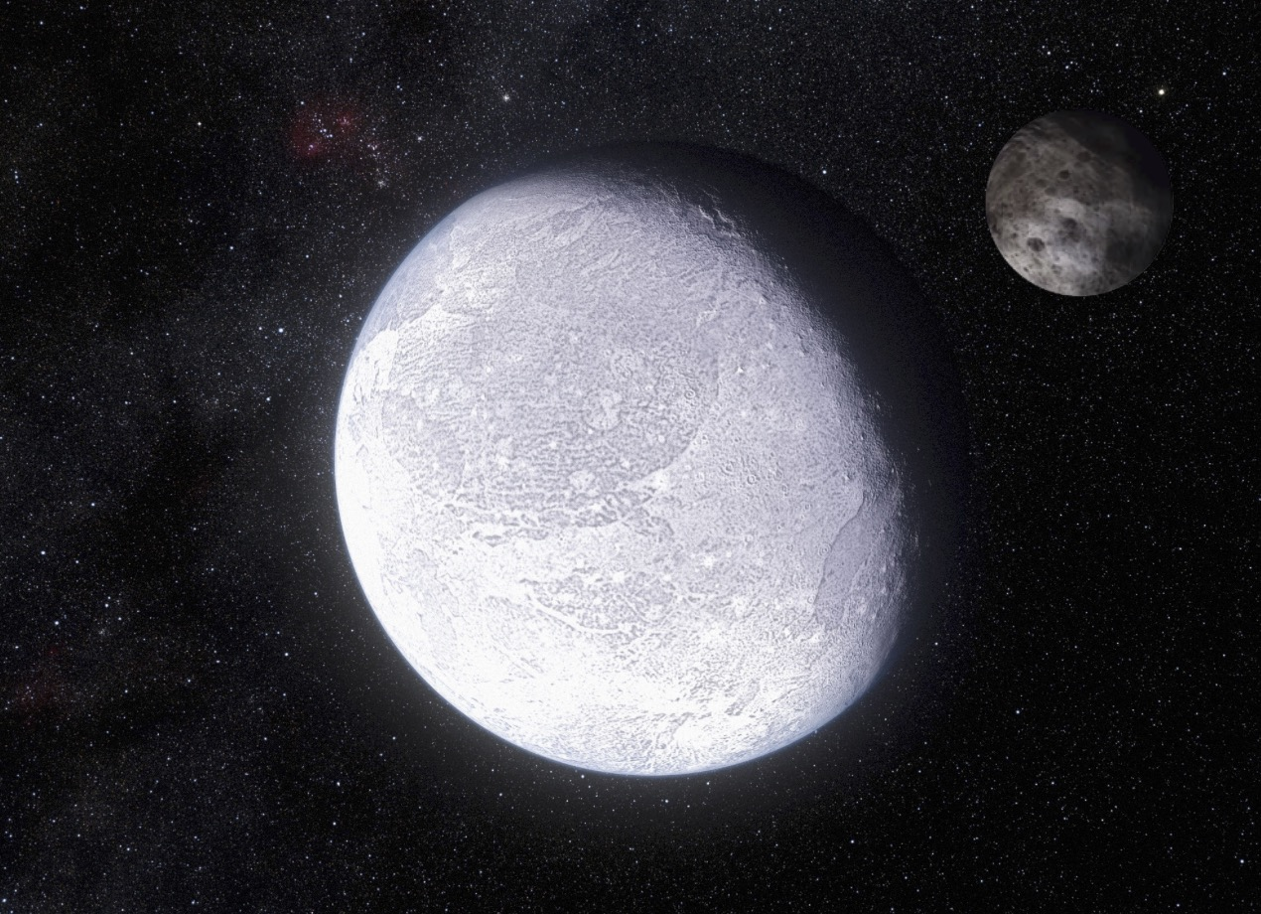
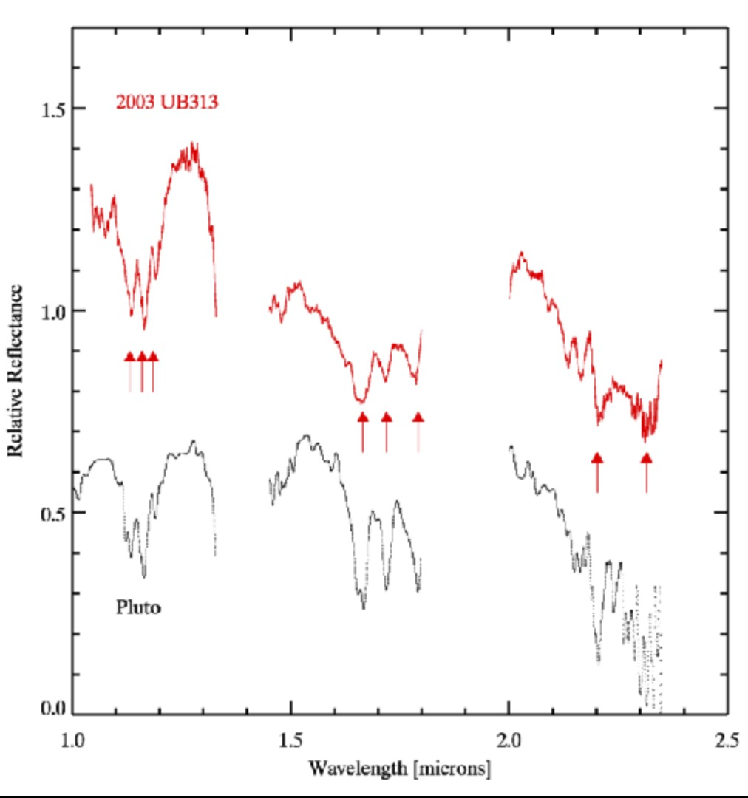
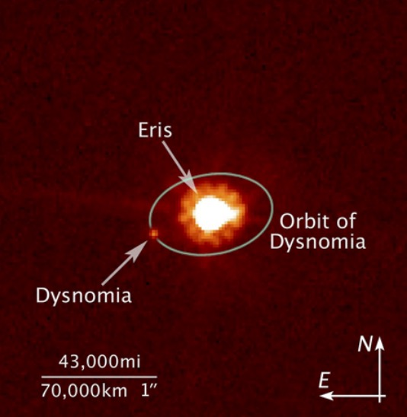
Eris
Eris
Pluto

Slide 10
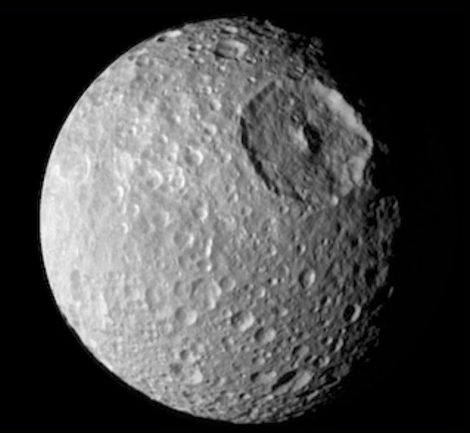
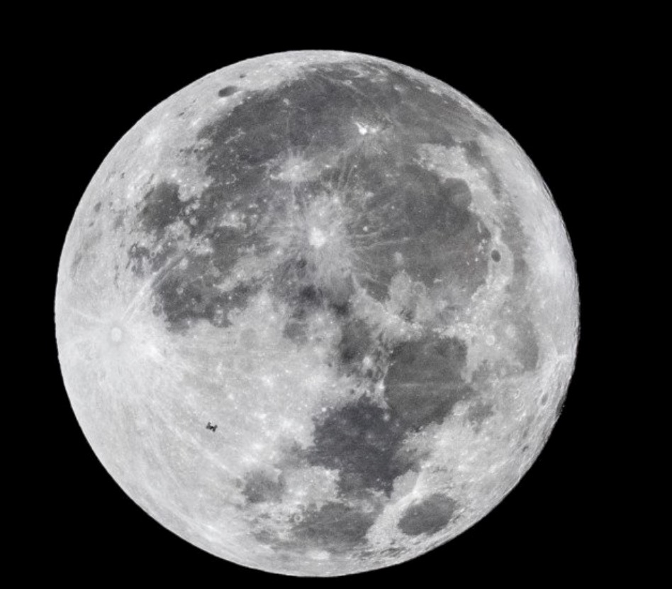
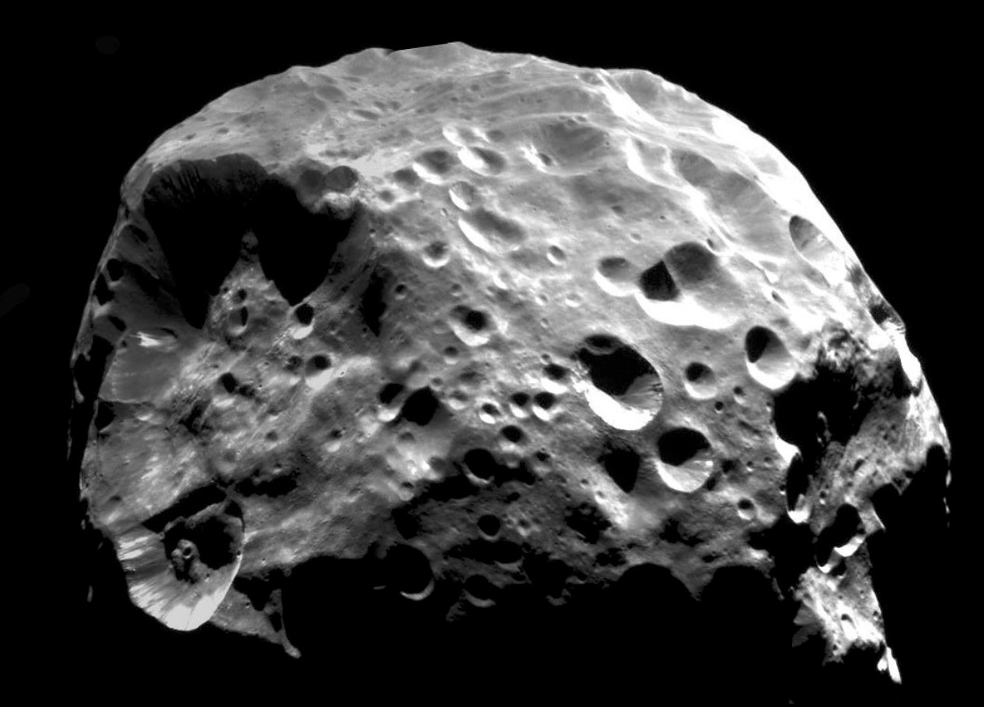
Major Satellites: Earth’s Moon, Mimas, Phoebe

Slide 11
The Moon: Internal Structure

Slide 12
The Moon: Surface Characteristics

Slide 13
Formation and History of the Moon

Slide 14
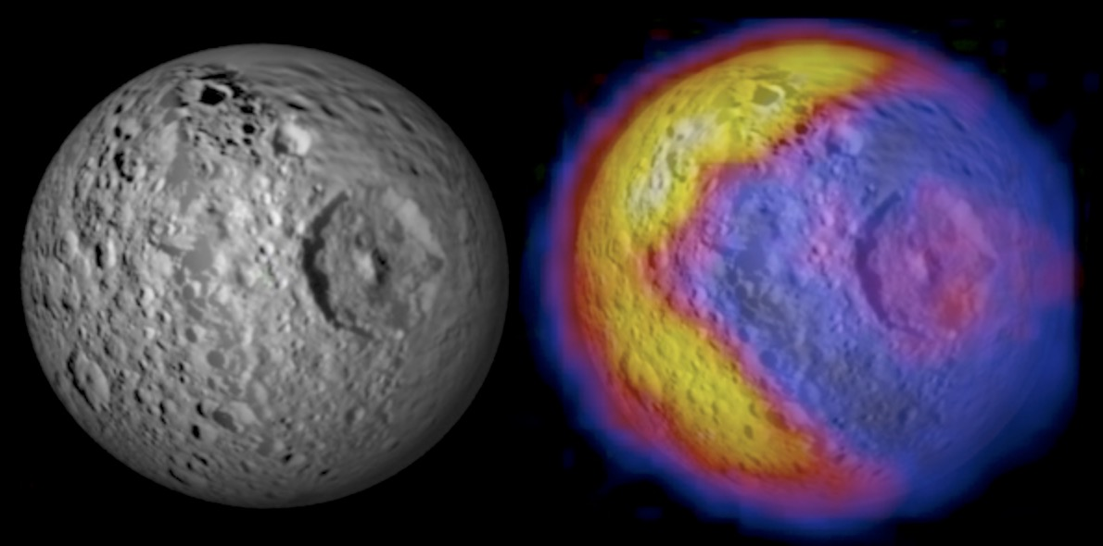
Saturn’s Moons Mimas

Slide 15
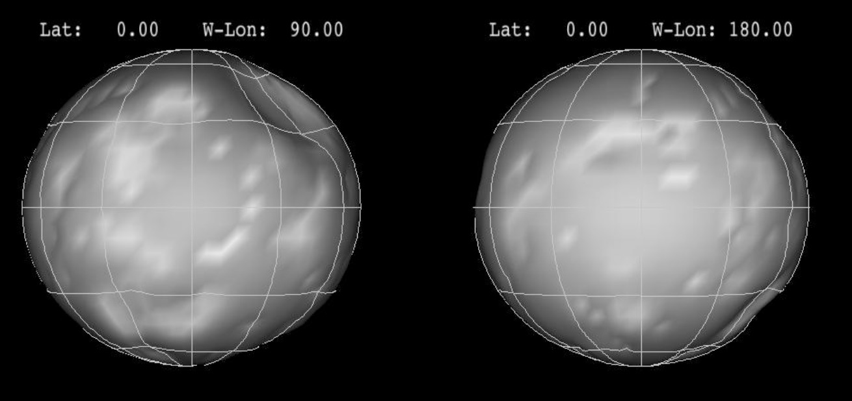
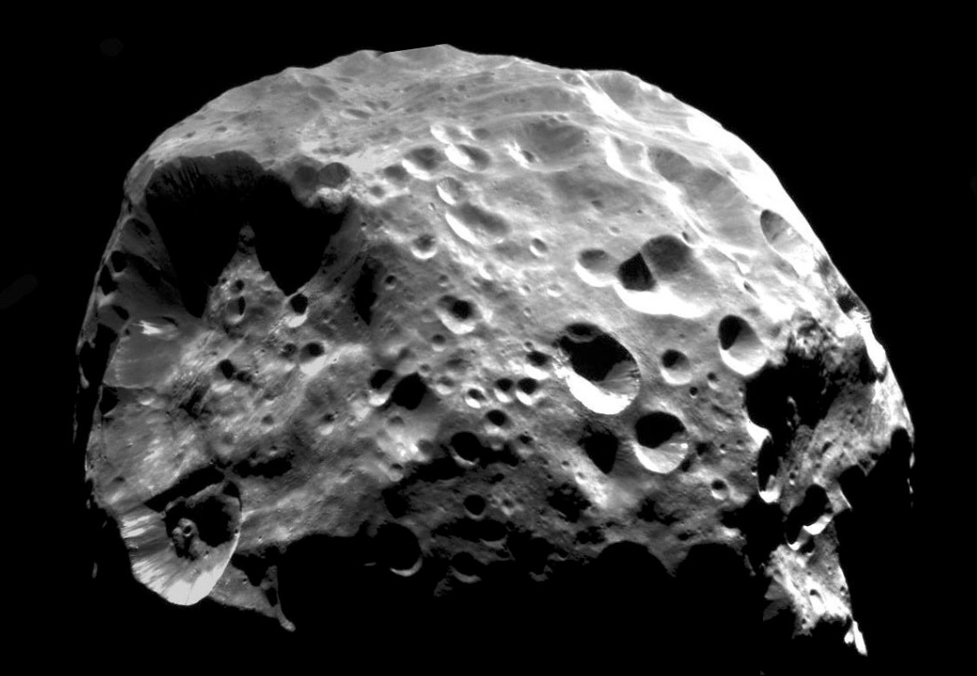
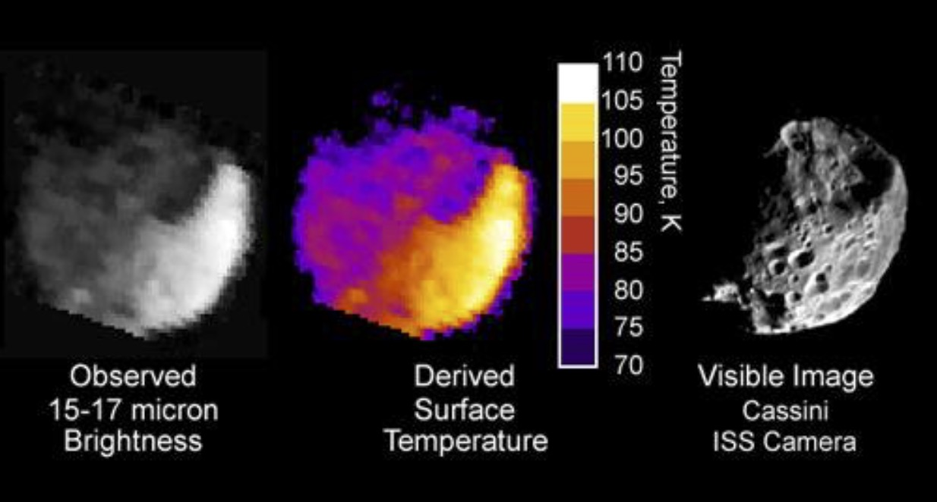
Saturn’s Moons Phoebe

Slide 16
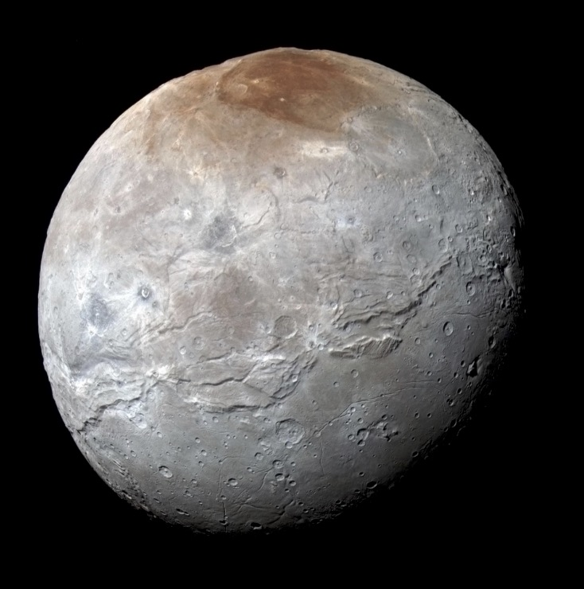
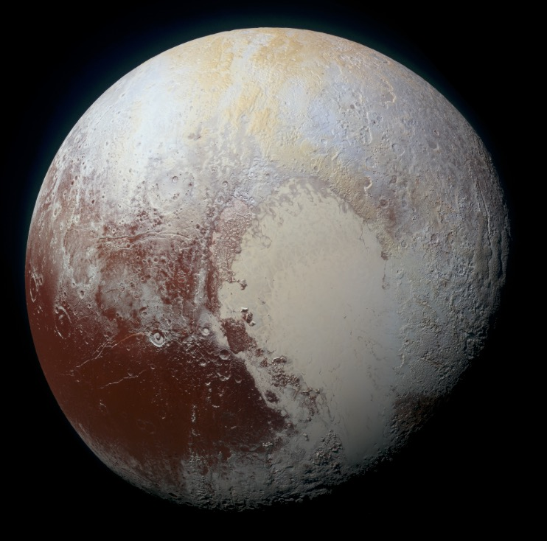
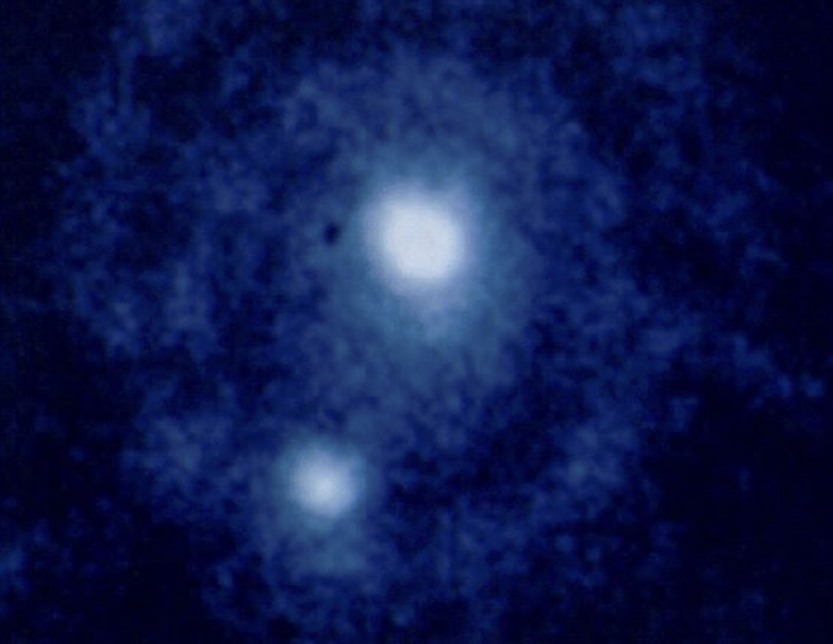
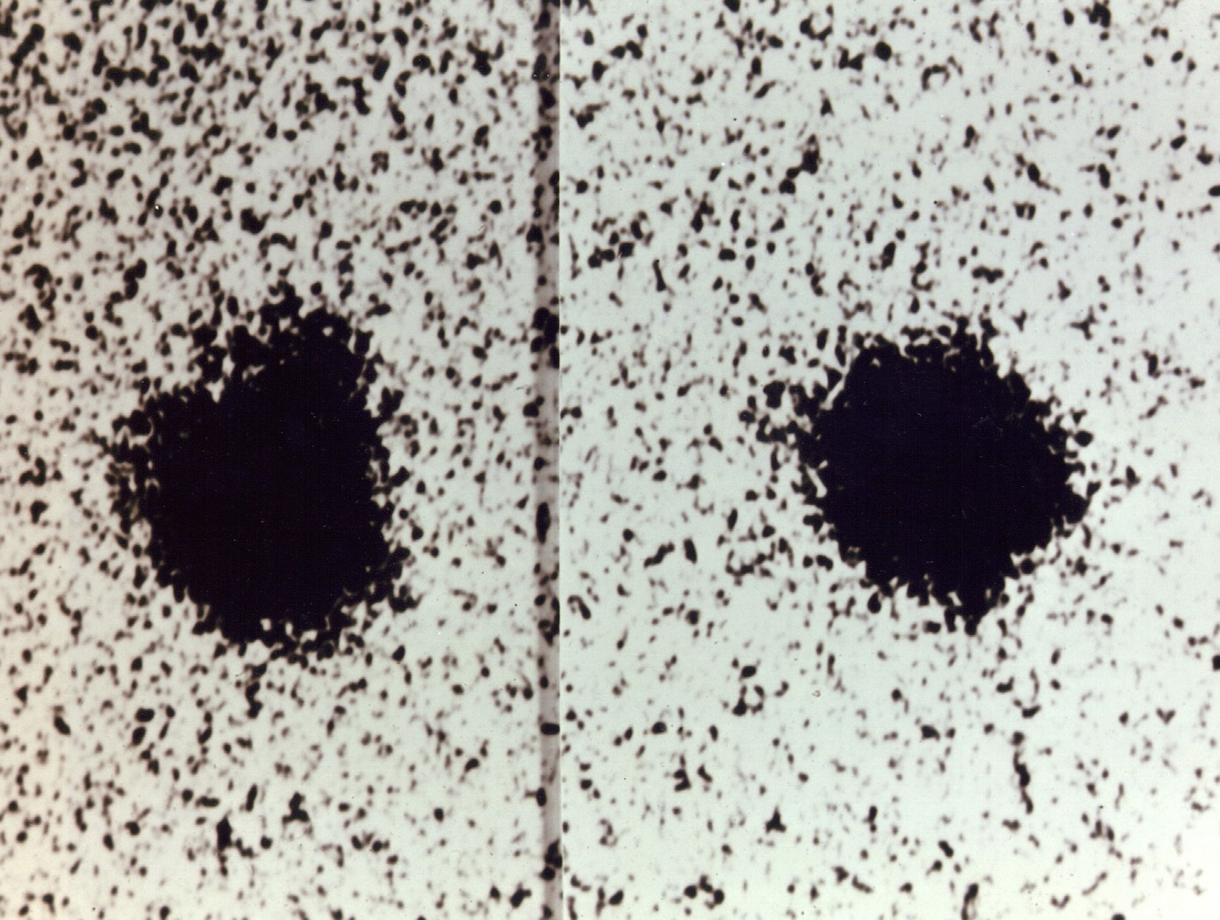
Charon

Slide 17
The Asteroid Belt
C-type
M-type
S-type

Slide 18
The Asteroid Belt

Slide 19
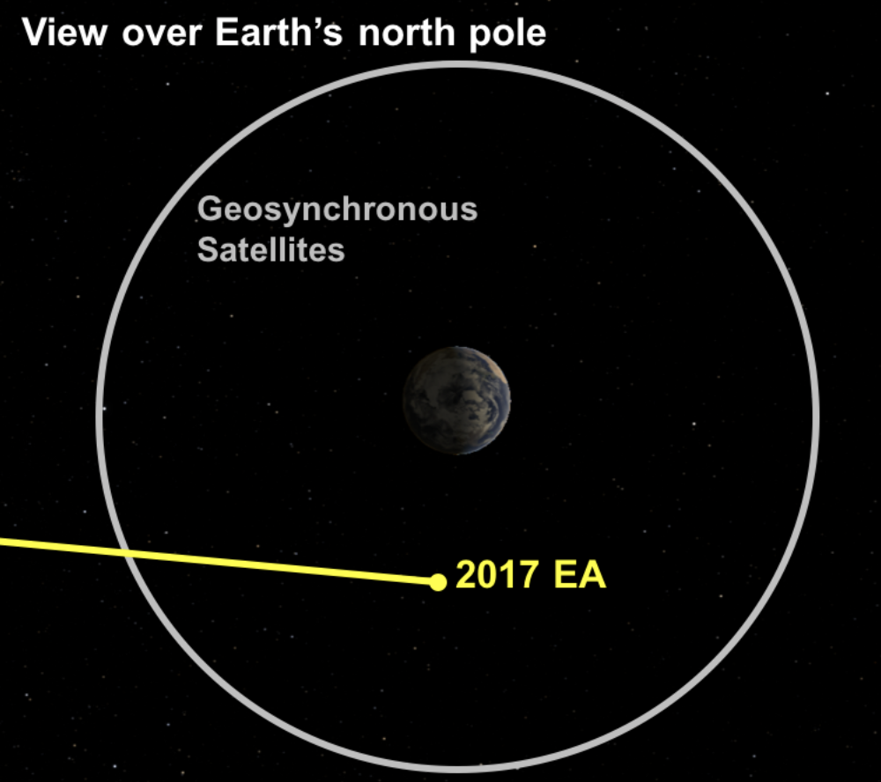
Formation of the Asteroid Belt

Slide 20
Formation of the Solar System

Slide 21
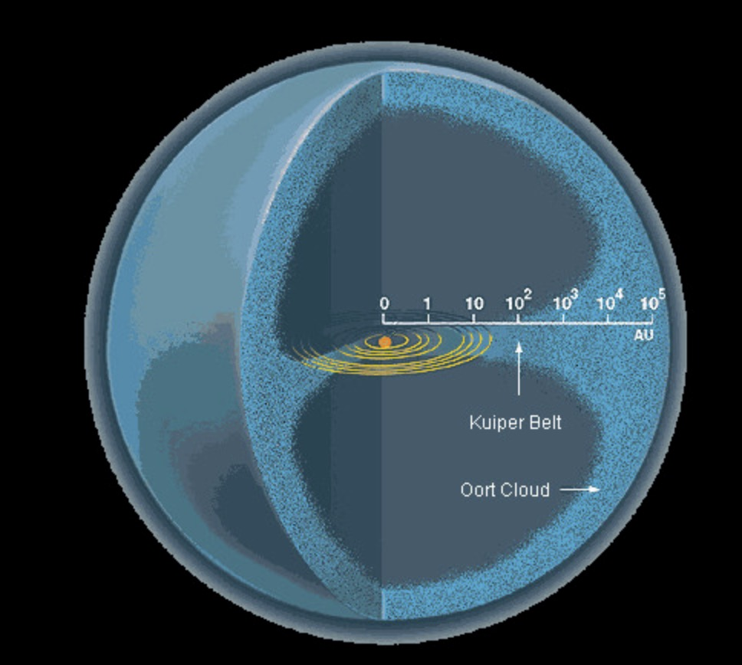
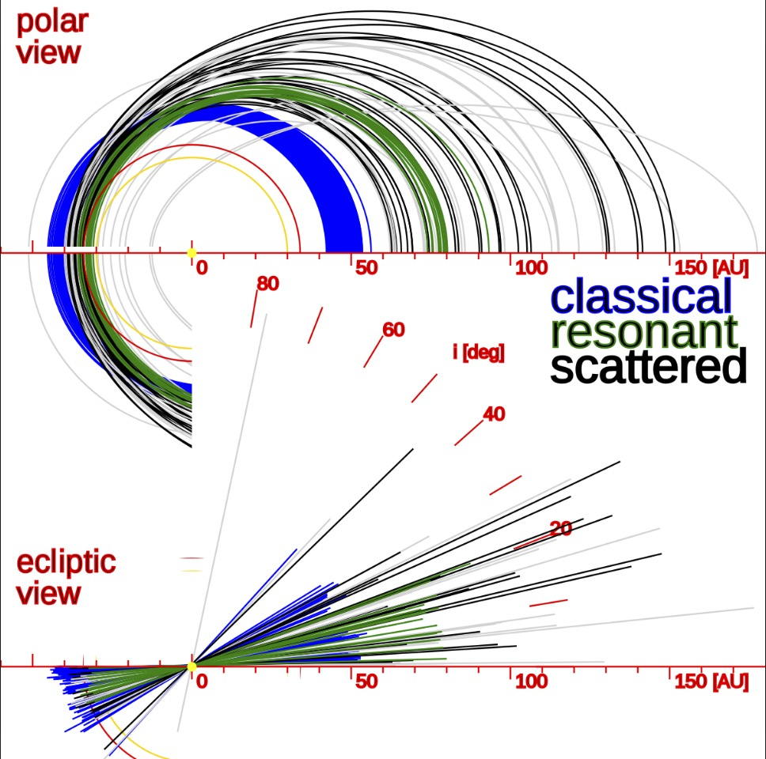
Trans-Neptunian Objects

Slide 22
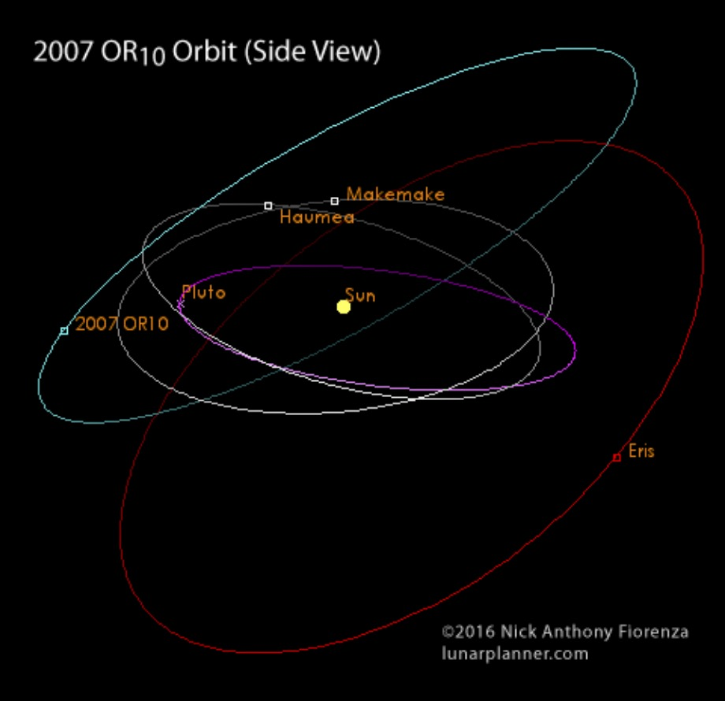
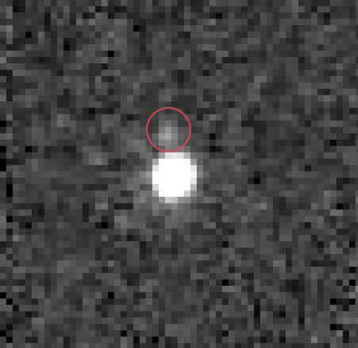
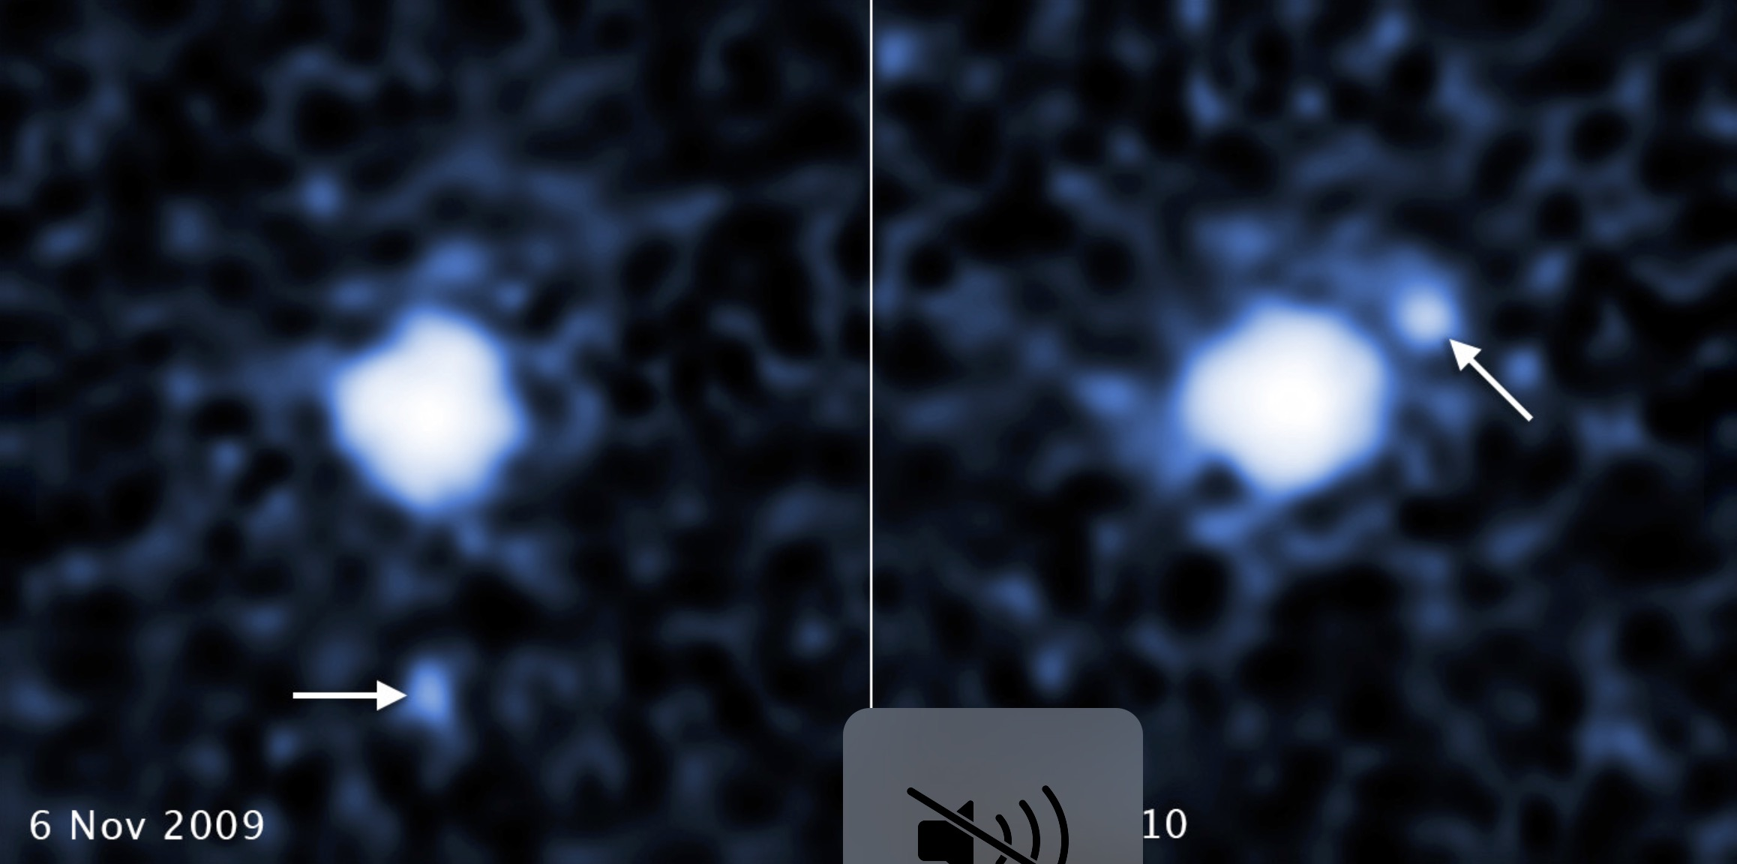
(225088) 2007 OR₁₀

Slide 23
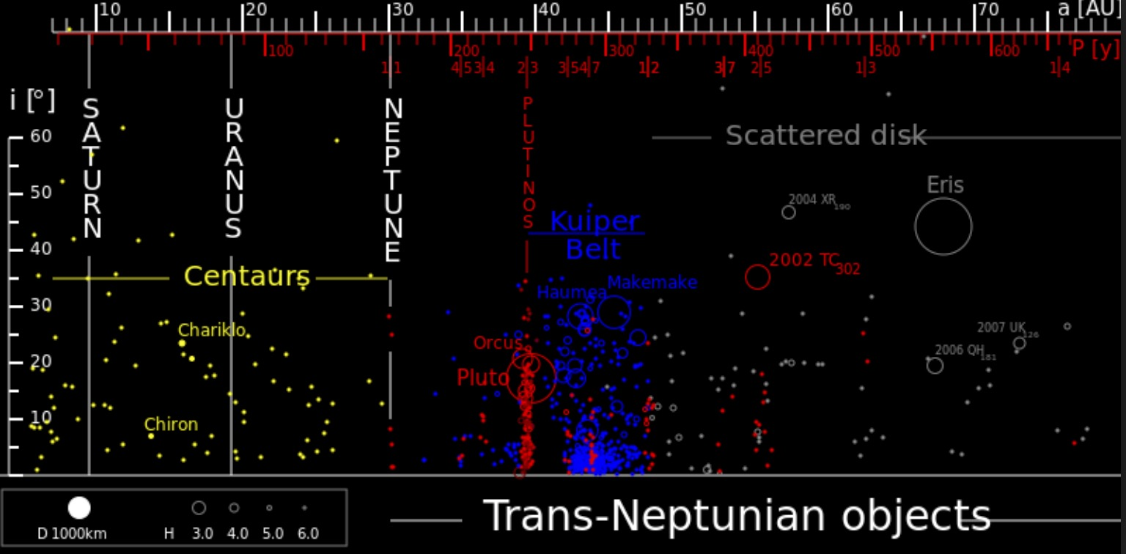
Centaurs

Slide 24
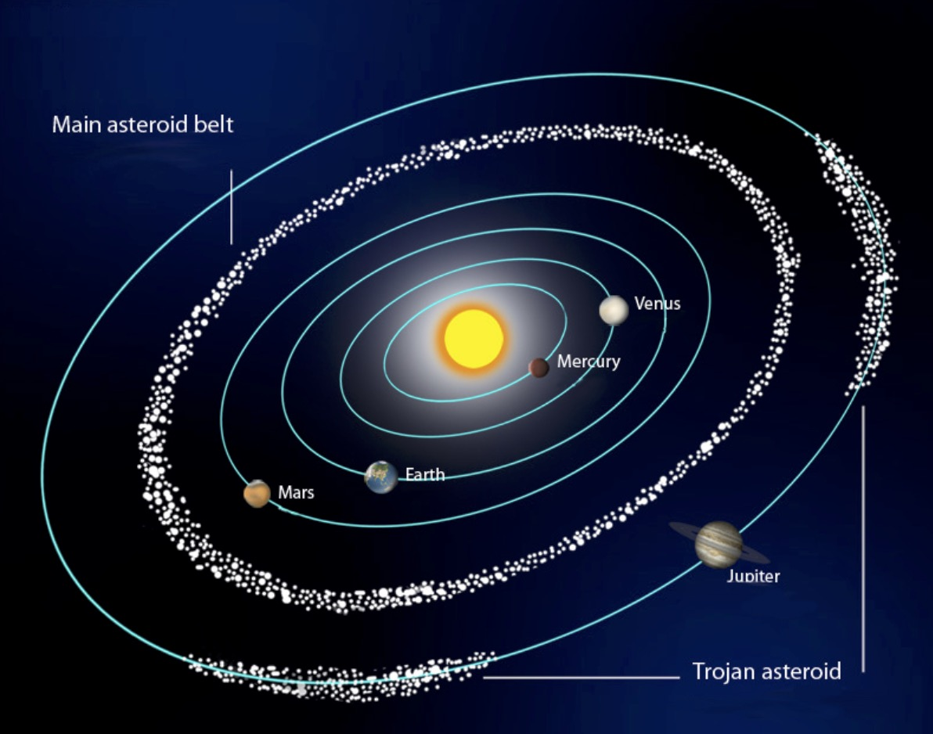
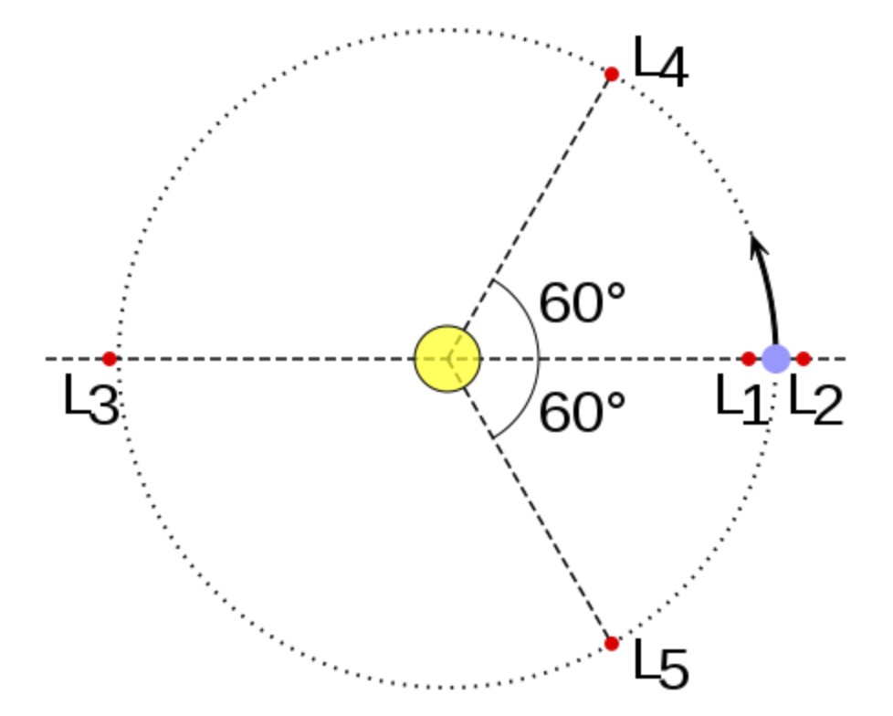
Trojans

Slide 25
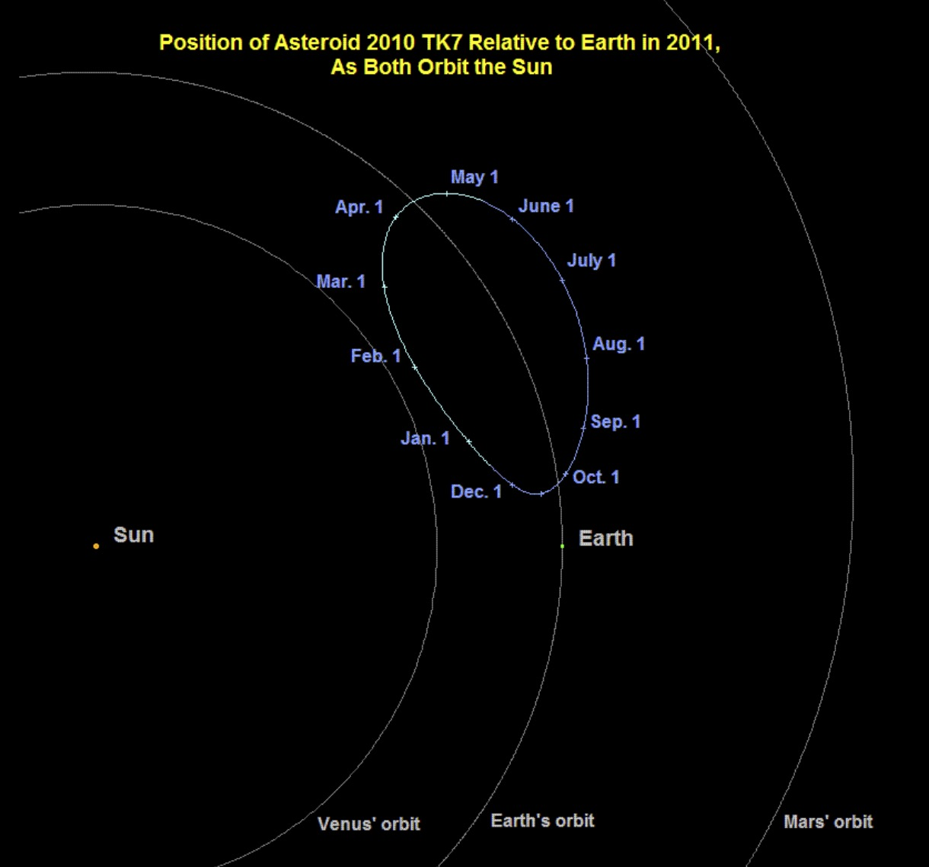
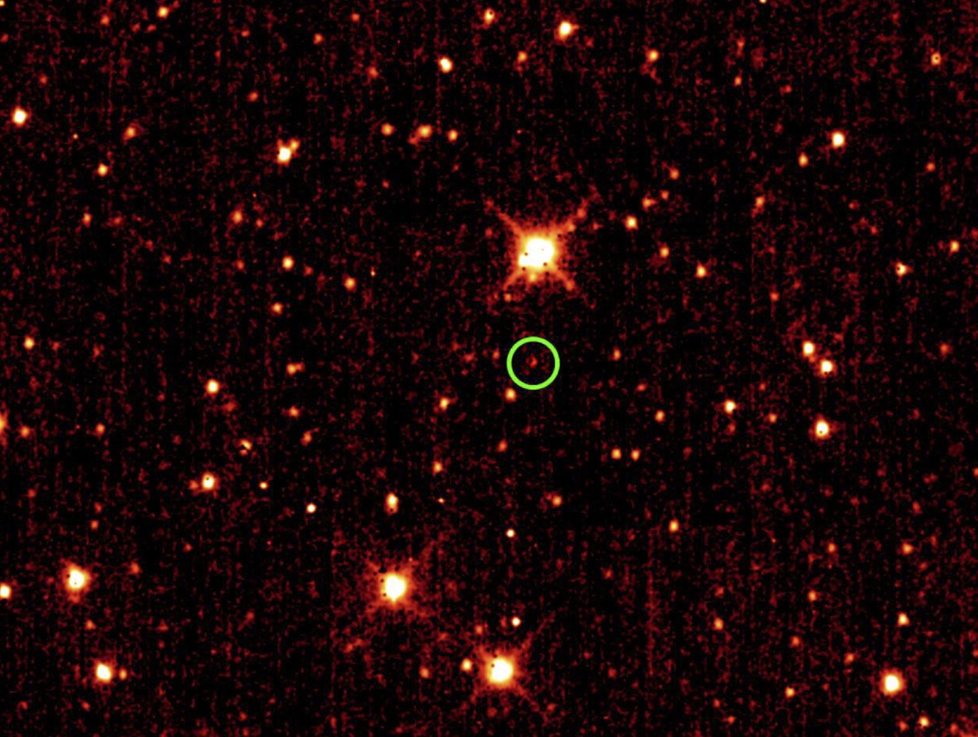
2010 TK₇

Slide 26
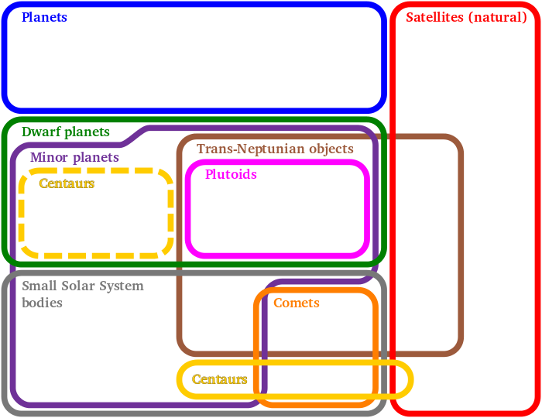

Slide 27



‘Oumuamua

Slide 28
Participants will be asked to complete one or more hands-on or interpretive tasks selected from the following topics:
i. History of and formation processes for the rocky bodies and their specific features
ii. Remote sensing, imagery, and satellite measurements
iii. Missions: New Horizons, Dawn, Cassini, Lucy, Voyager 2
iv. Kepler’s laws, gravitational effects of the Moon and tides
Rotation, libration, phases, and eclipses
iv. Surface dating, regolith, volcanism & weathering, cratering & impact processes
vi. Internal, surface, and atmospheric compositions

Slide 29

Remote Sensing and Surface Imagery
Electrostatic Analyzer
Radar Altimetry
Principles of Spectrometer

Slide 30



Missions: New Horizons, Dawn, Cassini, Lucy, Voyager 2
New Horizons
Voyager 2
Lucy

Slide 31
Kepler’s 1st Law
The orbit of a planet is an ellipse with the Sun at one of the two foci.

Slide 32
Kepler’s 2nd Law: “The Law of Equal Areas”
A line segment joining a planet and the Sun sweeps out equal areas during equal intervals of time.

Slide 33
Kepler’s 3rd Law: “The Harmonic Law”
T² = a³
The square of the orbital period of a planet is proportional to the cube of the semi-major axis of its orbit.

Slide 34
The Moon and Tides
Notes:
.

Slide 35

Solar Eclipses
Total Solar Eclipse
Annular Solar Eclipse

Slide 36

Lunar Eclipses
The Moon during a Lunar Eclipse is illuminated only by sunlight refracted around the Earth

Slide 37

Libration of Earth’s Moon
Cause of Latitudinal Libration
Cause of Diurnal Libration
Cause of Longitudinal Libration

Slide 38
Phases of Earth’s Moon

Slide 39


Cratering, Volcanism, Cryovolcanism, & Weathering
Scientists are currently working to understand resurfacing events on Haumea
Possible cryovolcano on surface of Pluto

Slide 40





2018 Solar System Event Example Exam & Event Resources
NASA Planets
JPL Planetary Geophysics
NASA Asteroids
NASA Space Place Eclipses
NASA Moon
Notes:
.

Slide 41
National Solar System Event Supervisors:
Dustin Schroeder - dschroed@gmail.com
Claire Burch – claire.b.burch@gmail.com
Rules clarifications:
available at www.soinc.org under event information

