Slide 1
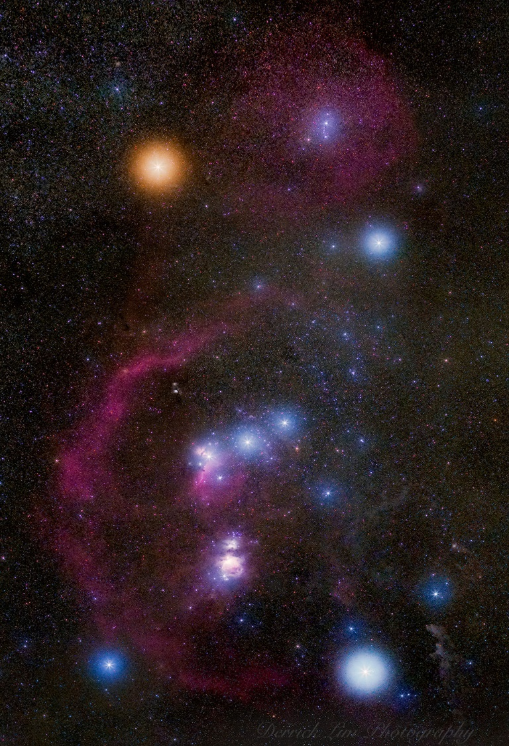
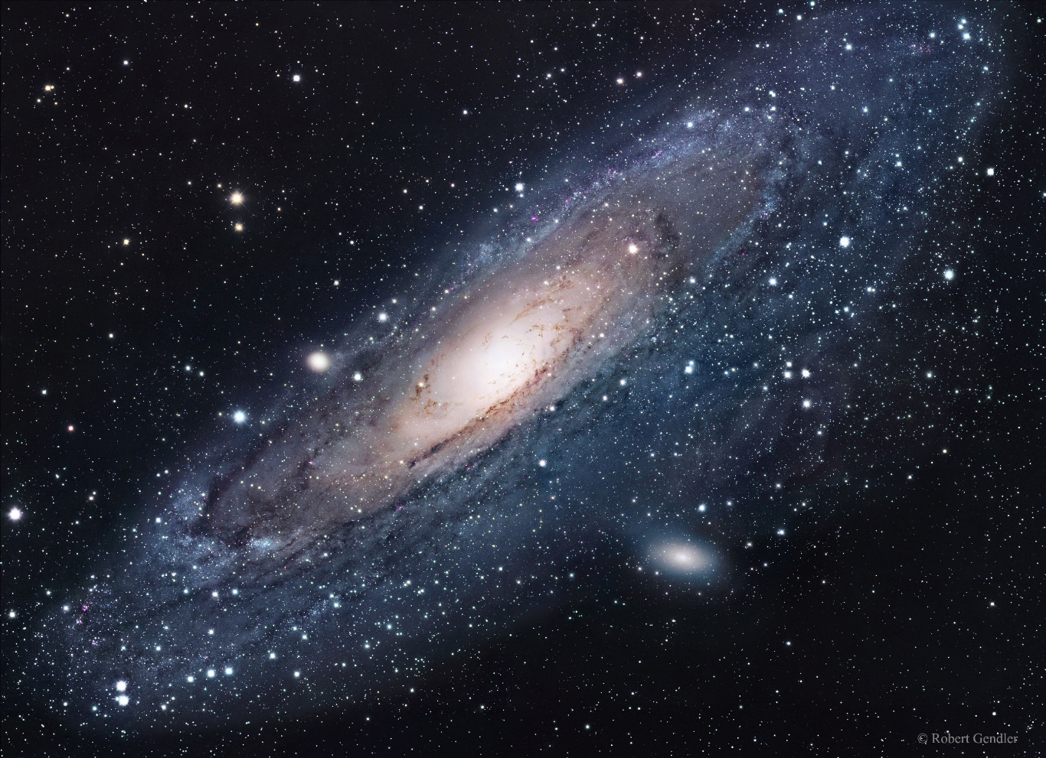
National Science Olympiad
Reach for the Stars B Event 2020
Properties and Evolution of Stars & Galaxies
Sponsored by NASA’s Universe of Learning STEM Literacy Network
Notes:
https://www.facebook.com/scioly2020/?ref=py_c

Slide 2
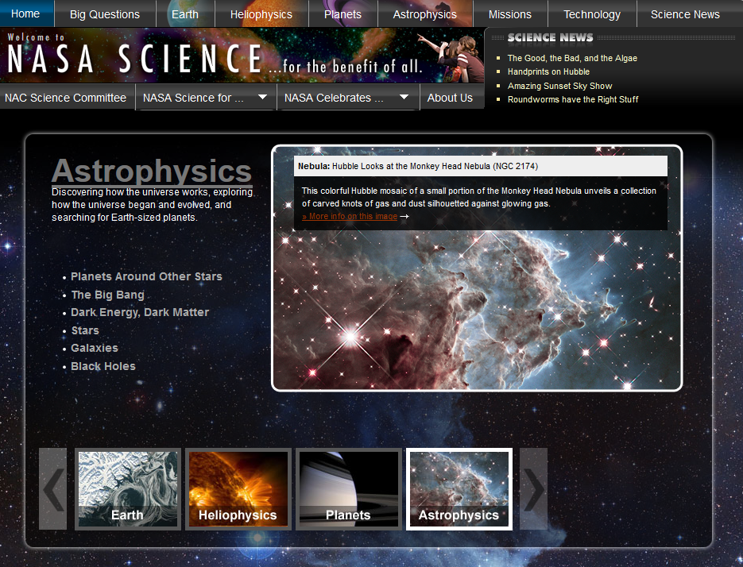
NASA Astrophysics Division/Chandra/NSO
Supported by the NASA Universe of Learning STEM Literacy Network
Notes:
http://science.nasa.gov/astrophysics/

Slide 3
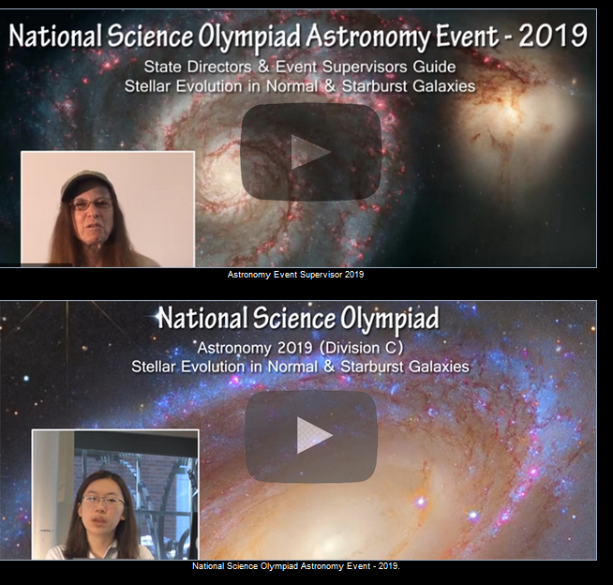
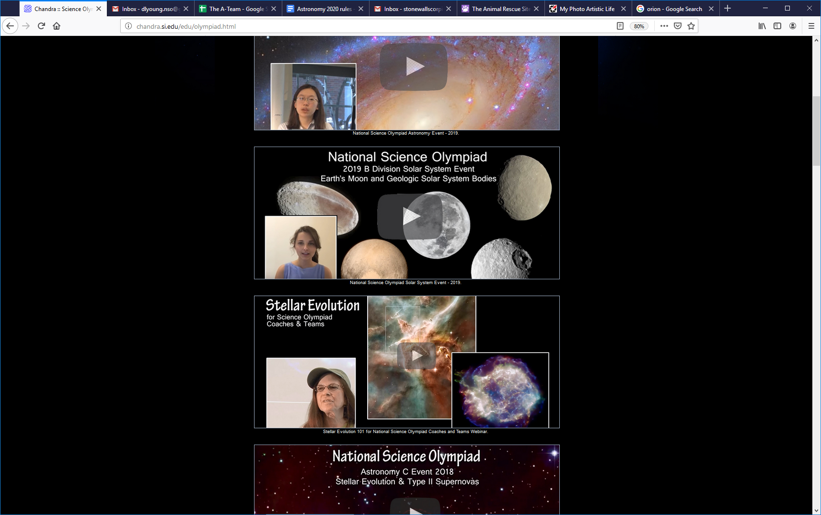
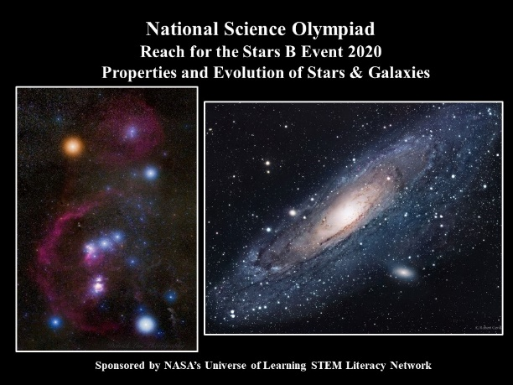
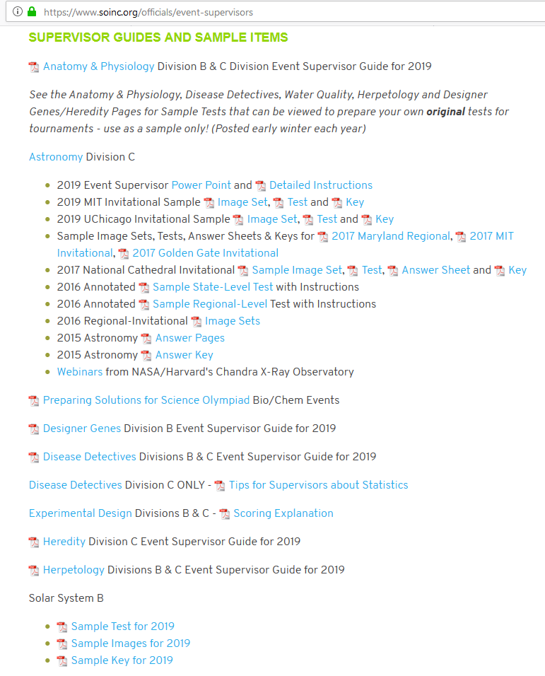
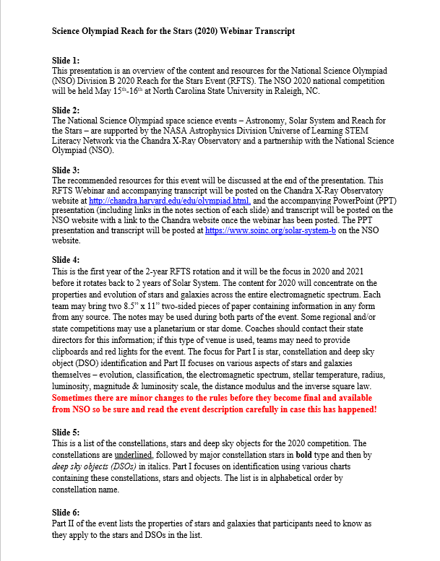
Chandra X-Ray Observatory
chandra.si.edu/edu/olympiad.html
Notes:
http://chandra.harvard.edu/edu/olympiad.html
https://www.soinc.org/solar-system-b

Slide 4
REACH FOR THE STARS, Division B
This is a final draft version and there may be minor changes
DESCRIPTION: Students will demonstrate an understanding of the properties and evolution of stars and galaxies, and their observation with different portions of the electromagnetic spectrum: Radio, Infrared, Visible, Ultraviolet, X-Ray & Gamma Ray.
EVENT PARAMETERS: Each team may bring only two 8.5”x11” two-sided pages
of information in any form from any source and may be asked to provide clipboards and red-filtered flashlights.
THE COMPETITION: This event is divided into two parts. Notes may be
used during both parts.
Part I: Constellation, Star, and Deep Sky Object Identification
Participants may be asked to identify the stars, constellations, and deep sky objects (DSOs) included in the list below as they appear on star chars, H-R diagrams, portable star labs, photos, or planetariums, and must be knowledgeable about the evolutionary states of all stars and deep sky objects on the list below. Note: Constellations are underlined; Stars are boldface; Deep Sky Objects (DSOs) are italicized
Notes:
https://www.soinc.org/events/2020-division-b-events

Slide 5
Part I: Constellations, Stars, and Deep Sky Objects
Andromeda: M31(Andromeda Galaxy) Orion: Betelgeuse, Rigel M42 (Orion Nebula)
Aquila: Altair Perseus: Algol NGC 1333
Auriga: Capella Sagittarius: SgrA*, M8 (Lagoon Nebula)
Bootes: Arcturus Sextans: J100054+023436 (Baby Boom)
Canis Major: Sirius Scorpius: Antares NGC 6357 (Lobster
Canis Minor: Procyon Nebula), NGC 6334 (Cat’s Paw Nebula)
Centaurus: NGC 5128 (Cen A) Taurus: Aldebaran T Tauri
Coma Berenices: NGC 4555, Tucana: Small Magellanic Cloud (SMC)
NGC 4676 (The Mice) Ursa Major: Mizar, Alcor GN-z11,
Corvus: NGC 4038 & 4039 (Antennae) M101 (Pinwheel Galaxy)
Crux: Dragonfish Nebula Ursa Minor: Polaris
Cygnus: Deneb Virgo: Spica M60, M104 (Sombrero Galaxy)
Dorado: 30 Doradus (Tarantula Nebula),
Large Magellanic Cloud (LMC)
Gemini: Castor, Pollux
Lyra: Vega
Ophiuchus: Zeta Ophiuchi Rho Ophiuchi Cloud Complex
Notes:
https://www.soinc.org/events/2020-division-b-events

Slide 6
REACH FOR THE STARS, Division B
DESCRIPTION: Students will demonstrate an understanding of the properties and evolution of stars and galaxies, and their observation with different portions of the electromagnetic spectrum: Radio, Infrared, Visible, Ultraviolet, X-Ray & Gamma Ray.
Part II:
i: Stellar and galactic evolution
ii: Spectral classification of stars
iii: Hubble classification of galaxies
iv: Observations using multiple portions of the electromagnetic spectrum
    v: The relationship between stellar temperature, radius, and luminosity
    vi. Magnitude & luminosity scales, distance modulus, inverse square law
Notes:
https://www.soinc.org/events/2020-division-b-events

Slide 7
Deep Sky Objects by Type
Stars (19):
Altair, Capella, Arcturus, Sirius, Procyon, Deneb, Castor, Pollux,
Vega, Zeta Ophiuchi, Betelgeuse, Rigel, Algol, Antares, Aldebaran,
Mizar, Alcor, Polaris, Spica
Galaxies (12 ):
M31 (Andromeda), NGC 5128 (Cen A), GN-z11, M101 (Pinwheel), M104 (Sombrero), LMC, SMC, M60, NGC 4555, NGC 4676 (The Mice), NGC 4038-4039 (Antennae), J100054+023436 (Baby Boom)
Star Formation Nebulas/Regions (8):
30 Doradus, Dragonfish Nebula, rho Ophiuchi Cloud Complex,
M42 (Orion Nebula), NGC 1333 (star cluster), M8 (Lagoon Nebula), NGC 6357 The Lobster Nebula, NGC 6334 (Cat’s Paw Nebula)
Others: Sgr A*: black hole at center of Milky Way Galaxy (MWG)
T Tauri: protostar

Slide 8
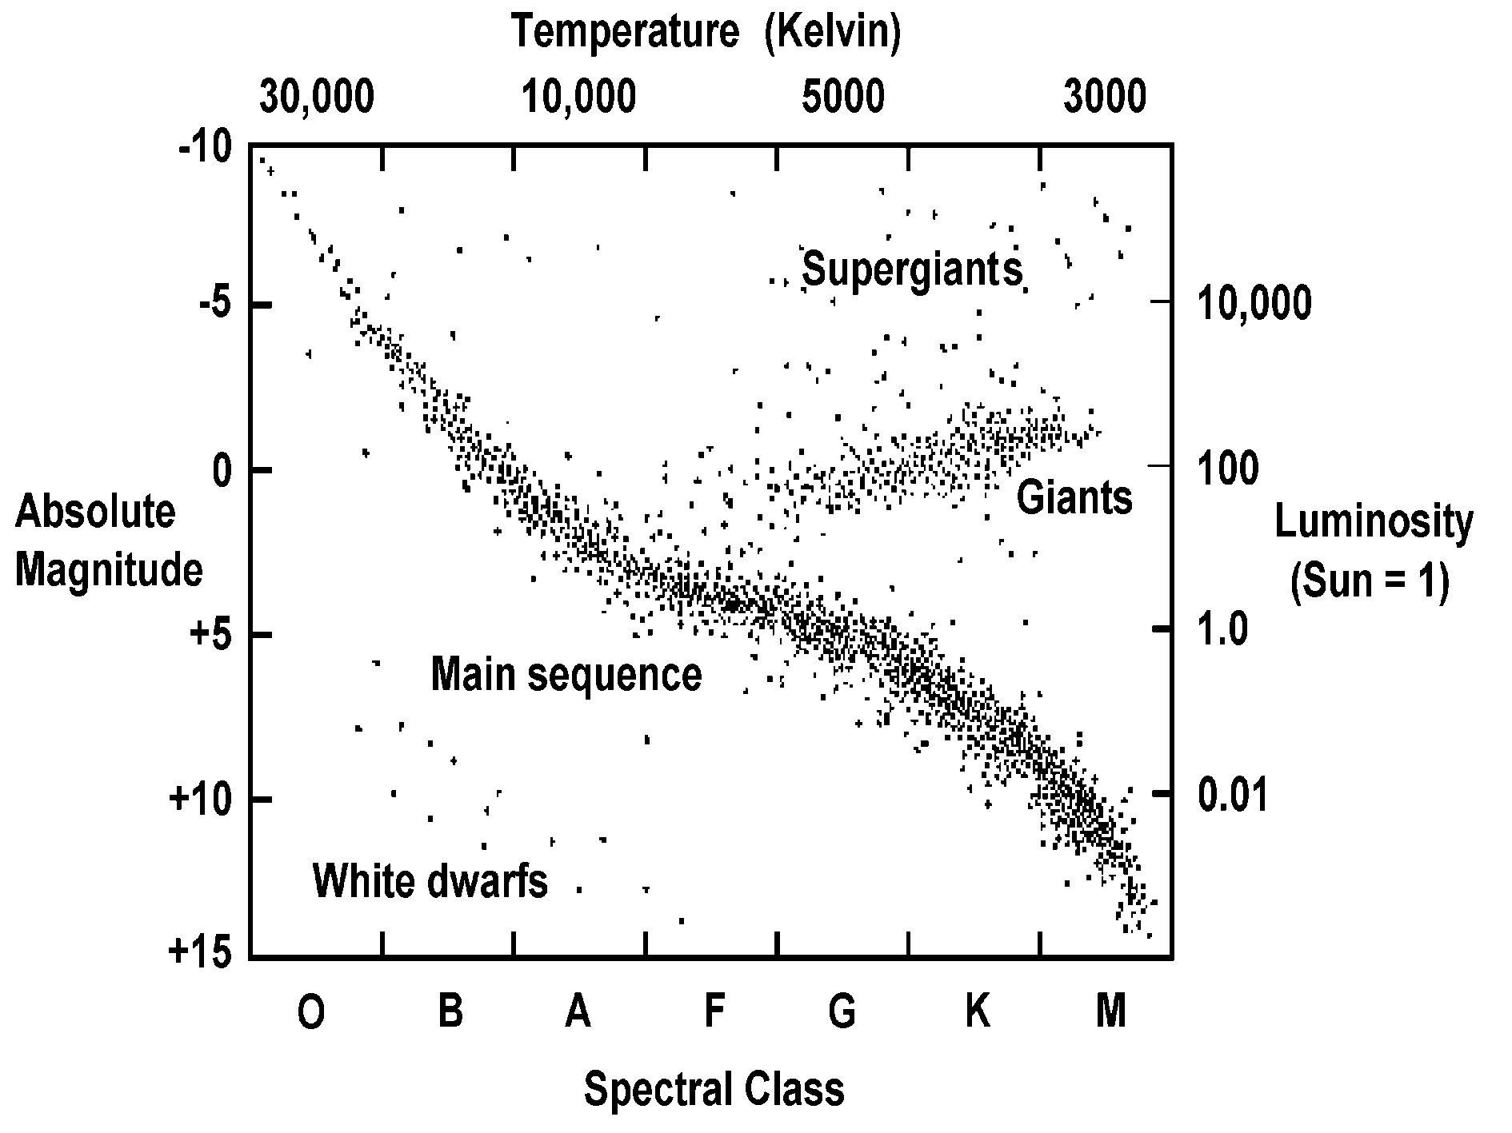
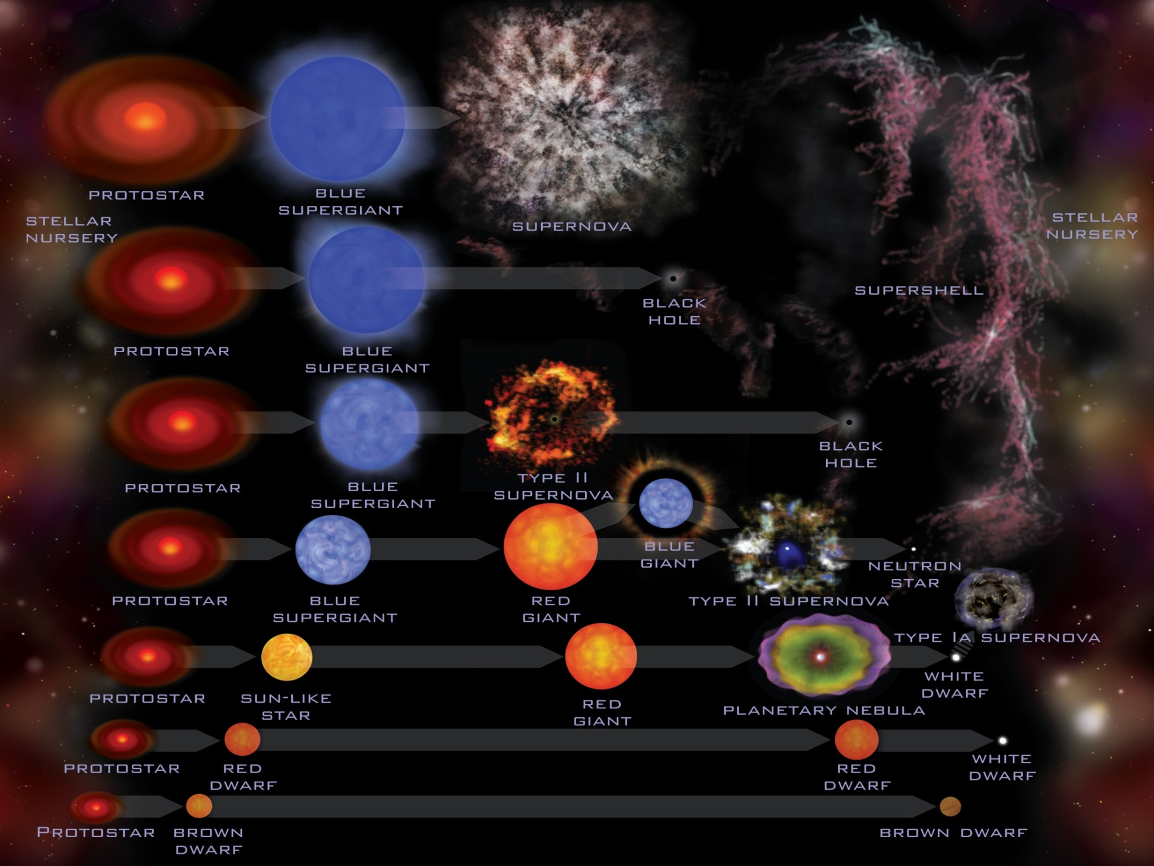
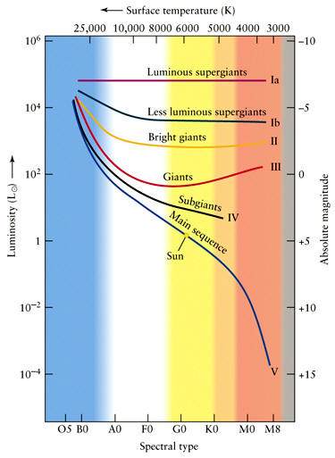
Stellar Evolution & H-R Diagram Overview
Notes:
http://chandra.si.edu/edu/olympiad.html
http://chandra.si.edu/edu/formal/stellar_ev/story/index3.html
http://chandra.si.edu/edu/formal/stellar_ev/story/index4.html

Slide 9
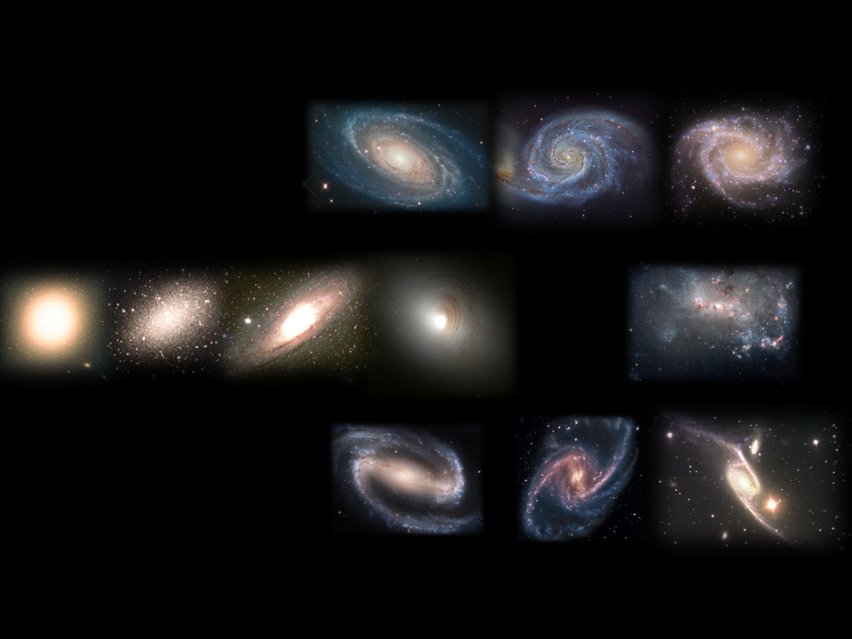
The Hubble Classification of Galaxies
Spirals, Ellipticals, Lenticular and Irregular
Notes:
https://en.wikipedia.org/wiki/Galaxy_morphological_classification
https://www.spacetelescope.org/news/heic1315/

Slide 10
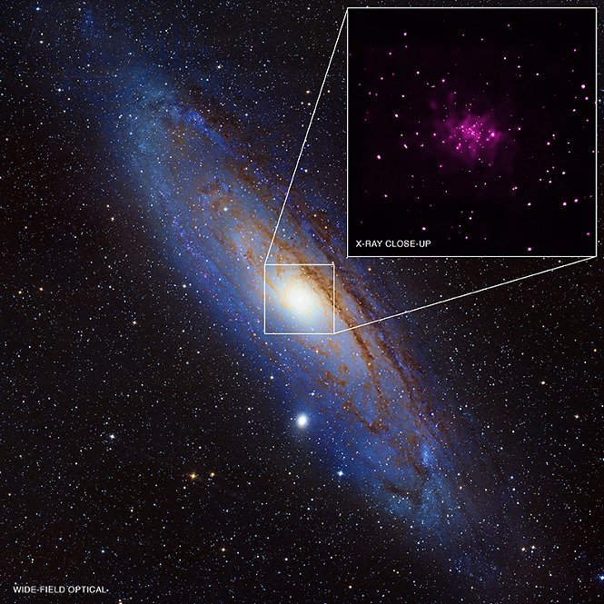
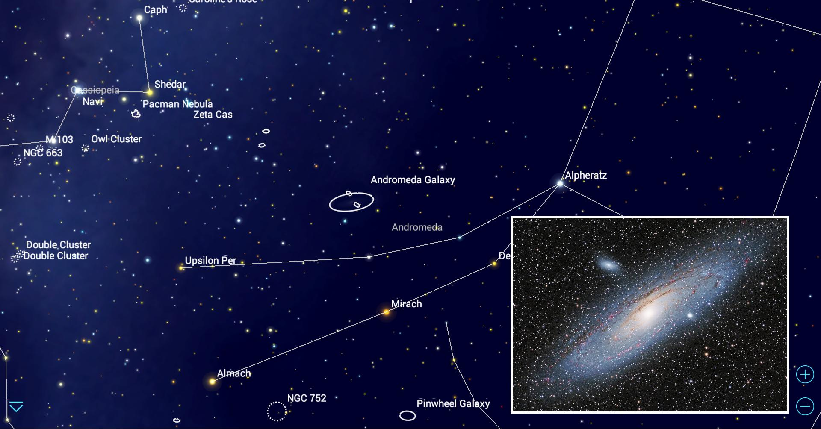
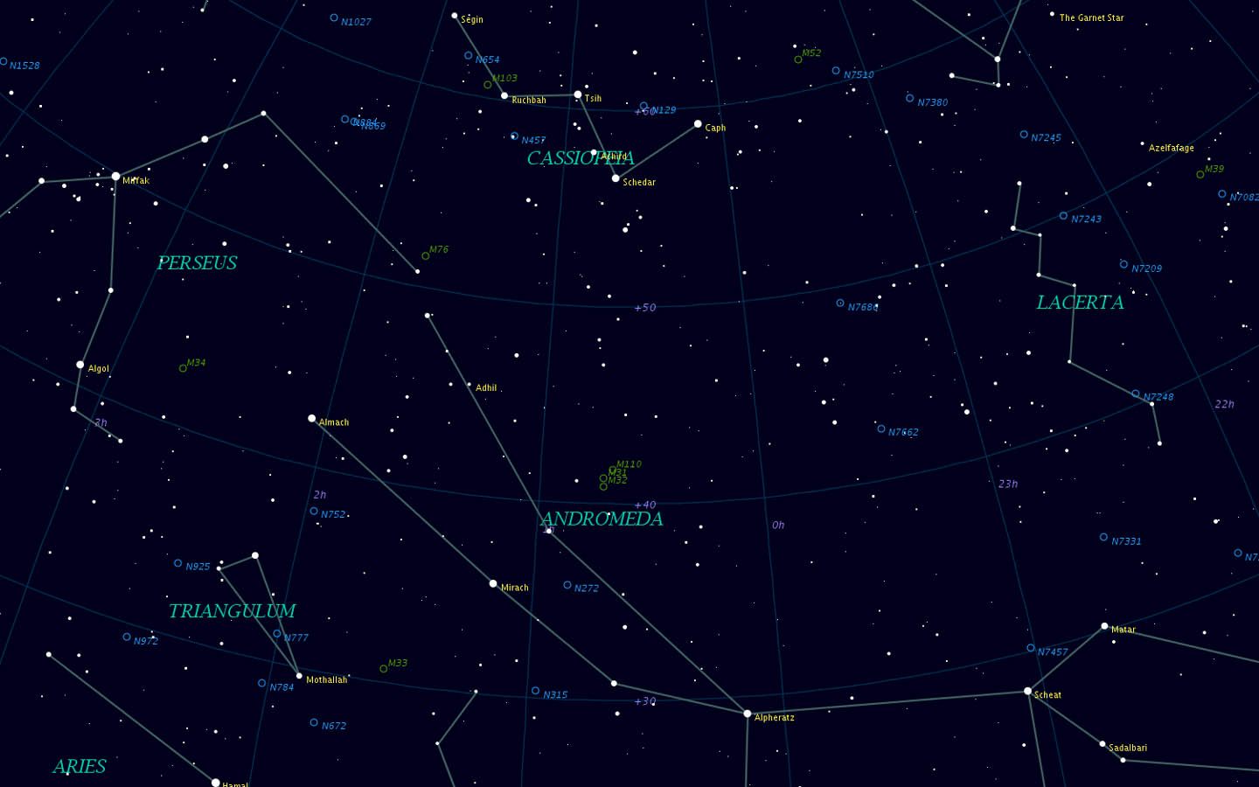
The Andromeda Constellation & Galaxy (M31)
Notes:
https://www.nasa.gov/mission_pages/chandra/multimedia/bonanza_image.html
http://chandra.harvard.edu/photo/2013/m31/

Slide 11
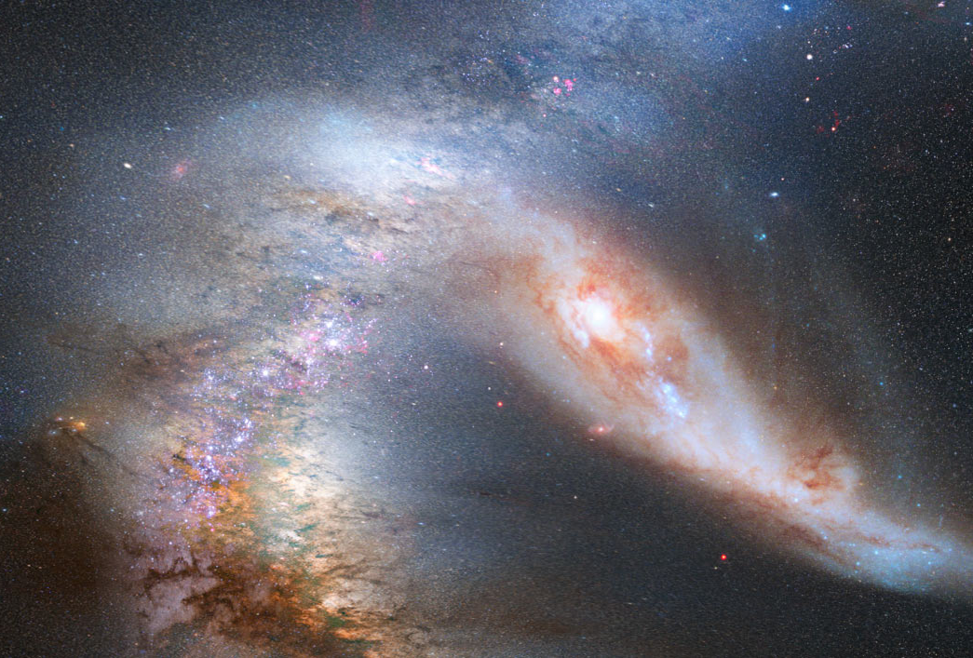
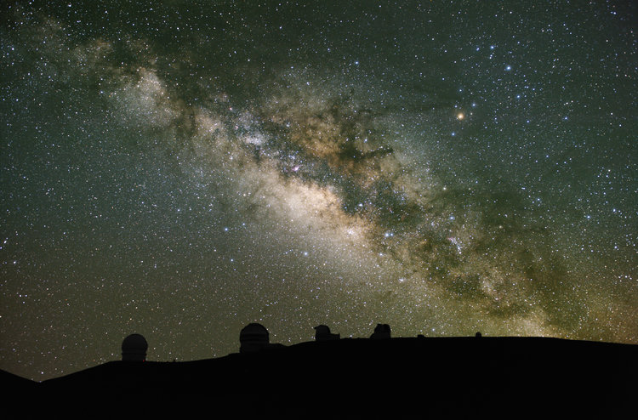
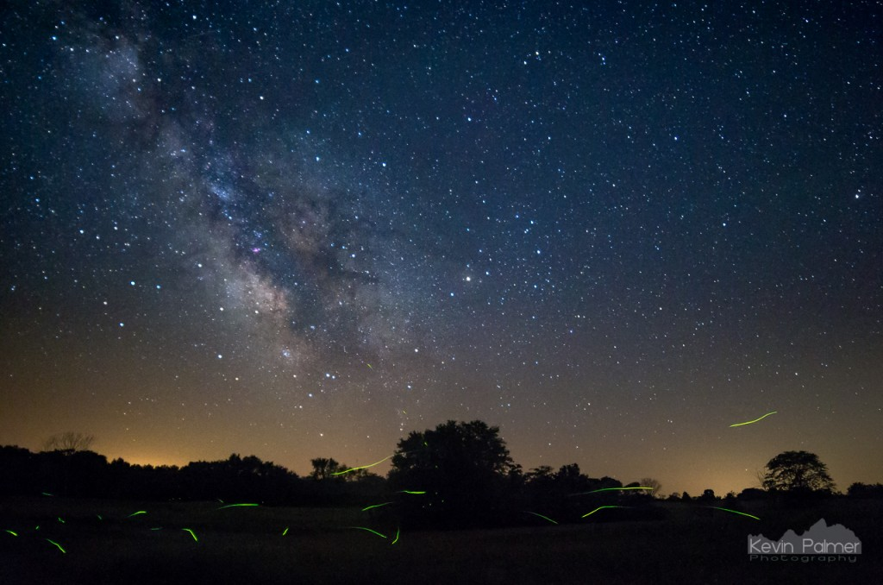
Notes:
https://apod.nasa.gov/apod/ap120604.html

Slide 12
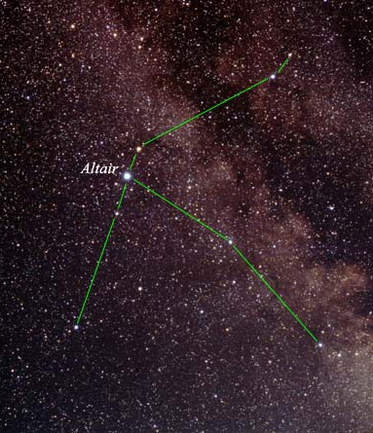
Aquila: Altair (A7IV/V)
Notes:
https://www.jpl.nasa.gov/spaceimages/details.php?id=PIA04204

Slide 13
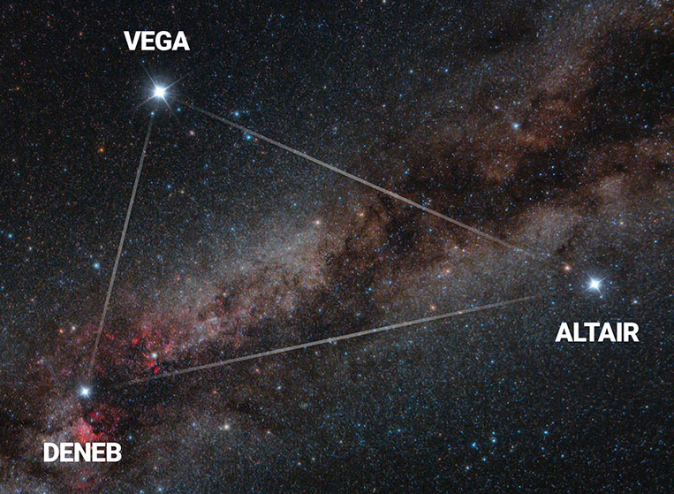
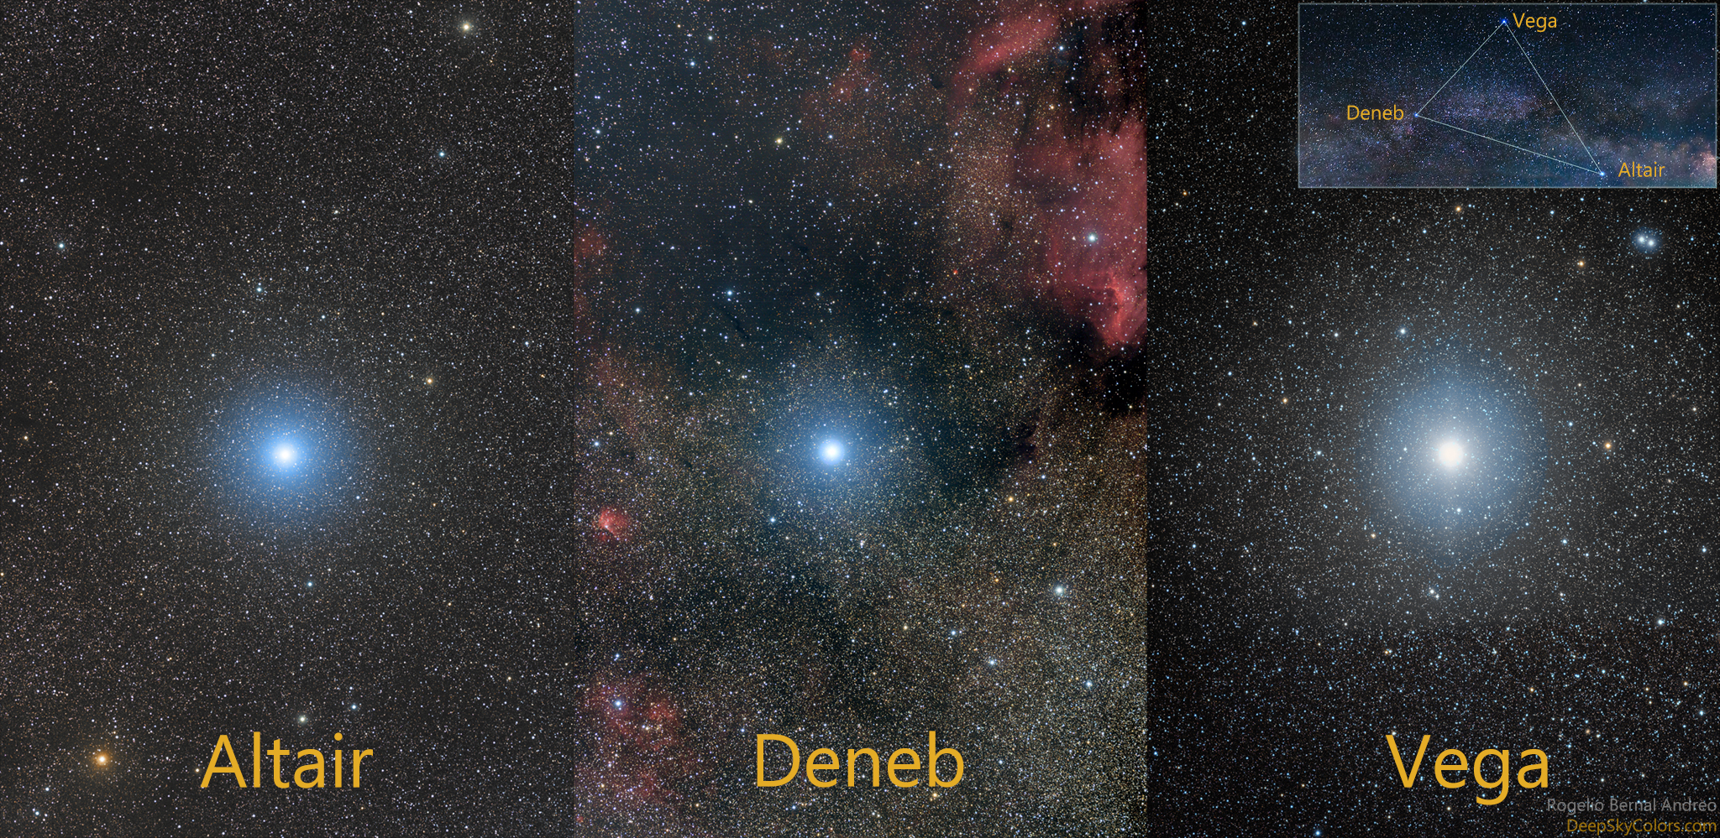
The Summer Triangle
Notes:
https://earthsky.org/favorite-star-patterns/summer-triangle-asterism-vega-deneb-altair

Slide 14
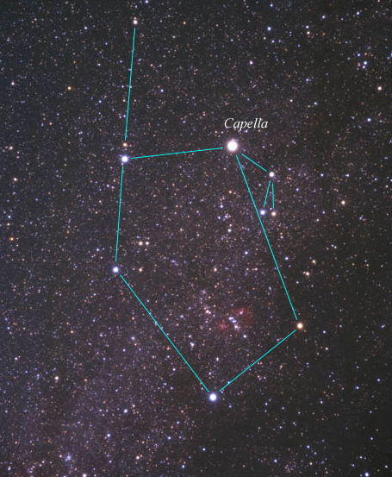
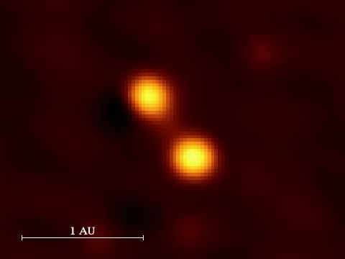
Auriga: Capella A & B(K0/G1III)
Notes:
http://earthsky.org/brightest-stars/capella-is-the-stellar-beacon-of-auriga-the-charioteer

Slide 15
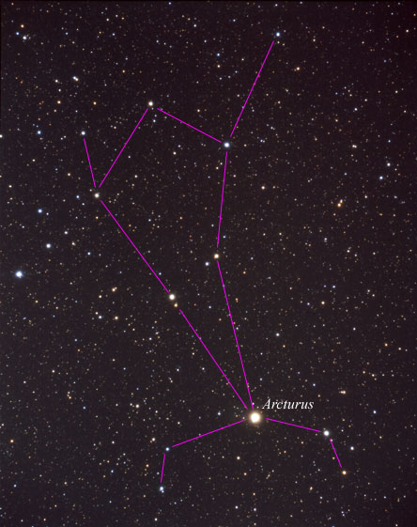
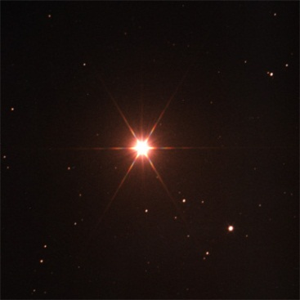
Bootes: Arcturus (K0III)
Notes:
http://earthsky.org/brightest-stars/bright-orange-arcturus-use-the-big-dipper-to-find-it

Slide 16
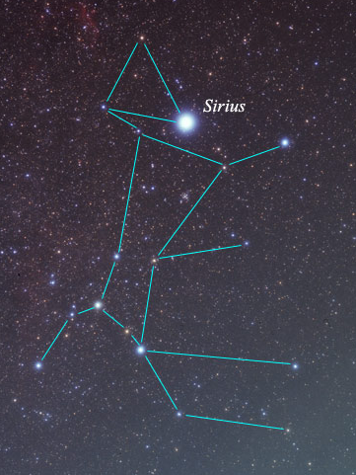
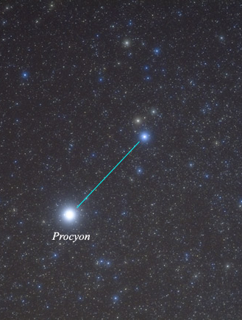
Sirius A & B
Procyon A & B
Canis Major: Sirius (A1V)
& white dwarf companion
Canis Minor: Procyon (F5IV)
& white dwarf companion
Notes:
http://earthsky.org/brightest-stars/procyon-harbringer-of-the-dog-star

Slide 17
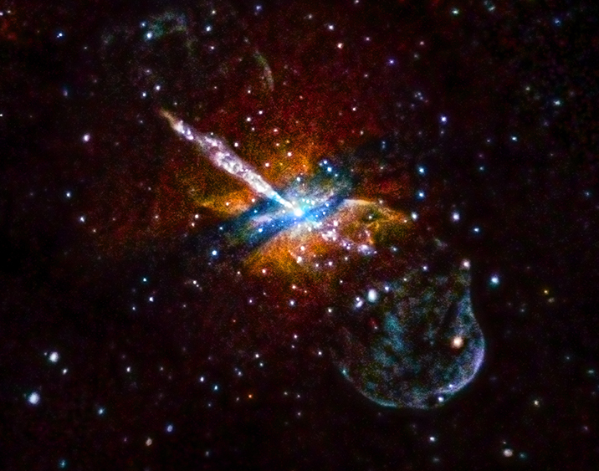
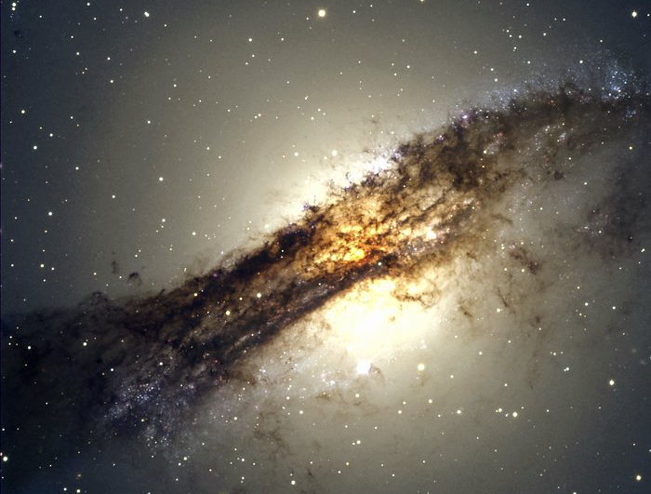
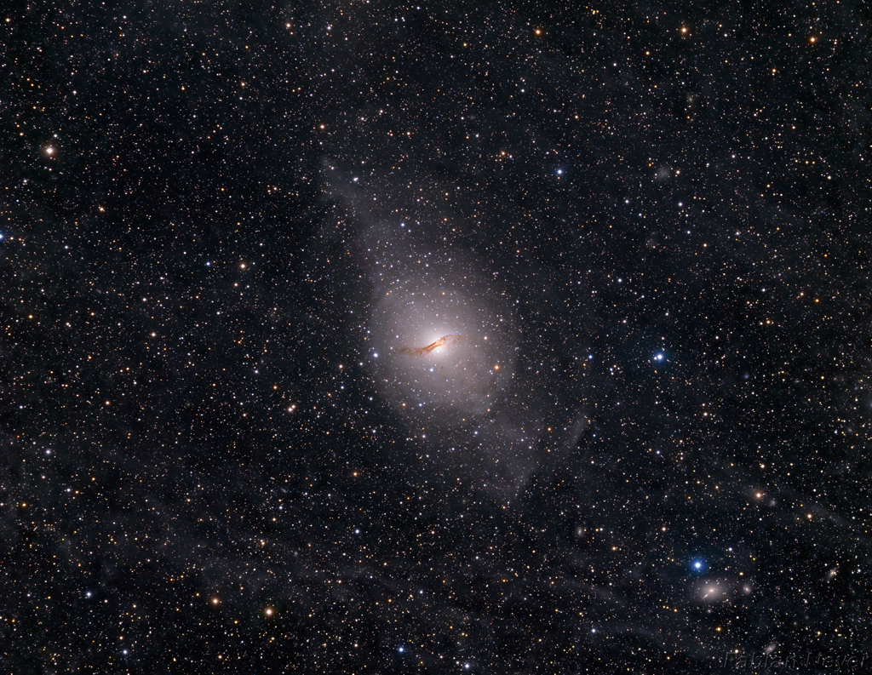
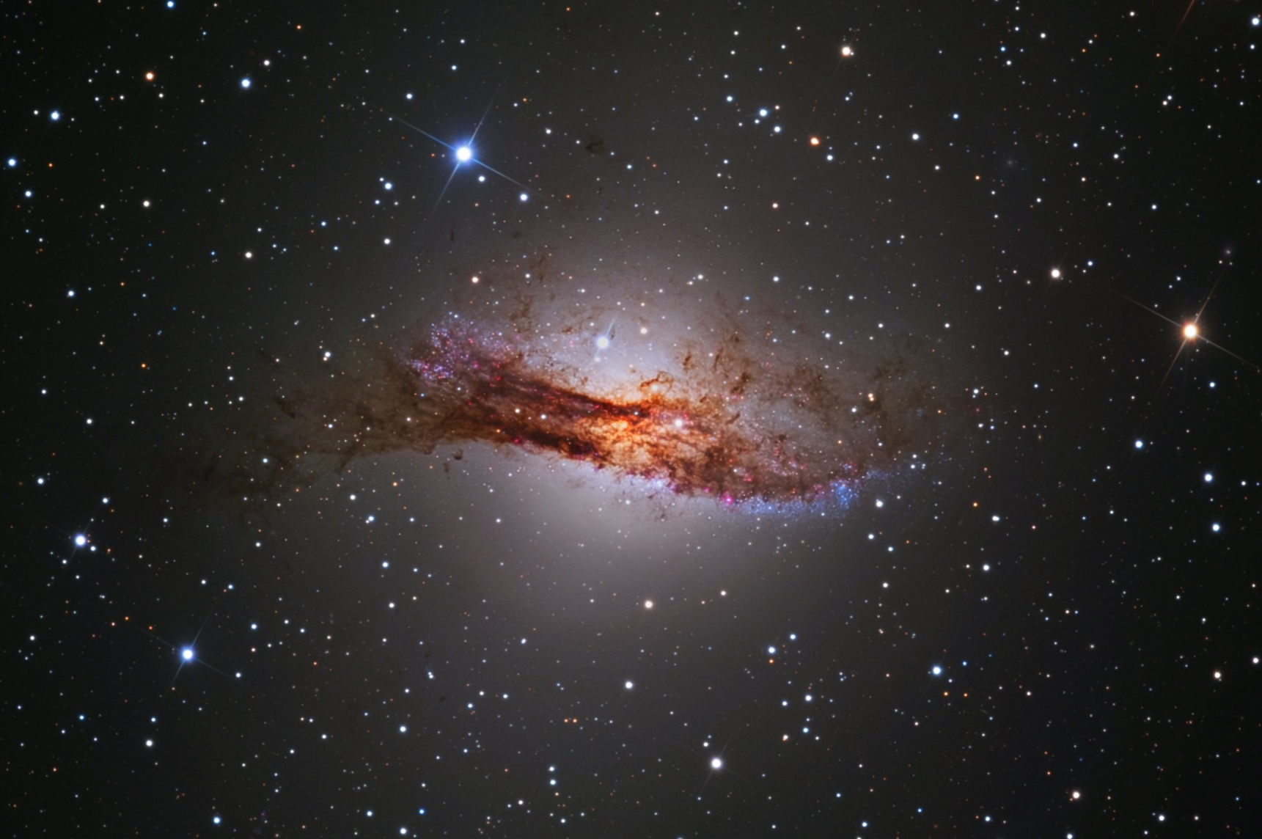
Centaurus A (NGC 5128) Active Starburst Galaxy
Notes:
https://apod.nasa.gov/apod/ap170309.html
http://chandra.harvard.edu/photo/2014/cena/

Slide 18
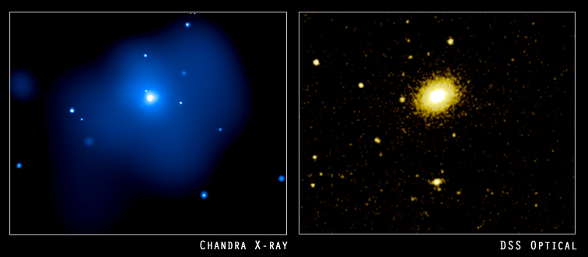
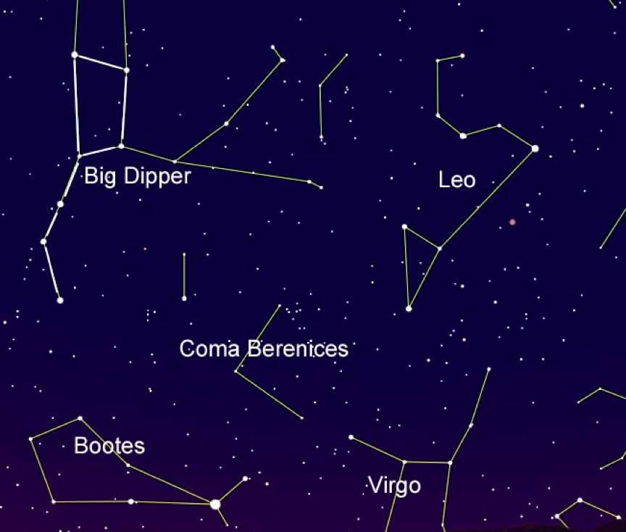
Coma Berenices & Galaxy NGC 4555
Notes:
https://otagomuseum.nz/blog/constellation-of-the-month-coma-berenices/
http://chandra.harvard.edu/photo/2004/ngc4555/

Slide 19
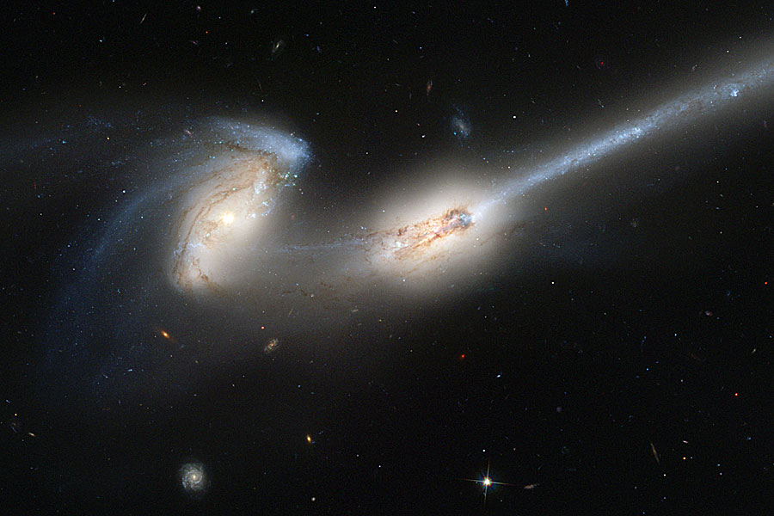
Coma Berenices & Galaxy NGC 4676
A.K.A. The Mice
Notes:
https://apod.nasa.gov/apod/ap150201.html
http://hubblesite.org/image/1191/news_release/2002-11

Slide 20
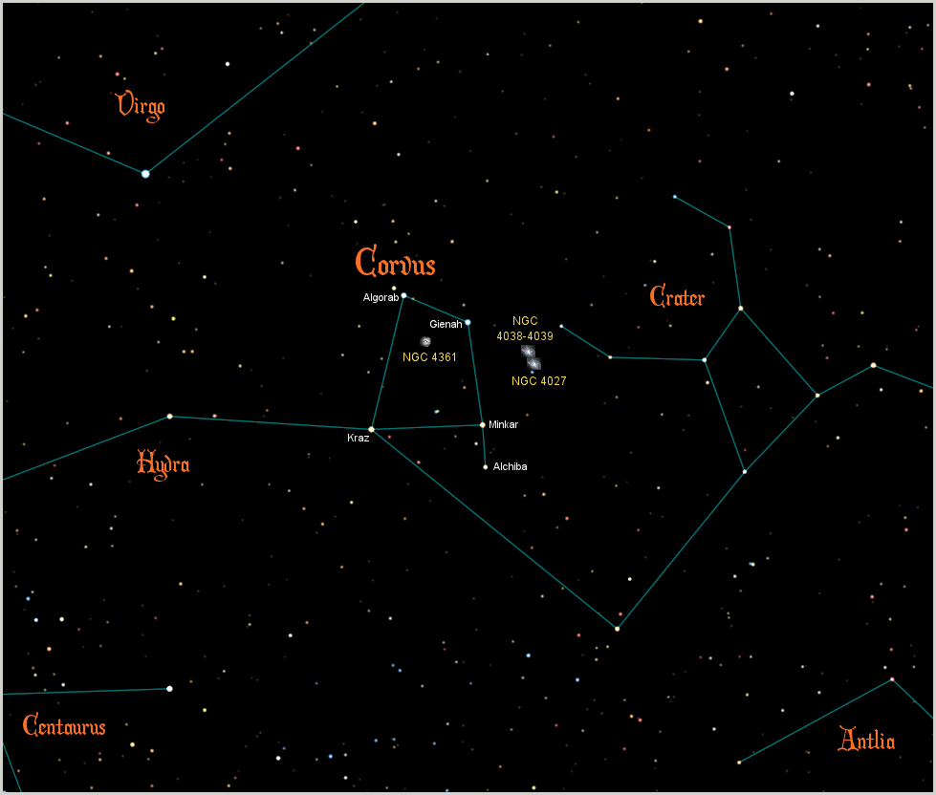
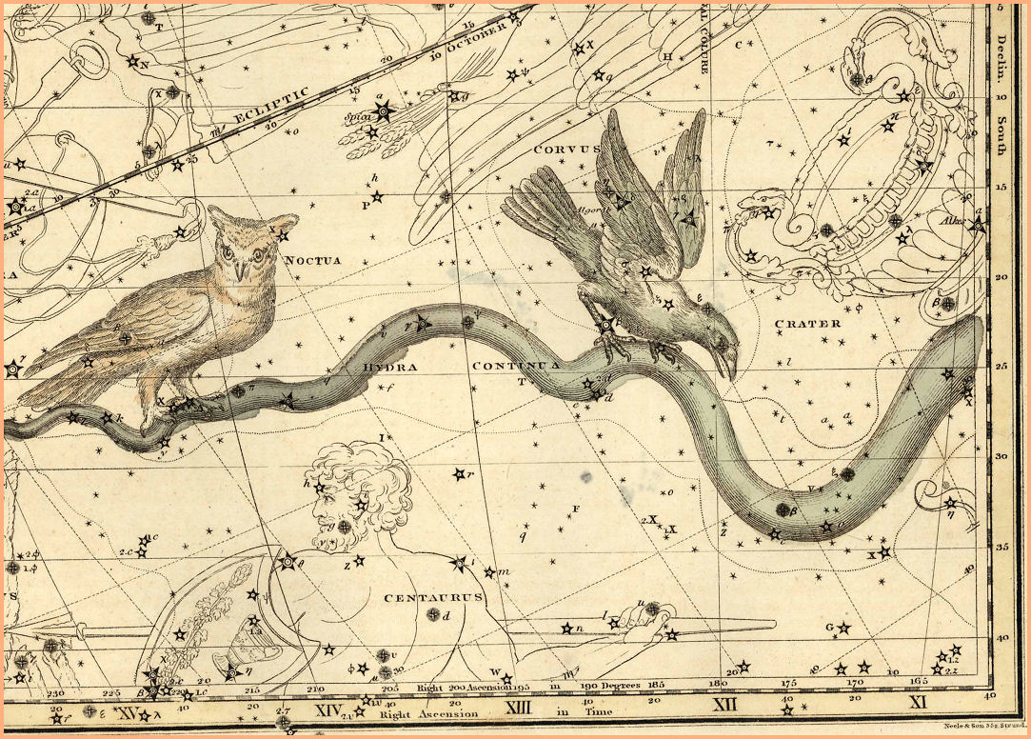
Corvus the Crow
Notes:
http://www.peoplesguidetothecosmos.com/constellations/corvus.htm

Slide 21
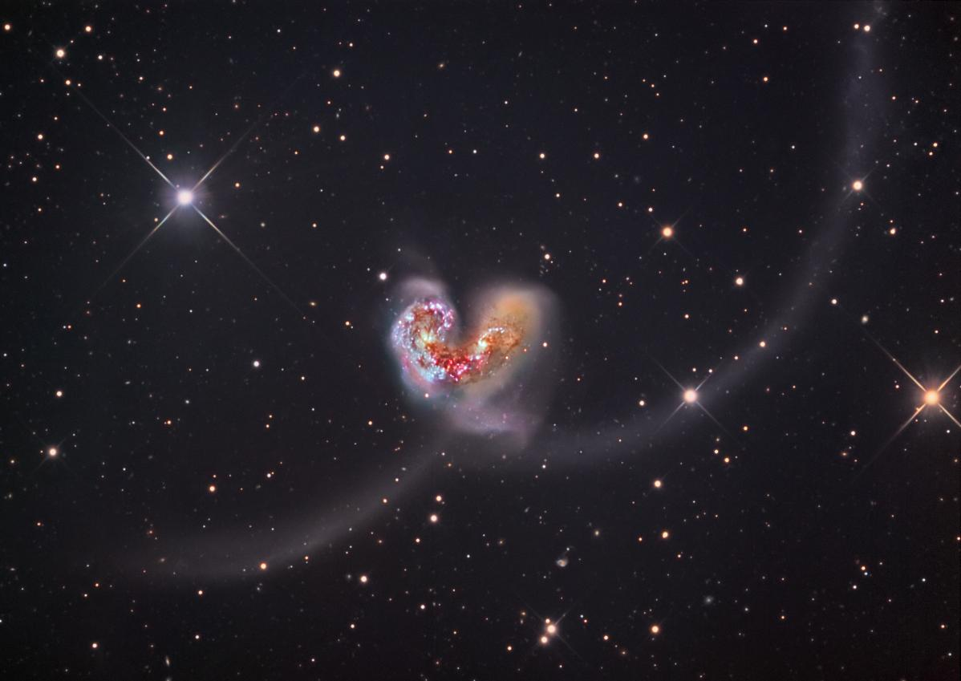
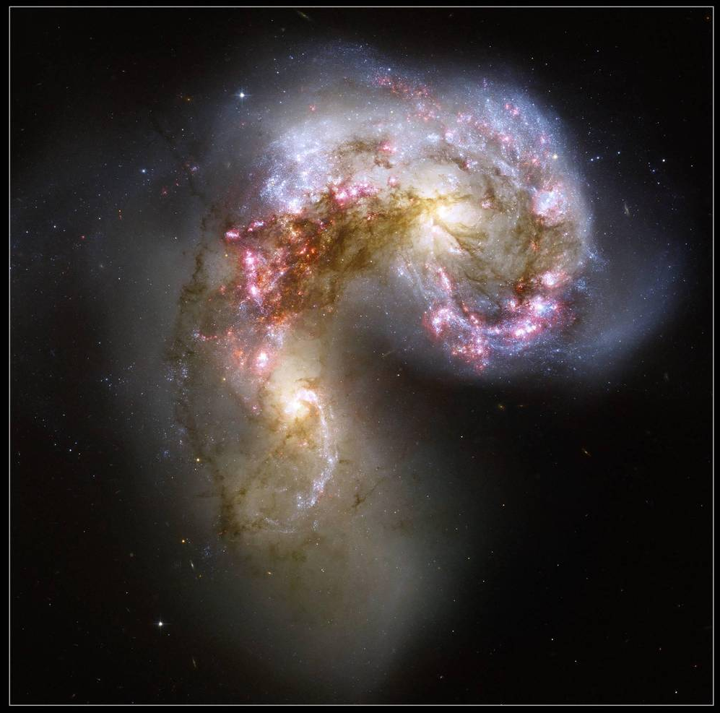
Corvus and Interacting Galaxies NGC 4038 & 4039
A.K.A The Antennae
Notes:
https://www.nasa.gov/multimedia/imagegallery/image_feature_1086.html
https://hubble25th.org/images/20

Slide 22
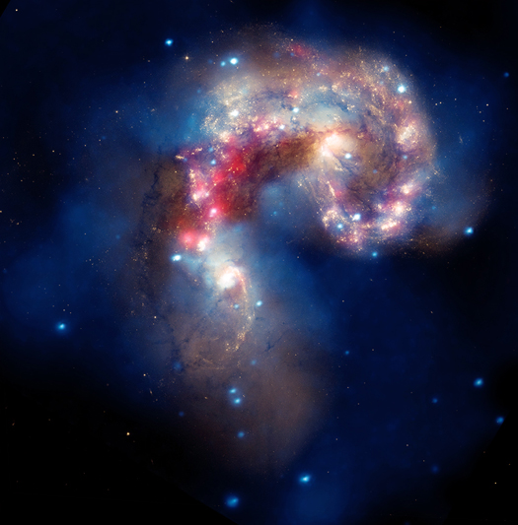
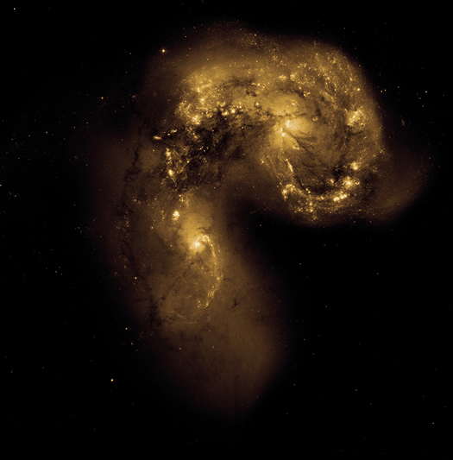
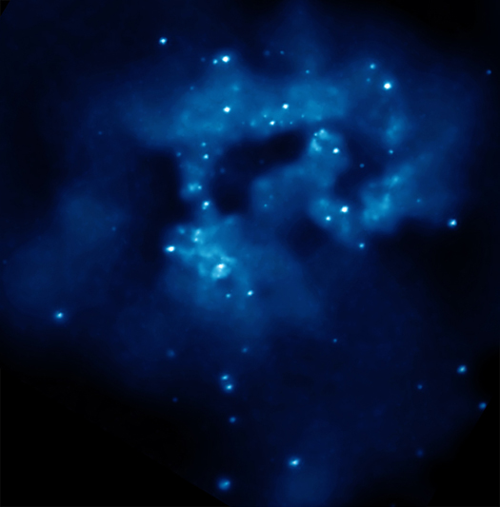
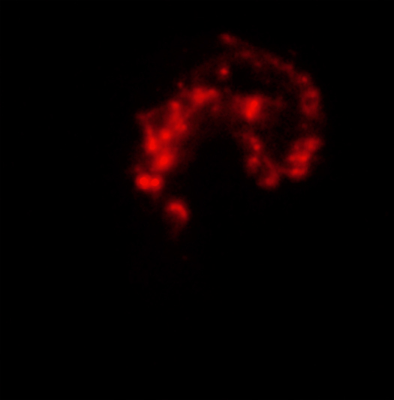
Antennae Interacting Galaxies – Optical, IR, X-Ray, Composite
Hubble
Spitzer
Chandra
Composite
Notes:
https://apod.nasa.gov/apod/ap061024.html
http://chandra.harvard.edu/photo/2010/antennae/

Slide 23
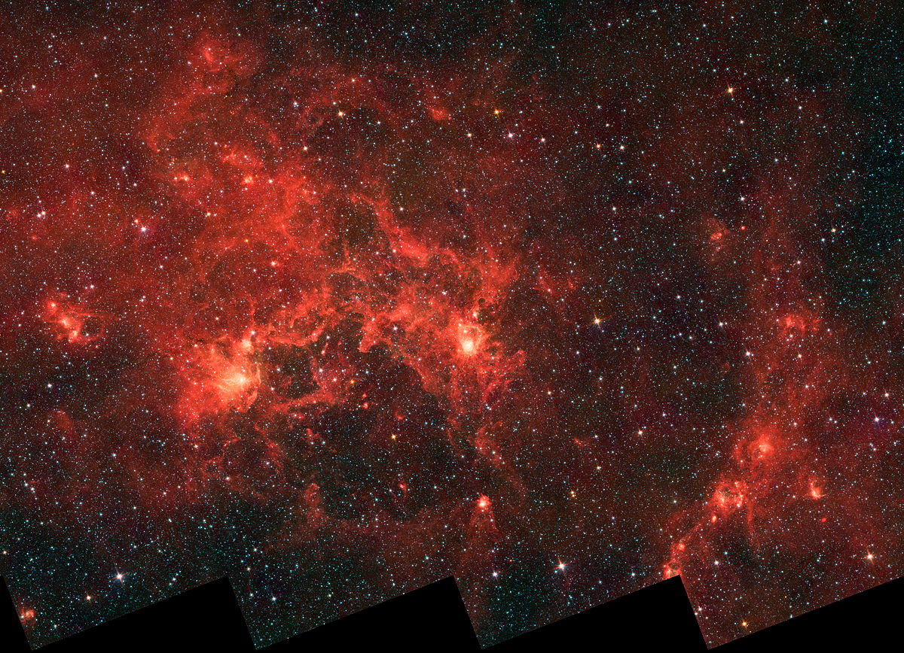
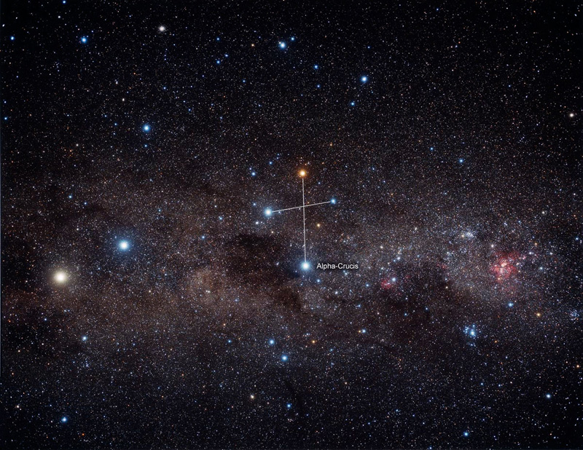
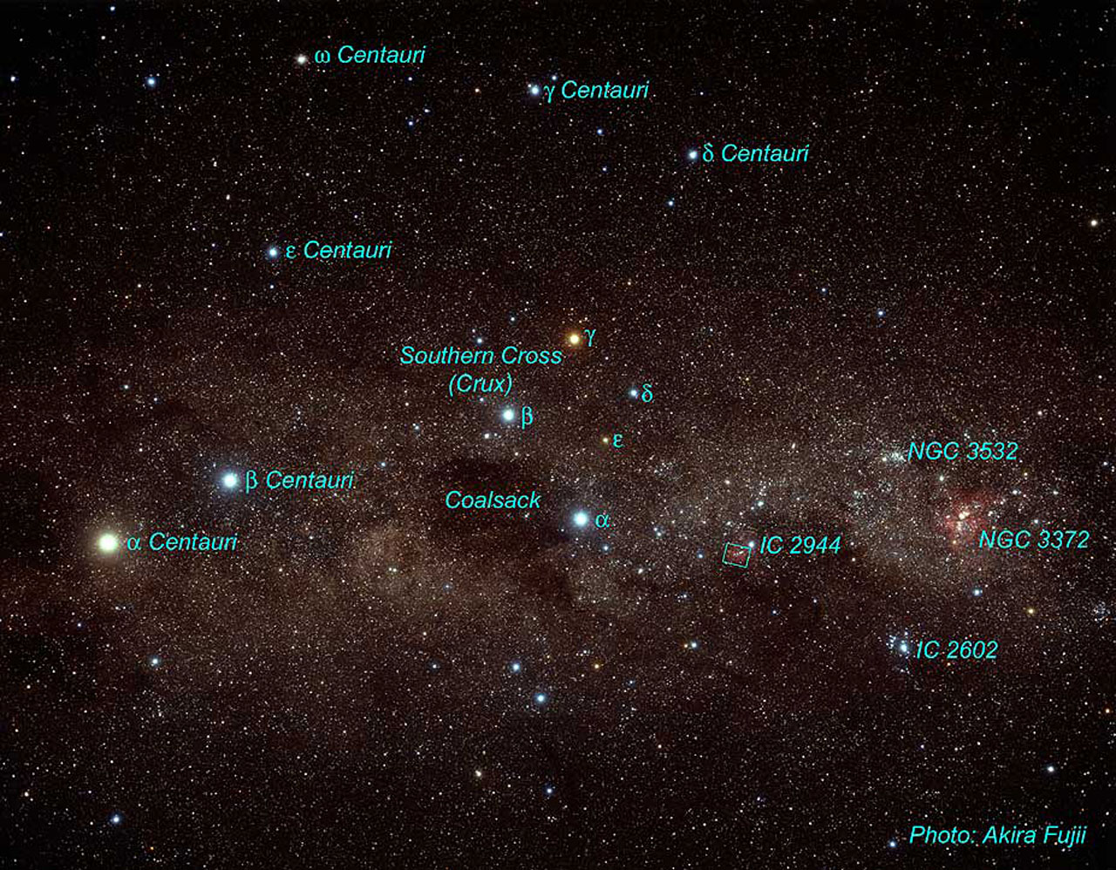
Crux – The Southern Cross
Dragonfish Nebula
Notes:
http://annesastronomynews.com/photo-gallery-ii/nebulae-clouds/the-dragonfish-nebula-g298/

Slide 24
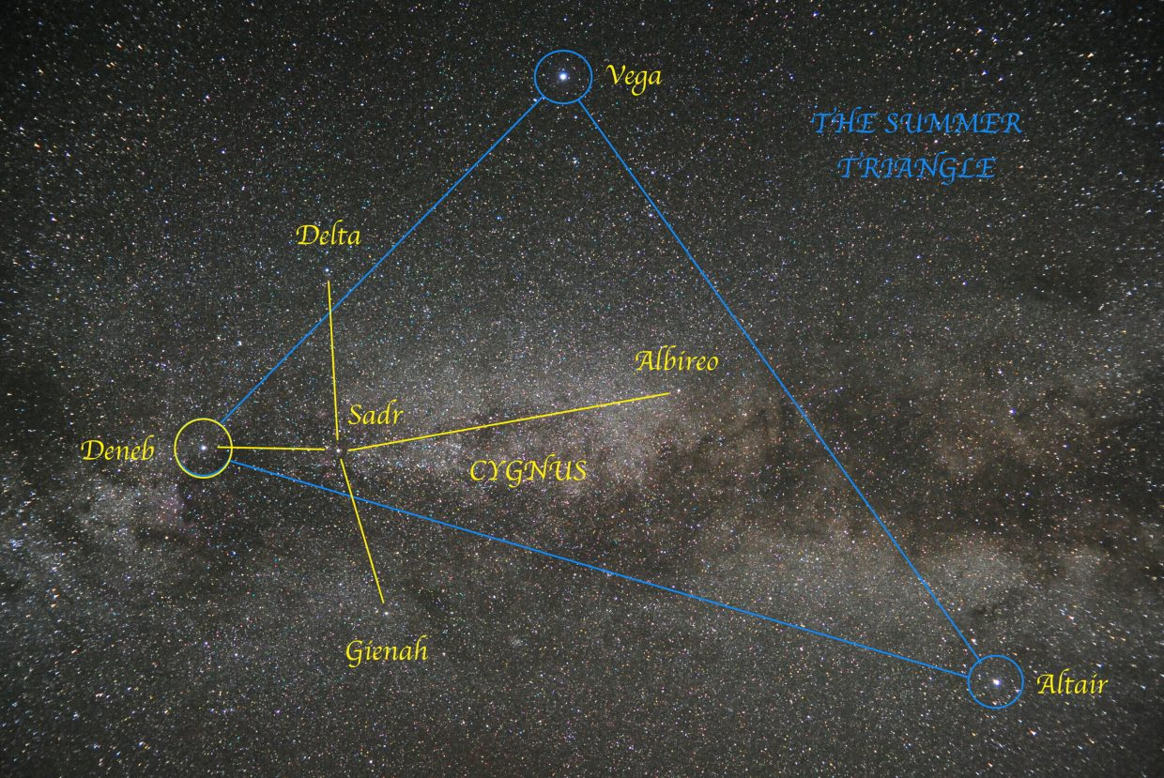
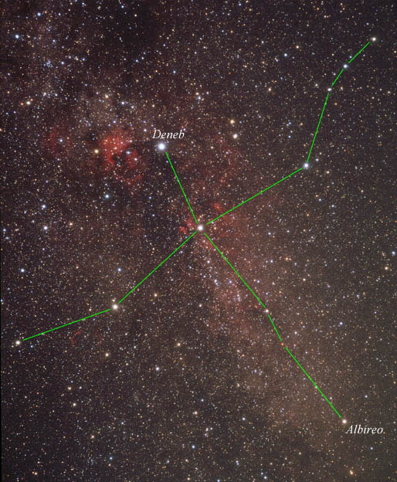
Cygnus The Northern Cross & Deneb (A2I)
Notes:
https://www.skyandtelescope.com/astronomy-resources/stargazing-basics/learn-the-sky/meet-deneb-the-bright-but-distant-star/

Slide 25
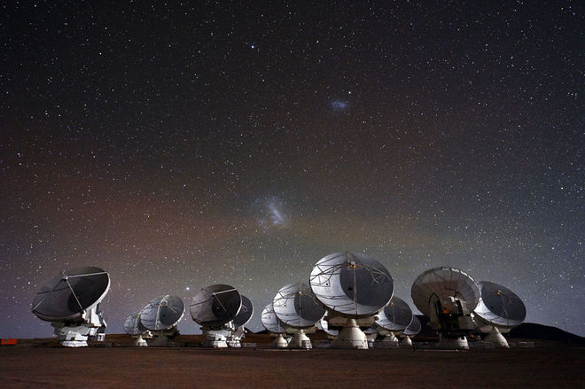
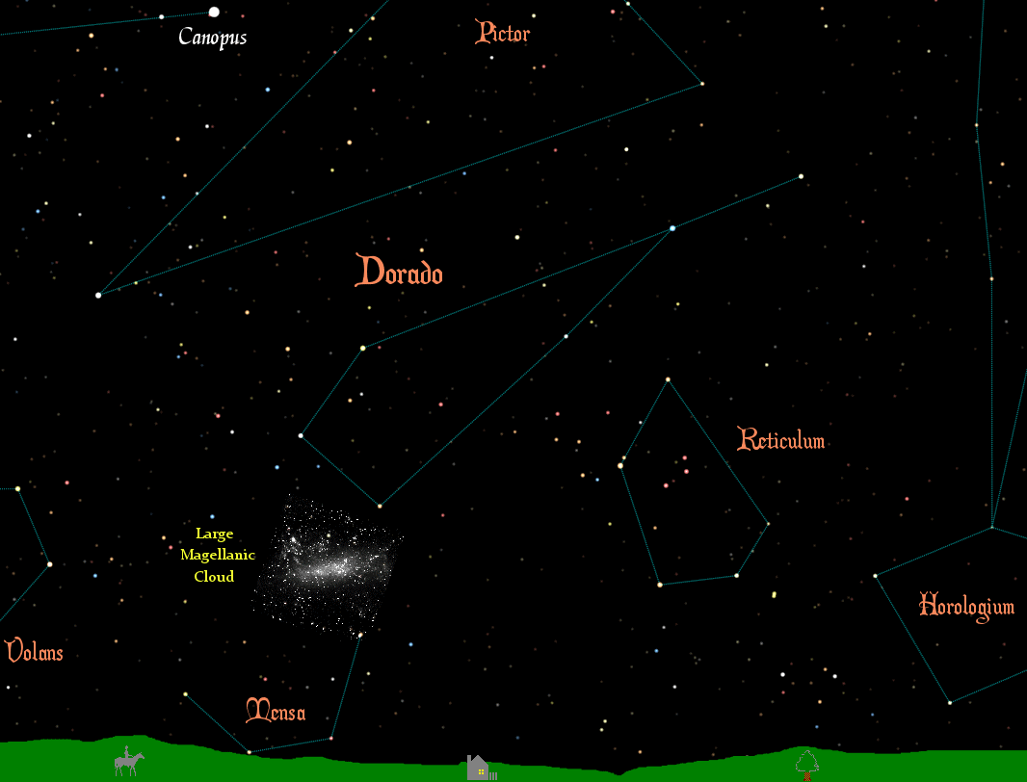
Doradus: Large Magellanic Cloud (LMC)
Notes:
http://earthsky.org/clusters-nebulae-galaxies/the-large-magellanic-cloud
https://en.wikipedia.org/wiki/Local_Group

Slide 26
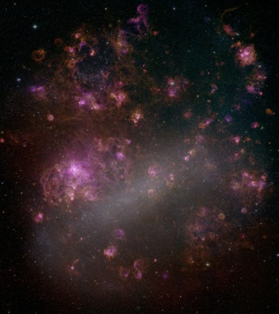

Doradus: 30 Doradus (Tarantula Nebula)
MCELS, University of Michigan
30 Doradus
Star Formation Region
Notes:
http://chandra.harvard.edu/photo/2008/30dor/
http://chandra.harvard.edu/photo/2008/30dor/

Slide 27

Gemini: Castor (A1V) & Pollux (K0III)
Notes:
http://www.windows2universe.org/the_universe/Constellations/gemini.html

Slide 28



Lyra: Vega (A0V)
Notes:
https://www.noao.edu/outreach/press/pr06/pr0603.html

Slide 29


Ophiuchus: Zeta Ophiuchi – 09.5V
Notes:
http://apod.nasa.gov/apod/ap150705.html
http://www.nasa.gov/mission_pages/WISE/multimedia/gallery/pia13455.html
http://www.spitzer.caltech.edu/images/5517-sig12-014-Massive-Star-Makes-Waves

Slide 30




The rho Ophiuchi Cloud Complex
Notes:
https://apod.nasa.gov/apod/ap160705.html
https://apod.nasa.gov/apod/ap190513.html
http://www.spitzer.caltech.edu/images/1891-ssc2008-03a1-Young-Stars-in-Their-Baby-Blanket-of-Dust-Rho-Ophiuchi

Slide 31


Orion: Betelgeuse (M2I), Rigel (B8I)
M42
Notes:
https://en.wikipedia.org/wiki/Orion_%28constellation%29

Slide 32





M42 (Great Orion Nebula) – Star Formation Region
Astrophotography
Hubble
Astrophotography
Chandra X-Ray
Hubble
Notes:
http://apod.nasa.gov/apod/ap050710.html
http://chandra.harvard.edu/photo/2007/orion/
http://chandra.harvard.edu/photo/2005/orion/

Slide 33



Perseus: Algol (B8V)
Notes:
http://www.skyandtelescope.com/observing/behold-algol-star-secret/
https://apod.nasa.gov/apod/ap090418.html

Slide 34




Perseus and the Stellar Cluster in NGC 1333
Chandra X-Ray
Spitzer IR
DSS-NOAO Optical
Notes:
http://chandra.harvard.edu/photo/2015/ngc1333/

Slide 35


Sagittarius: Sgr A* black hole at center of Milky Way Galaxy
Notes:
http://chandra.harvard.edu/photo/2003/0203long/
http://chandra.harvard.edu/photo/2012/sgra/
http://chandra.harvard.edu/photo/2009/gcenter/

Slide 36


Sagittarius: Sgr A* black hole at center of Milky Way Galaxy
Notes:
http://chandra.harvard.edu/photo/2009/gcenter/
http://chandra.harvard.edu/photo/2019/gcenter/

Slide 37


Sagittarius: Star Formation Region – Lagoon Nebula (M8)
Notes:
Lagoon Nebula: http://apod.nasa.gov/apod/ap140924.html
Lagoon Nebula: http://www.sci-news.com/astronomy/science-hubble-lagoon-nebula-03089.html
Lagoon Nebula: http://apod.nasa.gov/apod/ap160105.html

Slide 38



Sextans and J100054+023436 – Baby Boom Galaxy
Notes:
https://ephemeris.sjaa.net/0811/e.html
http://www.spitzer.caltech.edu/images/1933-ssc2008-12a1-Super-Starburst-Galaxy-J100054-023436

Slide 39




Scorpius: Antares (M1-1.5I)
Notes:
http://www.space.com/21905-antares.html
http://www.solarsystemquick.com/universe/antares-star.htm
https://astrobob.areavoices.com/2017/08/25/astronomers-capture-best-image-ever-of-antares/

Slide 40



Scorpius: Star Formation Region NGC 6357 (Lobster)
Notes:
https://apod.nasa.gov/apod/ap170207.htmlhttps://apod.nasa.gov/apod/ap131022.html

Slide 41

Scorpius: Star Formation Region NGC 6334 (Cat’s Paw)
Notes:
https://apod.nasa.gov/apod/ap170207.html

Slide 42


Scorpius: Star Formation Region NGC 6334 (Cat’s Paw)
Notes:
http://www.sci-news.com/astronomy/spitzer-cats-paw-nebula-06552.html

Slide 43




Taurus: Aldebaran (K5III)
T Tauri protostar
Notes:
https://apod.nasa.gov/apod/ap110326.html

Slide 44




Tucana & the Small Magellanic Cloud Galaxy (SMC)
Notes:
http://www.nasa.gov/mission_pages/spitzer/multimedia/pia16884.html
http://apod.nasa.gov/apod/ap050617.html

Slide 45



Ursa Major
Ursa Minor
Polaris (F7I)
Mizar (A2-A7V) & Alcor (A5V)
Notes:
https://en.wikipedia.org/wiki/Ursa_Major
https://en.wikipedia.org/wiki/Ursa_Minor

Slide 46



Ursa Major & galaxy GN-z11
Notes:
https://www.nasa.gov/feature/goddard/2016/hubble-team-breaks-cosmic-distance-record
https://nasaviz.gsfc.nasa.gov/12244

Slide 47

Ursa Major & M101 (Pinwheel Galaxy)
Notes:
https://apod.nasa.gov/apod/ap090414.html

Slide 48





Ursa Major & M101 (Pinwheel Galaxy)
Chandra X-Ray
UV GALEX
Optical Hubble
IR Spitzer
Notes:
http://chandra.si.edu/photo/2012/m101/

Slide 49



Virgo: Spica (B1III/IV)
Notes:
http://earthsky.org/brightest-stars/speed-on-to-spica-the-15th-brightest-star
http://cs.astronomy.com/asy/m/other/491545.aspx
https://www.astronation.science/2015/12/10-interesting-facts-about-spica-blue.html

Slide 50



Virgo: Galaxies M60 & M104 (Sombrero Galaxy)
Notes:
http://hubblesite.org/image/3102/news
https://apod.nasa.gov/apod/ap190329.html

Slide 51
Part II-i: Stellar & Galactic Evolution
Notes:
http://chandra.harvard.edu/edu/formal/stellar_ev/story/index3.html
http://chandra.harvard.edu/edu/formal/stellar_ev/story/index4.html

Slide 52




Part II-ii: Spectral Classification of Stars
Arcturus – K1
Sun – G2
Procyon – F5
Notes:
http://www.star.ucl.ac.uk/~pac/spectral_classification.html

Slide 53




Spectroscopy & Stellar Classification
Spectral Image
& Spectral Plot
Hydrogen
Balmer Lines
Spectral Image,
Spectral Plot &
Balmer Lines
He, Ca, H Lines
Notes:
An activity using these spectra is included with the Astronomy Coaches Manual available on the NSO website at http://store.soinc.org/s-3-division-c.aspx

Slide 54


Summary of the Classification of Stars
Spectral Class | Temperature (ºK) | Strength of Balmer lines | Other lines to look for
O | 30,000 - 60,000 | weak or not visible | Ionized He (4540Å)
B | 10,000 - 30,000 | moderate
A | 7,500 - 10,000 | strong
F | 6,000 - 7,500 | weak | Ionized Ca (3930Å, 3970Å) strong compared to neutral H (4340Å)
G | 5,000 - 6,000 | weak | Ionized Ca (3930Å, 3970Å) strong compared to neutral H (4340Å)
K | 3,500 - 5,000 | weak or not visible | Many lines, neutral Ca 4230 Å
M | < 3,500 | not visible | Many lines
Notes:
https://www.cfa.harvard.edu/~pberlind/atlas/htmls/note.html
https://astro.unl.edu/naap/hr/hr_background1.html
https://en.wikipedia.org/wiki/Stellar_classification

Slide 55
Part II-iii: Hubble Classification of Galaxies
Morphology:
Normal Spirals
Ellipticals
Lenticular
Irregular
Barred Spirals
Notes:
https://en.wikipedia.org/wiki/Galaxy_morphological_classification
https://www.spacetelescope.org/news/heic1315/

Slide 56







Part II-iv: Multiwavelength Universe
Cen A
Antennae
Composite
Optical
IR
X-Ray
X-Ray
Radio
Notes:
http://coolcosmos.ipac.caltech.edu/cosmic_classroom/multiwavelength_astronomy/multiwavelength_astronomy/observing.html
http://coolcosmos.ipac.caltech.edu/cosmic_classroom/multiwavelength_astronomy/multiwavelength_museum/gallery.html

Slide 57



Notes:
http://coolcosmos.ipac.caltech.edu/cosmic_classroom/multiwavelength_astronomy/multiwavelength_astronomy/observing.html

Slide 58


Part II-v: Stellar Temperature, Radius, and Luminosity
II-vi: Magnitude & Luminosity Scales………
Absolute Magnitude
Notes:
https://astro.unl.edu/naap/hr/hr_background3.html

Slide 59

Part II-vi: Distance Modulus & Inverse Square Law
The Distance Modulus: M = m - 5log₁₀ (r)
10
Inverse Square Law: L = 1/r²
Notes:
http://astro.unl.edu/naap/distance/spectroscopic_parallax.html

Slide 60


Notes:
http://chandra.si.edu/edu/olympiad.html
http://chandra.si.edu/edu/formal/stellar_ev/story/index3.html
http://chandra.si.edu/edu/formal/stellar_ev/story/index4.html

Slide 61




Resources
http://chandra.si.edu/edu/olympiad.html
Notes:
http://chandra.si.edu/edu/olympiad.html

Slide 62




Stellar Evolution is a PROCESS that is explained using
Specific examples (DSOs), H-R diagrams and light curves
Notes:
http://chandra.si.edu/edu/olympiad.html

Slide 63









Resources
http://soinc.org
chandra.harvard.edu
http://www.stsci.edu/hst/
https://public.nrao.edu/
http://www.spitzer.caltech.edu/
apod.nasa.gov
Notes:
http://store.soinc.org/p-149-test-packets-2016-division-b.aspx

Slide 64



Resources
The Cool Cosmos Website
Notes:
http://coolcosmos.ipac.caltech.edu/cosmic_classroom/multiwavelength_astronomy/multiwavelength_astronomy/observing.html
http://chandra.si.edu/edu/formal/ems/ems_explore_universe.html

Slide 65



The Cool Cosmos Website
Notes:
http://coolcosmos.ipac.caltech.edu/cosmic_classroom/multiwavelength_astronomy/multiwavelength_museum/gallery.html

Slide 66


Sample Pages NSO 2016 Reach for the Stars
from Test Packet available at the NSO store

Slide 67


Sample Pages NSO 2016 Reach for the Stars
from Test Packet available at the NSO store

Slide 68
National Reach for the Stars Event Supervisor:
Claire Burch: claire.b.burch@gmail.com
Rules clarifications:
available at www.soinc.org under event information
Event Preparation:
Read the Event Description for content and allowable resources.
Use the Webinars (Chandra) and PowerPoints (NSO) for an
overview of the content topics and deep sky objects.
3. Use the Astronomy Coaches Manuel and/or links provided in the
PPT notes section for information on stellar evolution and DSOs.
4. Use the websites in the event description for images and content.
5. The 2016 & 2017 test packets on the NSO website include Reach
for the Stars tests and answer keys for those 2 years.
6. A sample state test and some early invitational and regional tests will be posted on the NSO website for teams to use as practice so keep checking at: https://www.soinc.org/officials/event-supervisors
Notes:
https://www.soinc.org/event-supervisors

